Slide 1
Redistributive Policies and Fiscal Sustainability
Comments by Nora Lustig
Tulane University to:
Strengthening long-term growth in Argentina
D. Artana, E. Bour, J.L. Bour and N. Susmel
OECD Seminar “Beyond the crisis – Returning to sustainable growth in Latin America”
Paris, November 24th 2010

Slide 2
Outline
Argentina’s Decline in Poverty and Income Inequality: Proximate Determinants
Cash Transfers and the Decline in Poverty and Income Inequality
Are Redistributive Policies Compatible with Fiscal Sustainability?
Regime at a Crossroad

Slide 3
Outline
Argentina’s Decline in Poverty and Income Inequality: Proximate Determinants
Cash Transfers and the Decline in Poverty and Income Inequality
Are Redistributive Policies Compatible with Fiscal Sustainability?
Regime at a Crossroad

Slide 4
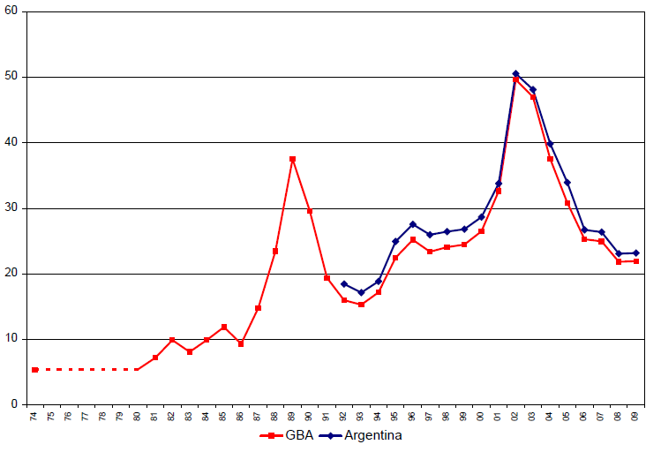
Argentina: Headcount Ratio (%): GBA and Urban Areas (Gasparini y Cruces, 2010)

Slide 5
Gini Coefficient GBA 1974-2009
(Gasparini and Cruces, 2010)

Slide 6
Argentina: Gini Coefficient in the 2000s (urban areas)
(Gasparini y Cruces, 2010)

Slide 7
Argentina: Proximate Determinants of Changes in Inequality (urban areas; 2000-06) – (Alejo et al.)

Slide 8
Argentina: Proximate Determinants of Changes in Inequality (urban areas; 2000-06) – (Alejo et al.)
Decline in labor income inequality accounts for fifty percent of the overall decline in household per capita income inequality
Decline in non-labor income inequality accounts for about a quarter of the overall decline in household per capita income inequality

Slide 9
Decline in Labor Income Inequality
Decline in skill premium:
  … institutions: increase in minimum wages & mandatory wage increases?
  …race between technological change and educational upgrading?
There is evidence of both (Lopez-Calva & Lustig, 2010; next slide)

Slide 10
Argentina: Skill Premium
(Gasparini and Cruces, 2010)

Slide 11
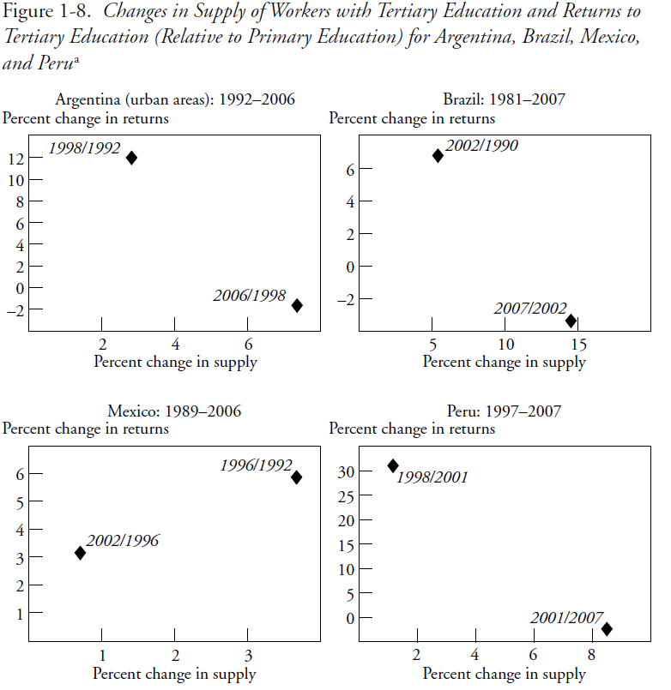

Slide 12
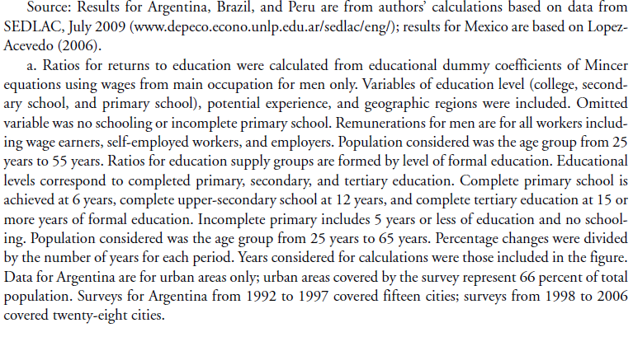

Slide 13
Argentina: sharp increase in real minimum wages (McLeod and Lustig, 2010)

Slide 14
Outline
Argentina’s Decline in Poverty and Income Inequality
Cash Transfers and the Decline in Poverty and Income Inequality
Are Redistributive Policies Compatible with Fiscal Sustainability?
Regime at a Crossroad

Slide 15
Decline in Non-labor Income Inequality: Cash Transfers since 2002
Jefes y jefas de hogar (emergency employment program) – 2002
Pension moratorium – 2007
Asignacion universal por hijo – 2009

Slide 16
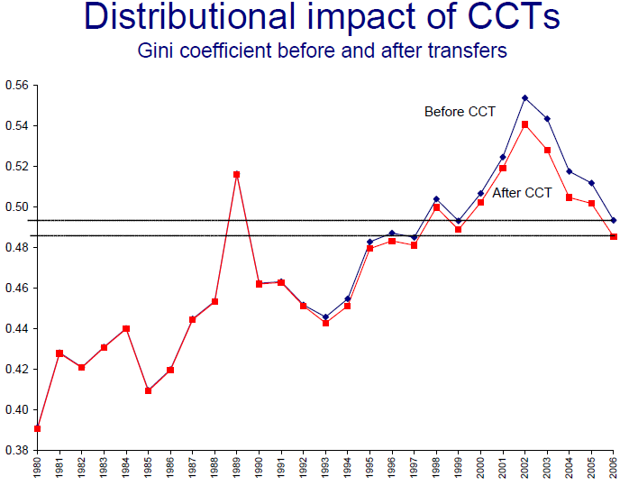

Slide 17
Pessino (2010)

Slide 18
Pessino (2010)

Slide 19
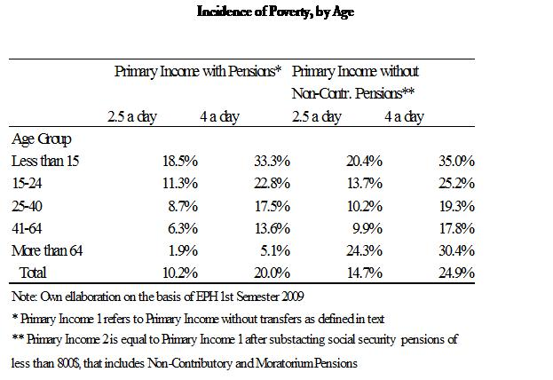
Pessino (2010)

Slide 20
Cash Transfer Programs: Total Beneficiaries
(Gasparini y Cruces, 2010)

Slide 21
Monthly Benefits per Household (with 3 children) – In 2010 pesos
(Gasparini y Cruces, 2010)

Slide 22
Impact of Transfers on Poverty and Inequality - 2009

Slide 23
Pessino (2010)

Slide 24
Outline
Argentina’s Decline in Poverty and Income Inequality
Cash Transfers and the Decline in Poverty and Income Inequality
Are Redistributive Policies Compatible with Fiscal Sustainability?
Regime at a Crossroad

Slide 25
Artana et al. (2010)

Slide 26
But such a comparison can be misleading…
…because Gini coefficients for primary (pre-transfers and taxes) income tend to be quite lower in all the other countries considered in the sample
More useful to compare changes in pre- and post-transfers Gini with government effort:
  Argentina reduces the Gini by 5 percentage points (upper bound) through transfers; better than LA average which is between 1-2 percentage points
  Question: how does the Gini reduction per percentage of government spending-to-GDP compare to others: Latin America, Asia, OECD, Other emerging economies?

Slide 27
Impact of Transfers on Poverty and Inequality - 2009

Slide 29
Redistribution and Fiscal Sustainability
Closing the extreme (pov line US$2.50) and total poverty (pov line US$4) gaps--with perfect targeting--would cost:
  0.7 and 1.7 percent of GDP, respectively
  2.2 and 5.3 percent of tax revenues, respectively
  3.2 and 7.8 percent of redistributive spending, respectively
Seems compatible with fiscal sustainability

Slide 30
Redistributive vs Social Spending
(Lustig, 2010)

Slide 32
Outline
Argentina’s Decline in Poverty and Income Inequality
Cash Transfers and the Decline in Poverty and Income Inequality
Are Redistributive Policies Compatible with Fiscal Sustainability?
Regime at a Crossroad

Slide 33
Growth in Argentina in Post 2002 Crisis
Unusually favorable terms of trade and devaluation led to current account surplus
Default on public debt, taxes on exports and financial transactions, and recovery-led tax revenues led to fiscal surplus
However, adverse business climate led to a decline in private investment. The share of private investment was 40% in 1993-2001 and declined to only 18% from 2002-2008

Slide 34
Terms of trade favored Argentina
(McLeod and Lustig, 2010)

Slide 35
Growth in Argentina in Post 2002 Crisis
The regime has been using the larger fiscal space to:
Partially compensate the reduction in private investment with an increase of public investment in infrastructure: public investment increased from an average of 2.3% of GDP to 4.3% of GDP in 2007
Increase public sector wages and benefits to formal sector workers
Increase producer and (regressive) consumer subsidies in energy and transport (with a budget cost of around 2.5% of GDP)
Significantly expand pro-poor transfers (Jefes y Jefas de Hogar, Moratoria Previsional, Asignacion Universal por Hijo)
As a consequence, central government expenditures to GDP have risen sharply

Slide 36
Pessino (2010)

Slide 37
Growth in Argentina in Post 2002 Crisis
And,
Fiscal and external surpluses have been quickly eroding

Slide 38
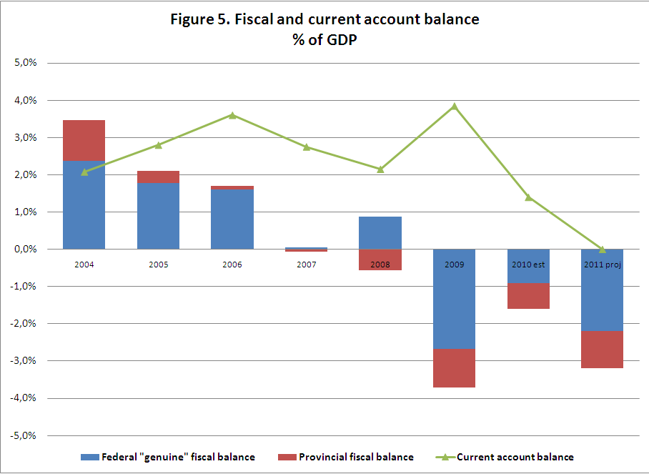
Artana et al. (2010)

Slide 39
Regime at a Crossroad
Unless TOTs continue to improve “indefinitely” eventually the government will have to choose between:
Public investment in infrastructure
Public sector wages and benefits to formal sector workers
Producer subsidies
Regressive consumer subsidies
Pro-poor transfers;
For long-term growth, an emphasis on the investment in human capital is essential as well as generating the conditions to attract private investment

Slide 40
References
Strengthening long-term growth in Argentina
Artana, Daniel, E. Bour, J.L. Bour and N. Susmel “Strengthening Long Term Growth in Argentina,” paper prepared for OECD Seminar “Beyond the crisis – Returning to sustainable growth in Latin America” Paris, November 24th 2010
Alejo, Javier, Marcelo Bergolo, Fedora Carbajal y Guillermo Cruces (2009) “Cambios en la desigualdad del ingreso en América Latina. Contribución de sus principales determinantes: 1995-2006”. Informe preparado para el proyecto ”Markets, the State and the Determinants of Inequality” UNDP, mimeo, CEDLAS, Universidad de La Plata, Argentina, junio 3.
Gasparini, Leonardo and Guillermo Cruces (2010) “A Distribution in Motion: the Case of Argentina,” in Lopez-Calva, Luis F. and Nora Lustig Declining Inequality in Latin America: a Decade of Progress? Brookings Institution Press and UNDP.
______ (2010) “Las asignaciones universales por hijo: impacto, discusión y alternativas”. CEDLAS, Documento de Trabajo No. 102, julio.
Lopez-Calva, Luis F. and Nora Lustig (2010) “Explaining the Decline in Inequality in Latin America: Technological Change, Educational Upgrading and Democracy,” in Declining Inequality in Latin America: a Decade of Progress? Brookings Institution Press and UNDP.
  Lustig, Nora (2009) Poverty, Inequality and the New Left in Latin America, Washington, D.C.: Woodrow Wilson International Center for Scholars, Latin American Program, October.
  ______“Commitment to Equity (CEQ): A Diagnostic and Ranking Tool of Latin American Governments’ Fiscal Policies,” CIPR & Econ Dept/Tulane and Inter-American Dialogue, mimeo.
  ______ and Carola Pessino (2010) “Argentina’s Redistributive Policies: Are They Affordable?” Tulane University and Universidad Torcuato di Tella, draft.
  McLeod, Darryl and Nora Lustig (2010) “Poverty and Inequality under Latin America’s New Left Regimes,” Prepared for the 15th Annual LACEA Meeting, Medellín, Colombia on November 11th-13th.
  Pessino, Carola (2010) “Commitment to Equity (CEQ): Argentina,” CIPR & Econ Dept/Tulane and Inter-American Dialogue, mimeo. CIPR & Econ Dept/Tulane and Inter-American Dialogue, mimeo.

