Slide 1
Taxes, Transfers, Inequality, and Poverty: Argentina, Bolivia, Brazil, Mexico, and Peru
Nora Lustig
Tulane University
Nonresident Fellow Center for Global Development and Inter-American Dialogue
IMF, FAD
Washington, DC, May 14, 2012

Slide 2
Outline
Commitment to Equity Project: Background
Standard Incidence Analysis: Methodological Highlights
How much redistribution LA achieves through fiscal policy? How effective are governments at redistribution?

Slide 3
Commitment to Equity Project
Commitment to Equity (CEQ) Project; Inter-American Dialogue and Tulane University’s CIPR and Dept. of Economics.
Currently: 12 countries
6 finished: Argentina (2009), Bolivia (2007), Brazil (2009), Mexico (2008), Peru (2009) and Uruguay (2009) (year of HH survey)
6 in progress: Chile, Colombia, Costa Rica, El Salvador, Guatemala, Paraguay
To begin soon: Dominican Republic
Branching out into other regions

Slide 4
Commitment to Equity Project
Argentina: Carola Pessino (CGD and CEMA)
Bolivia: George Gray Molina (UNDP), Wilson Jimenez, Veronica Paz and Ernesto Yañez (Instituto Alternativo, La Paz,
Brazil: Claudiney Pereira and Sean Higgins (Tulane)
Mexico: John Scott (CIDE and CONEVAL)
Peru: Miguel Jaramillo (GRADE)
Uruguay: Marisa Bucheli, Maximo Rossi, and Florencia Amabile (Universidad de la Republica)

Slide 5
References
Lustig, Nora (coordinator). Fiscal Policy and Income Redistribution in Latin America: Challenging the Conventional Wisdom, Argentina: Carola Pessino; Bolivia: George Gray Molina, Wilson Jimenez, Verónica Paz, Ernesto Yañez; Brazil: Claudiney Pereira, Sean Higgins; Mexico: John Scott; Peru: Miguel Jaramillo. , Economics Department, Tulane University, Working Paper. 2011. Revised: Forthcoming.

Slide 6
References
Lustig, N. and S. Higgins. Fiscal Incidence, Fiscal Mobility and the Poor: a New Approach. Economics Department, Tulane University, Working Paper. 2012.
Bucheli, M., N. Lustig, M. Rossi and F. Amabile Social Spending, Taxes and Income Redistribution in Uruguay. Economics Department, Tulane University, Working Paper. Forthcoming.

Slide 7
Basic elements of incidence analysis
Start with:
Pre-tax/pre-transfer income of unit h, or I_{h}
Taxes/transfers programs T_{i}
“Allocators” of program i to unit h, or S_{ih} (or the share of program i borne by unit h)
Then, post-tax/post-transfer income of unit h (Y_{h}) is:
Y_{h} = I_{h} - ∑_{i} T_{i}S_{ih}
All of this seems easy, and answers the key question:
Who pays the taxes or gets the transfers?

Slide 8
Methodological Highlights

Slide 9
There are lots of questions that must be answered.
What is the “unit” (e.g., individual versus household)?
What is “income”?
  Comprehensive income?
  Annual versus lifetime measure?
  Market and non-market measure (including tax evasion)?
How are components of income measured (e.g., capital income)?
Should “consumption” be used instead of “income”?
What is the time frame of analysis (e.g., annual versus lifetime)?
What taxes and transfers are included?
What are the allocators?
What happens when individuals change “ranks”?
How can the results be easily summarized?

Slide 10
Methods to Allocate Taxes and Transfers
Direct Identification Method
Inference Method
Simulation Method
Imputation Method
Alternate Survey
Secondary Sources Method

Slide 11
Some additional considerations…
Analyzing one part of the tax/transfer system in isolation of another can give misleading results
Analyzing the effects of taxes/transfers at the “top” and at the “bottom” is especially difficult
State and municipal taxes
How to scale-up
How to rank
Implications of re-ranking

Slide 12
Definitions: Effectiveness Indicator
Example: Gini net mket income & Gini Disposable income
Numerator: Gini (net mkt inc) -Gini(disp inc)/Gini(net mkt inc)
Denominator: Gov. Spending on Direct Transfers/GDP

Slide 13
Defining Progressive and Regressive Taxes and Transfers

Slide 14
CEQ Project: Defining and Constructing Welfare Indicator

Slide 15
Fiscal Incidence: Welfare Indicator
  Current Income per capita
  No adjustment for age, gender or economies of scale
  No adjustment for under-reporting
  Several household surveys in LA only have income data; so, if one wants to compare across countries, income data must be used in all, even in those in which there is data on consumption. But, for the latter, ideally one should do both.

Slide 16
Taxes and Transfers Included
Taxes
Personal Income Tax
Contributions to Social Security (Payroll Taxes)
Indirect Taxes (mainly VAT)
Transfers
Direct Cash Transfers
Food Transfers
Indirect Subsidies
Transfers in-kind through public education and health

Slide 17
Fiscal Incidence Indicators
Changes in inequality and poverty
Incidence by decile/quintile
Concentration shares by decile/quintile
Leakages and Coverage
Per capita transfers
Probit of “excluded”
Fiscal mobility (transition) matrices

Slide 18
Fiscal Incidence: Caveats
No modeling:
  No behavioral responses (or almost none)
  No inter-temporal dimensions
  No general equilibrium effects
  No fiscal sustainability analysis
Average Incidence

Slide 19
Fiscal Incidence: Caveats
One can never know the distribution of income that would have existed in the absence of the taxes/transfers.
Most up-to-date and microdata-based analysis of taxes and transfers combined

Slide 21
What is Market Income?
  Labor and nonlabor income from all sources
  Private Transfers
  Auto-consumption
  Imputed rent for owner’s occupied housing
  Alimony, Inheritance and Gifts
  Contributory pensions from individualized accounts
  NO: Incomes from sales of durables
  NO: Capital Gains
  Contributory pensions from social security:
    Benchmark: YES
    Sensitivity Analysis: NO

Slide 22
What is Net Market Income?
Market Income minus Direct Taxes and Contributions to Social Security (Payroll Taxes)
But, contributions to social security:
  Benchmark: contributions going to pension, are NOT subtracted; all the other contributions are
  Sensitivity Analysis: all contributions to social security are subtracted

Slide 23
Construction of Income Concepts/Calculating Taxes & Transfers
Unfortunately, it is not possible to construct income concepts directly from household surveys
Household Surveys in LA are quite heterogeneous:
  Some report income and not consumption
  Some do not report autoconsumption
  Some do not report owner’s occupied housing rent; they do not have the information to run hedonic regressions

Slide 24
Construction of Income Concepts/Calculating Taxes & Transfers
Even more importantly:
  Not clear if reported income is before or after taxes. SEDLAC database assumes that employees’ income is net of taxes and contributions to social security and self-employment and capital incomes are before taxes and transfers
  Not always clear if people include government transfers in the income they report (which we usually take as “market” income)

Slide 25
Construction of Income Concepts/Calculating Taxes & Transfers
Data on direct taxes, contributions to social security, government transfers, consumption (for indirect taxes and subsidies), use of government health services may be imperfectly captured or not captured at all

Slide 29
Options to Construct Income Concepts
Direct Identification Method
Inference Method
Imputation Method
Alternate Survey
Simulation Method
Secondary Sources Method
Appendix shows what was used in each country and for every tax and transfer

Slide 30
Results: A Primer
Declining inequality in Latin America
Reduction in higher education premia and pro-poor government transfers
Incidence of Taxes and Transfers

Slide 32
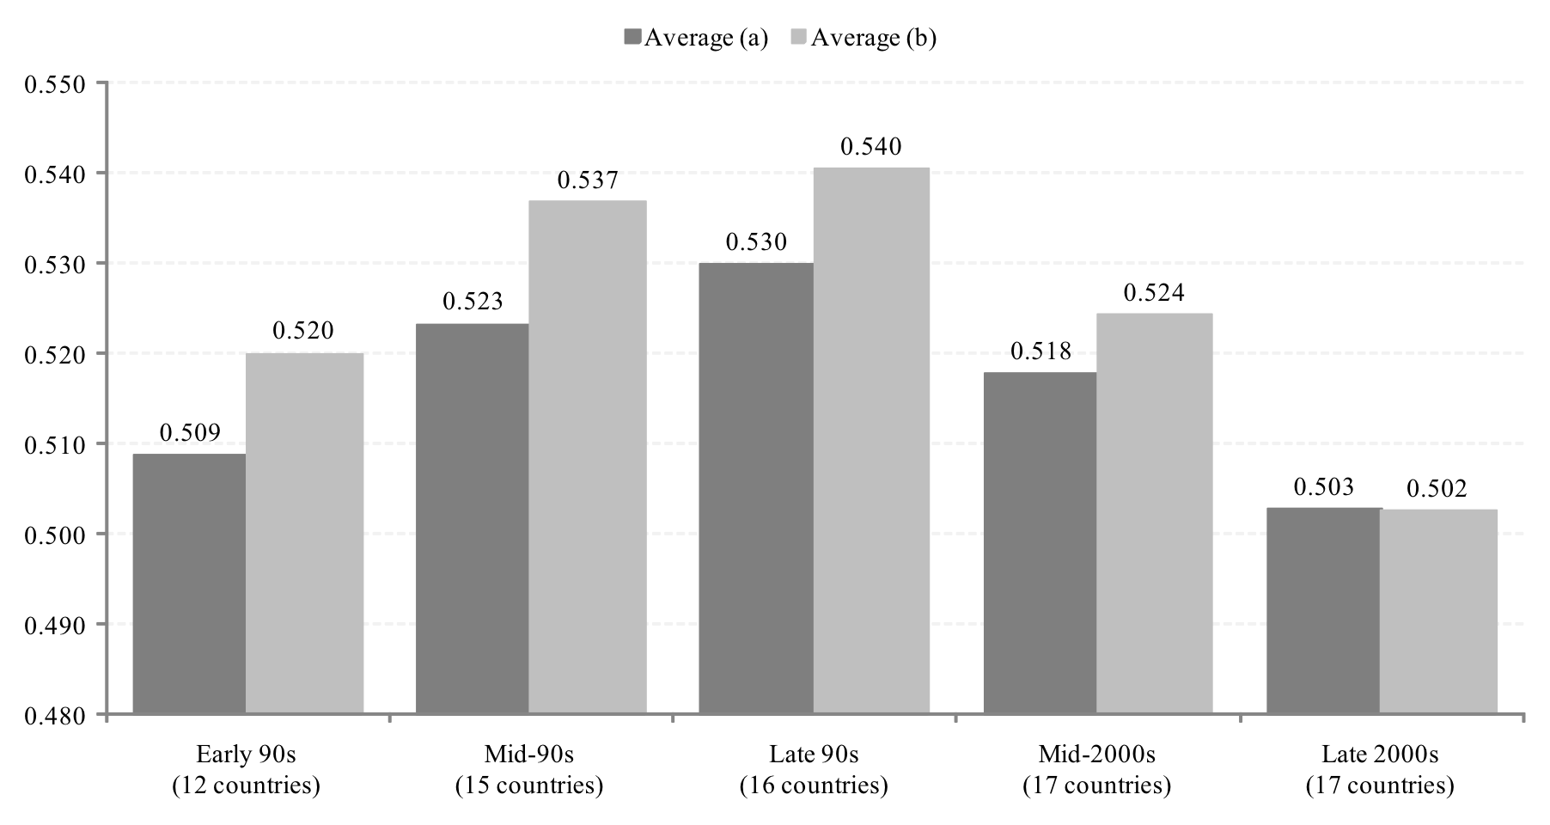
Trends in Inequality
Gini Coefficient Early 1990’s-Late 2000’s (Unweighted ave.)
Light Grey: Countries with Falling Ineq (Lustig et al., 2011)

Slide 33
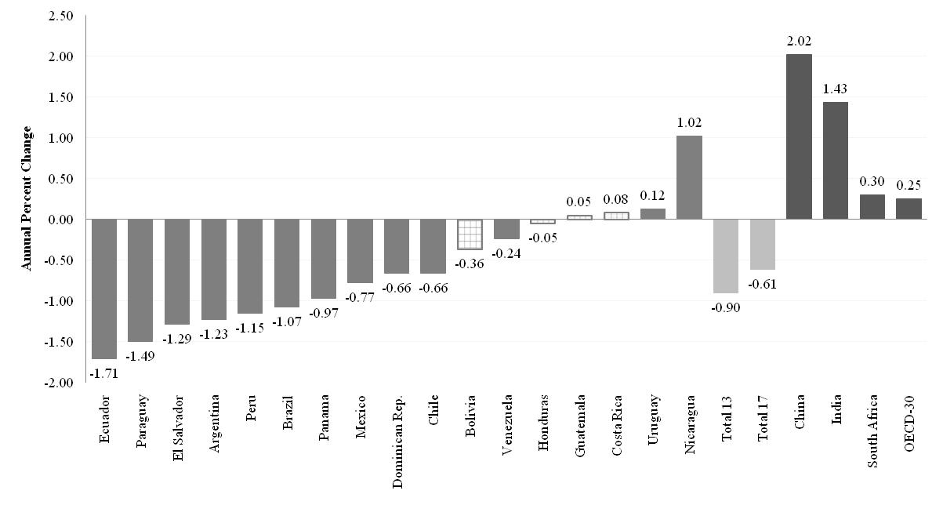
Change in Gini Coefficient by Country: circa 2000-2009 (yearly change in percent)

Slide 34
Comparing the Increase in the 1990’s with Decline in the 2000’s (Lustig et al., 2011)

Slide 35
Results: A Primer
Incidence of Taxes and Transfers
Lots of heterogeneity in LA
No clear-cut correlation between government size, the extent of redistribution, redistributive effectiveness
Direct taxes achieve little in the form of redistribution
Direct transfers reduce poverty the most when coverage of the poor is high and average transfer is close to average poverty gap
Indirect taxes can make poor people net contributors to the state and a substantial portion of the poor poorer

Slide 37
Conclusions:
  First, Latin America is heterogenous; can’t talk of “a Latin America”
  The extent and effectiveness of income redistribution and poverty reduction, government size, and spending patterns vary significantly across countries.

Slide 38
Heterogeneous LA: State comes in different sizes

Slide 39
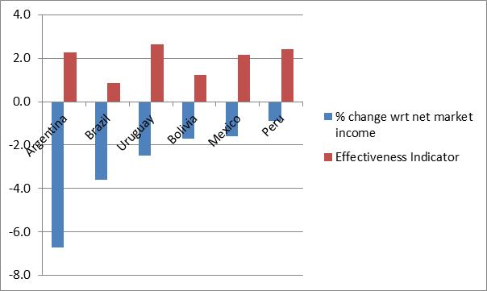
Decline in Gini and Effectiveness: Heterogeneous LA

Slide 40
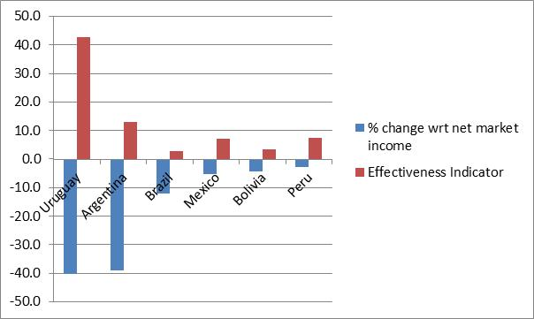
Decline in Headcount Ratio $2.50 PPP and Pov. Reduction Effectivenenss

Slide 41
Conclusions
Second, no clear-cut correlation between government size and the extent and effectiveness of redistribution and poverty reduction.

Slide 43
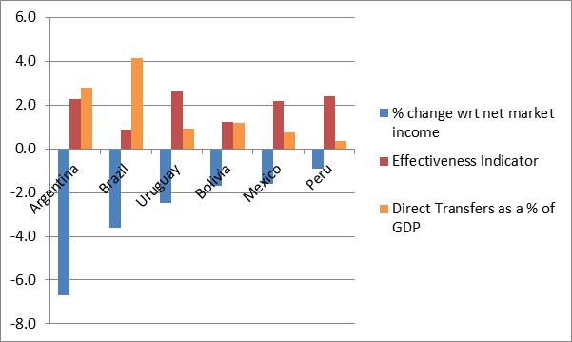
Decline in Disp Inc Gini, Direct Transfers and Effectiveness Indicator

Slide 44
Decline in Final Inc Gini, Direct Transfers and Effectiveness Indicator

Slide 45
Conclusions
Third, direct taxes achieve relatively little in the form of redistribution.
Caveat:
The rich are excluded from analysis using household surveys; need governments to share information from tax returns (anonymous of course) as all OECD countries do (except for Chile, Mexico and Turkey)

Slide 46
Fiscal Policy and Decline in Gini

Slide 47
Conclusions
Fourth, large-scale targeted cash transfers can achieve significant reductions in extreme poverty.
The extent of poverty reduction depends on:
  size of per capita transfer (related to leakages to nonpoor)
  coverage of the poor

Slide 48
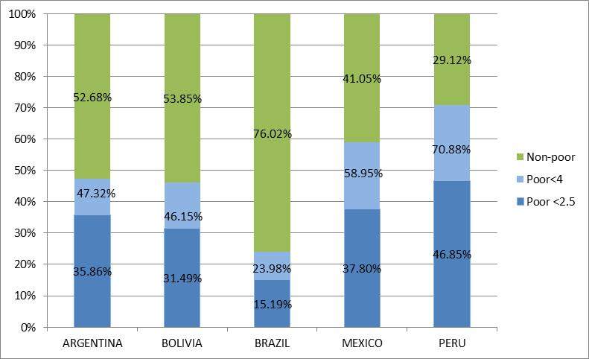
“Leakages” to Non-poor

Slide 49
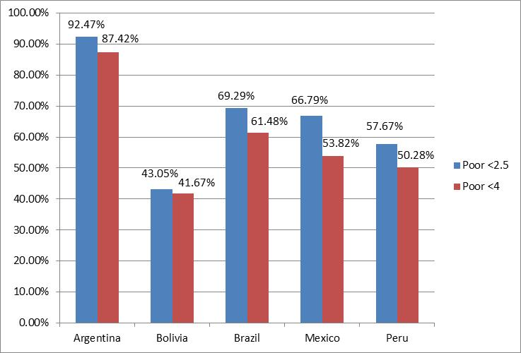
Coverage of the Extreme and Total Poor

Slide 50
Conclusions
Fifth, when indirect taxes are taken into account
  The moderate poor and the near poor become net payers to the fiscal system (except for Mexico, 2008)
  A significant share of the moderate (extreme) poor become extreme (ultra) poor in some of the countries; results for Brazil are striking

Slide 51
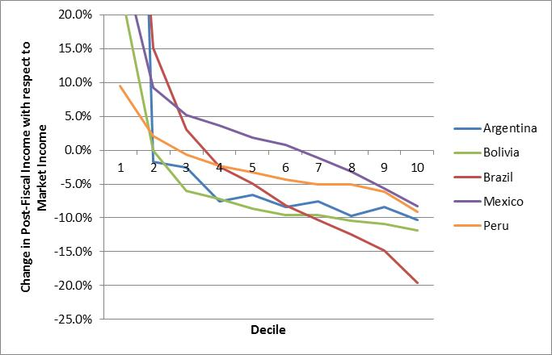
Impact of Indirect Taxes
Arg &Bol
Brazil

Slide 52
Indirect Taxes and the Poor in Brazil (Lustig and Higgins, 2012)
Indirect taxes make around 11 percent of the non-poor poor, 15 percent of the moderate poor extremely poor, and 4 percent of the extremely poor “ultra-poor” despite any cash transfers they receive
We would have missed this with standard analysis:
  extreme poverty and inequality indicators decline
  overall taxes are progressive

Slide 53
Fiscal Mobility: Fiscally-induced Upward and Downward Movement (in %). Brazil’09

Slide 54
Where public contributory pensions go matters…
Benchmark: contributorypensions are treated as market income; assumes an actuarially fair system on average
Sensitivity Analysis: contributory pensions are considered as a government transfer
Redistribution and incidence results are sensitive to the placement of contributory pensions
Here we shall present benchmark results but show a couple of examples for the sensitivity analysis

Slide 55
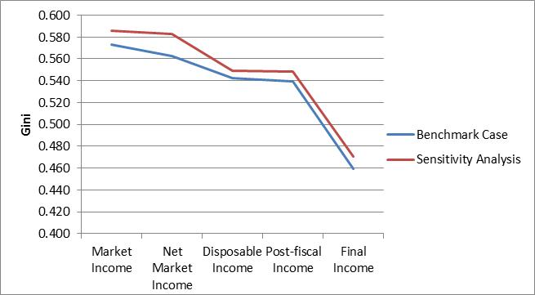
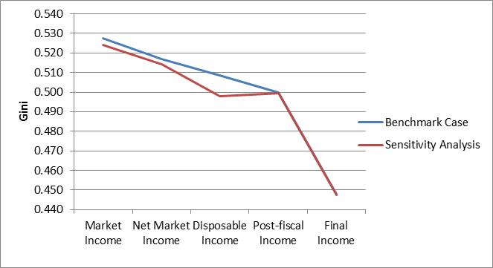
How sensitive are results to the placement of contributory pensions? Brazil vs. Mexico

Slide 56
How sensitive to placement of contributory pensions: Uruguay incidence

Slide 57
Adding the top; Greater Bs. As., Argentina (Alvaredo and Piketty en López-Calva y Lustig, 2010)

Slide 58
Thank you

