Slide 1
Fiscal Incidence, Fiscal Mobility and the Poor: A New Approach
Nora Lustig
Sean Higgins
Department of Economics
Tulane University
Well-being and inequality in the long run:
measurement, history and ideas
Universidad Carlos III de Madrid and the World Bank
June 1, 2012
Madrid

Slide 2
Acknowledgements
Technical companion paper with Satya Chakravarty and Nachiketa Chattopadhyay explores theoretical properties of our fiscal mobility matrices
Joint work with Claudiney Pereira on fiscal incidence in Brazil
Part of the Commitment to Equity (CEQ) project
Center for Inter-American Policy and Research (CIPR) and Department of Economics at Tulane University, and Inter-American Dialogue
Excellent research assistantship from Qingyang Luo

Slide 3
Standard Measures
Standard measures of poverty, inequality, progressivity and incidence are by definition anonymous
The identity of winners and losers is not known
In fact, the anonymity axiom is considered a desirable property of indicators
Leave out important information about how the poor are affected by fiscal policy
Don’t capture the “losing poor”

Slide 4
Standard Measures
For example, we can have:
Poverty (including the squared poverty gap) declining
Income distribution becoming less unequal
Progressive net taxes
But some of the poor become substantially poorer

Slide 5
New Approach: Fiscal Mobility Matrix
Directional mobility literature provides a useful framework
See, for example, Fields (2008)
Compare the status of identified individuals in the before and after taxes and transfers situations
One can see which individuals are adversely/favorably impacted by a particular policy
We establish dominance criteria so that alternative policies can be compared in terms of the downward mobility they induce

Slide 6
Definitions
Fiscal Mobility
The directional movement between the before and after net taxes situations among k pre-defined income categories
Fiscal Mobility Matrix
k × k transition matrix P where the ij-th element p_{ij} is the probability of moving to income group j after net taxes for an individual in group i before net taxes
Poverty lines
Let z be a vector of poverty lines between z_{min} and z_{max}. These poverty lines determine a subset r of the k income categories (r < k) that are considered poor

Slide 7
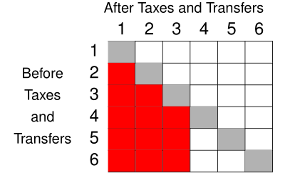
Downward Mobility
If any element that is both in the strictly lower triangle of P and an element of one of the first r columns of P is unequal to 0, there is downward mobility among the poor (or into poverty)
i.e., if p_{ij}> 0 for some i ∈ {1,...,k} and some j ∈ {1,...,r} such that j < i
Example: k = 6 and r = 3

Slide 8
An Illustration: Brazil
Inequality, ultra-poverty and extreme poverty fall
Indicator | Before taxes and transfers | After taxes and transfers
Gini Coefficient | .573 | .539
Headcount Index¹ | 5.7% | 4.3%
Poverty Gap¹ | 2.3% | 1.3%
Squared Poverty Gap¹ | 1.3% | 0.6%
Headcount Index² | 15.3% | 15.0%
Poverty Gap² | 6.3% | 5.4%
Squared Poverty Gap² | 3.7% | 2.7%
Note: 1. $1.25 PPP per day. 2. $2.50 PPP per day.

Slide 9
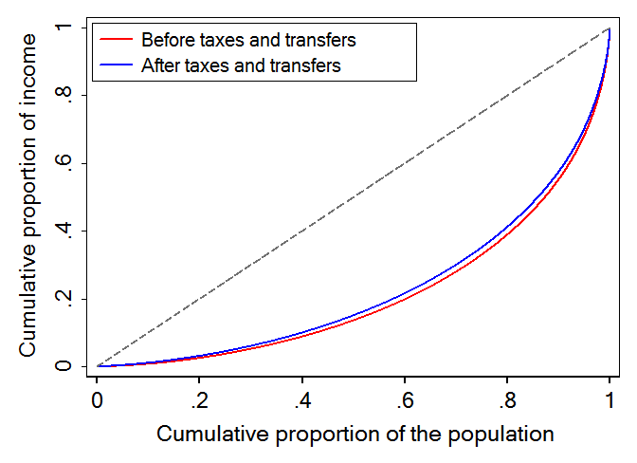
An Illustration: Brazil
Income distribution after taxes and transfers Lorenz dominates distribution before taxes and transfers

Slide 10
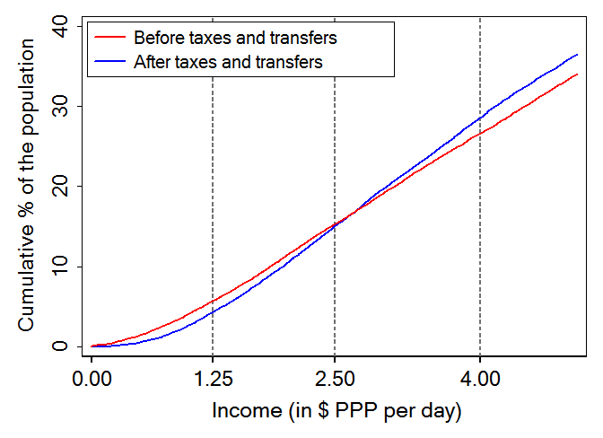
An Illustration: Brazil
CDF of after taxes and transfers income first-order stochastic dominates CDF of before taxes and transfers income over domain of ultra and extreme poverty lines (≤ $2.50 PPP per day)

Slide 11
An Illustration: Brazil
Progressive overall tax system:
Kakwani index of direct and indirect taxes is 0.03
Reynolds-Smolensky index of after taxes and transfers income with respect to before taxes and transfers income is 0.05

Slide 12
An Illustration: Brazil
Anonymous incidence analysis: two poorest deciles are, on average, net recipients from the tax and transfer system
Non-anonymous incidence analysis: three poorest deciles are, on average, net recipients from the tax and transfers system
Incomes of those in the poorest decile by market income increase by 80% on average

Slide 13
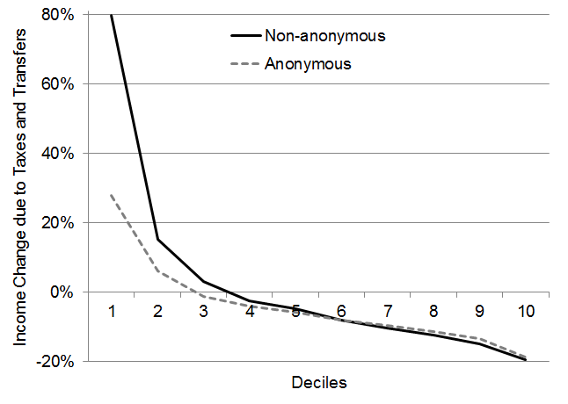
An Illustration: Brazil
Incidence by deciles

Slide 14
An Illustration: Brazil
However:
Around 15% of the moderate poor become extreme poor
Around 4% of the extreme poor become ultra poor

Slide 15
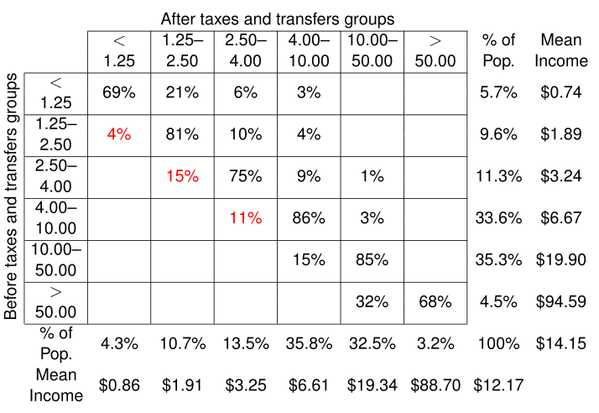
Fiscal Mobility Matrix: Brazil

Slide 16
How Much do the Losing Poor Lose?
Matrix of average proportional losses
k × k matrix L with ij-th element l_{ij} equal to the average percent decrease in income of those who began in group i and lost income due to taxes and transfers, ending in group j ≤ i
Negative semi-definite and weakly lower-triangular by construction
There is income loss among the poor if and only if l_{ij} < 0 for some i ≤ r

Slide 17
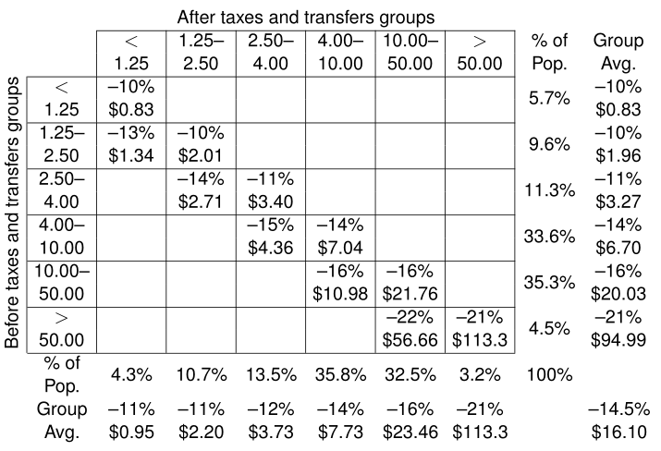
Average Proportional Losses: Brazil

Slide 18
Average Proportional Losses: Brazil
Ultra poor who lose
Begin with $0.83 PPP per day on average
Lose 10% of their income on average
Extreme poor before transfers who become ultra poor after transfers
Begin with $1.34 PPP per day on average
Lose 13% of their income on average

Slide 19
Fiscal Mobility Dominance
In terms of fiscal mobility, is an alternative scenario more desirable for the poor than the actual scenario?
Compare two fiscal mobility matrices P and P’ and denote strong downward mobility dominance by the binary relation $ℳ^{S}$
P $ℳ^{S}$ P’ if P exhibits less downward mobility among the poor (and into poverty) than P’
Formally, P $ℳ^{S}$ P’ if $\sum_{m=1}^{j}{p_{im}≤}\sum_{m=1}^{j}{{p′}_{im}}$ for i ∈ {2,...,k} and j ≤ r < i, with strict inequality for some i

Slide 20
Alternative Scenario: Neutral Tax
Compare actual scenario in Brazil to an alternative
Neutral tax
Individuals are taxed proportional to their incomes such that total tax revenue remains fixed
Transfers received are still as observed
22% of ultra poor become extreme poor
7% of extreme poor become ultra poor

Slide 21
Fiscal Mobility Matrix: Neutral Tax

Slide 22
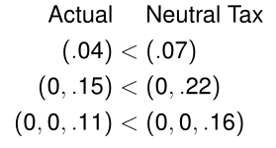
Alternative Scenario: Neutral Tax
Higher downward mobility among the poor in neutral tax scenario
Compare cumulative downward mobility vectors:

