Slide 2
Outline
Motivation
What is the Commitment to Equity Assessment (CEQ)?
CEQ in Practice: An Application to Brazil

Slide 3
Background
Joint project Commitment to Equity Assessment (CEQ); Inter-American Dialogue and Tulane University’s CIPR and Dept. of Economics
Background paper: Lustig (2011) “Commitment to Equity Assessment (CEQ) A Diagnostic Framework to Assess Governments’ Fiscal Policies,” Dept. of Economics, Tulane University, Working Paper 1119, April

Slide 4
Motivation
Goñi et al. (2011): in fifteen European countries the average Gini coefficient for market (before direct taxes and transfers) income declines by 15 ppts for disposable income (from .46 to .31)
In contrast, six largest Latin American countries (Argentina, Brazil, Chile, Colombia, Mexico and Peru) the Gini declines by only 2 ppts (from .52 to .50)
When you factor in the effect of indirect taxes, redistributive effect is tempered but contrast still striking: Gini declines by 12 ppts in Europe and only 1 ppt in Latin America

Slide 5
Motivation
Using Engel et al.’s (1999) analytical framework, Goñi et al. conclude lower fiscal redistribution in Latin America is a result of low tax revenues and -- above all -- lower and less progressive transfers
The neutral or even regressive incidence of the tax system (direct and indirect taxes combined) plays a secondary role
The authors find that lower transfers are primarily due to the differences in revenue collection rather than the composition of spending (i.e., the share of spending allocated to transfers in the budget is similar between the two groups)

Slide 6
What is the Commitment to Equity Assessment?
A diagnostic framework to evaluate:
  how aligned fiscal policies are with supporting a minimum living standard
  in ways that reduce inequality and are broadly consistent with macroeconomic stability, microeconomic efficiency and growth

Slide 7
Supporting a minimum living standard
  poverty reduction: ensuring that everyone has a minimum level of consumption
  insurance: preventing individuals from falling (or falling further) below the minimum level of consumption due to adverse shocks, both idiosyncratic (unemployment, illness, bad harvests, etc.) and systemic (economic crises, natural disasters, spikes in food prices, etc.)
  income smoothing: ensuring that a minimum level of consumption is achieved throughout an individual’s life-cycle (maternity/paternity leave and retirement, in particular)
  building poor people’s human capital: ensuring that everyone has a minimum level of education and health.

Slide 8
CEQ evaluates efforts based on whether governments:
collect and allocate enough resources to support a minimum living standard for all: RESOURCES
collect and distribute resources equitably: EQUITY
ensure spending is fiscally sustainable and that programs are incentive compatible: QUALITY
collect and publish relevant information as well as are subject to independent evaluations: ACCOUNTABILITY

Slide 9
CEQ: Diagnostic Framework
Main question: Does a government make substantial efforts to support a minimum standard of living and build the human capital of the poor?
Define “substantial effort:”
  after net transfers income and human capital poverty gaps are “close to” zero

Slide 10
Suppose, as in most developing countries, that the poverty gap is not close to zero
In searching for the causes, we follow a logical sequence that will help us to identify the contributing factors and binding constraints.
In middle-income countries, insufficient total fiscal revenues or social spending are not likely to be a cause for not bringing the poverty gaps close to zero. However …
Within social spending, fiscal resources that actually reach the poor may not be enough for at least three main and not mutually exclusive reasons:
  benefits to the non-poor are too high
  coverage of the poor is not universal
  average per capita transfers to the poor fall short

Slide 11
Diagnostic Framework
In turn, for example, insufficient coverage could be caused either by design--that is, the range of existing programs leave some groups out intentionally (for example, undocumented migrants or working age able men are not eligible to receive transfers)--or “true” errors of exclusion.
In turn, “true” errors of exclusion could be caused by failures in design or implementation, clientelistic politics, geographic isolation, high administrative costs, leakages, lack of accrediting documentation, self-selection, or other factors.

Slide 12
CEQ: Snapshot of Diagnostic Framework

Slide 13
Policy Instruments Considered
Monetary transfers
In-kind transfers through the fully or partially subsidized provision of goods and services particularly in the area of education and health
Subsidies to consumption goods and (some) production inputs when feasible
Taxes on income, consumption and assets (including tax expenditures) when feasible

Slide 14
CEQ: What form does it take?
A questionnaire whose underpinning can be found in:
  Economics of the welfare state
  Best practices in quality assurance and accountability
Indicators derived from standard poverty and inequality analysis, fiscal incidence analysis and public finance
It uses ‘static’ incidence analysis; it does not include behavioral responses or general equilibrium effects (but they could be incorporated)

Slide 15
CEQ: Data requirements
Household (Income/Expenditure) Surveys
Detailed public sector accounts
“External” information on macroeconomic sustainability, cost effectiveness, program evaluations, data accessibility and accountability mechanisms

Slide 16
CEQ: Indicators
Calculate market, disposable, post-fiscal and final income (described below)
  Imputation methods for in-kind income (health and education services provided by government free or quasi free)
  Estimation of impact of indirect taxes (including tax expenditures) and subsidies requires consumption data at the household level
Government Revenues and Redistributive Spending
Calculate poverty gaps
Estimate/calculate incidence of public revenues and spending

Slide 17
Definitions of Income Concepts
Includes Contributory Pensions; in sensitivity analysis they are added to government transfers

Slide 18
CEQ in Practice
In progress in 9 countries: Argentina, Bolivia, Brazil, Costa Rica, Guatemala, Mexico, Paraguay, Peru and Uruguay
Highlights of Results for Brazil (POF, 2009)

Slide 19
Brazil: Basic Information
Year of analysis: 2009
GNI/capita in PPP: 10,140
Population: 190.5 million
Tax Revenues/GDP: 16.9%
Government Primary Spending/GDP: 36.9%
Direct Transfers/GDP: 4.1%
Flagship transfer programs: Bolsa Família, Benefício de Prestação Continuada

Slide 20
Brazil: Effects of Taxes and Transfers on Inequality and Poverty
Direct taxes and transfers reduce inequality by 5.4%.
Transfers reduce poverty by 12% and extreme poverty by 23%.

Slide 21
Brazil: Resources
Does the government allocate sufficient budgetary resources for redistributive spending purposes to potentially close the poverty gaps?
Yes. Brazil allocated $552,621 million reais to redistributive spending (including the subsidized portion of social security but excluding the contributed portion), or 17.4% of GDP. The overall poverty gap at $4 PPP is 33% of total redistributive spending, meaning that the government allocates sufficient budgetary resources for redistributive spending purposes to potentially close the poverty gap.
A very large proportion of total government spending is spent on debt servicing. But, social spending exceeds our international benchmark. Nevertheless, the high interest rates on the debt may be an obstacle in the future.

Slide 22
Brazil: Resources

Slide 23
Brazil: Equity
Is the proportion of social spending allocated to the poor sufficient?
Targeted anti-poverty spending is sufficient to close the before transfers income poverty gap at $2.5 PPP per day, but insufficient at $4 PPP per day. Note that targeted anti-poverty spending only includes direct transfers so we do not compare it to the human capital or overall poverty gaps.
The before-transfers income poverty gap ($2.5 PPP) is 64% of targeted anti-poverty spending, while for $4 PPP the before-transfers income poverty gap is nearly double (193%) the income poverty gap. Thus, even with perfect targeting, Brazil would need to allocate double what it is currently spending on targeted anti-poverty direct transfers to close the income poverty gap at $4 PPP.
Direct transfers to the non-poor are too large. 75.7% of the total benefits of direct transfers go to the non-poor, while only 24.3% reach the market income poor (those living on less than $4 PPP per day before government intervention).
Furthermore, only 15.4% of total direct transfers reach the market income extreme poor (those living on less than $2.5 PPP per day before government intervention).

Slide 24
Brazil: Equity
The distribution of net direct transfers reduces the Gini by 5.4% (this is the reduction between the market income Gini and the disposable income Gini). The distribution of net transfers reduces the Gini by 19.8% (this is the reduction between the market income Gini and the final income Gini).
Bolsa Família, Brazil’s signature conditional cash transfer (CCT) program, has a concentration coefficient of -0.60 (note that this is the second-most progressive program in any of the countries included in the study behind Peru’s Juntos) and by itself contributes to almost a 1% decrease in the market income Gini.
Brazil’s non-contributory pension system, Benefício de Prestação Continuada (BPC) is also particularly progressive, with a concentration coefficient of -0.46. Since BPC is larger than Bolsa Família, its absolute impact on the Gini is even more impressive: it alone causes a 3% reduction in the market income Gini.

Slide 25
Brazil: Equity
Other direct transfer programs are not sufficiently progressive.
With regard to in-kind transfers, spending is not sufficiently equalizing. While pre-school education spending, primary education spending, secondary education spending, and health spending are absolutely progressive, tertiary education spending is large and has a concentration coefficient of 0.46.

Slide 26
Brazil:
Coverage and Leakages of Main Social Programs
Bolsa Família has the largest coverage: 55% of the extreme poor and 47% of the moderate poor.
All other programs have coverage rates of the extreme poor and total poor below 13%.
Only 17.8% of the poor receive a direct transfer other than Bolsa Família or BPC (note this figure is not shown in this table).
The vast majority of benefits from scholarships (80.3%), unemployment benefits (83.6%), special circumstances pensions (83.6%), and other social programs (81.6%) go to the non-poor.

Slide 27
Brazil:
Progressivity and Regressivity of Government Spending

Slide 28
Brazil:
Progressivity and Regressivity of Government Spending

Slide 29
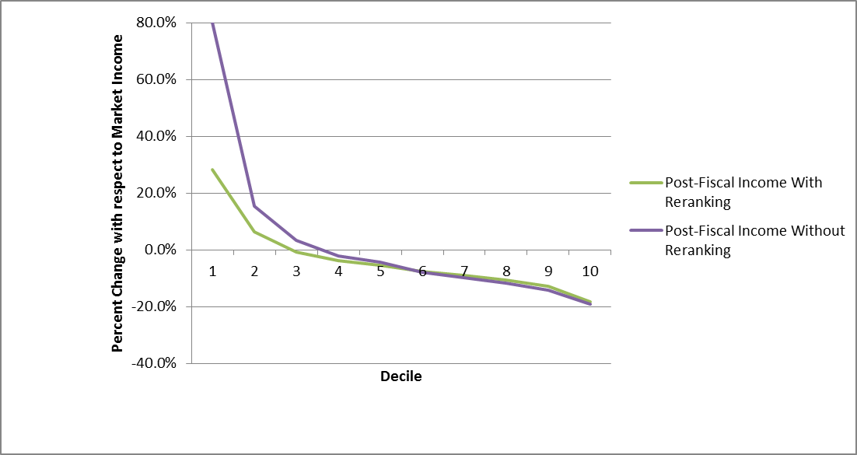
Brazil:
Fiscal Mobility Profile and Fiscal Incidence Curve, from Market to Post-fiscal Income
When indirect taxes are included, members of the third decile are, on average, net payers to the fiscal system. This is not good, especially because some members of the third decile are still below the $4 PPP line.

Slide 30
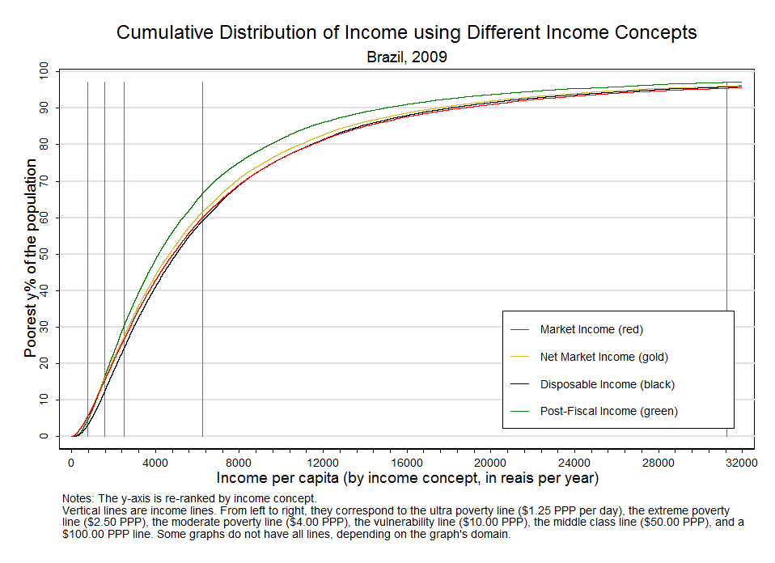
Brazil:
Cumulative Distribution of Income

Slide 31
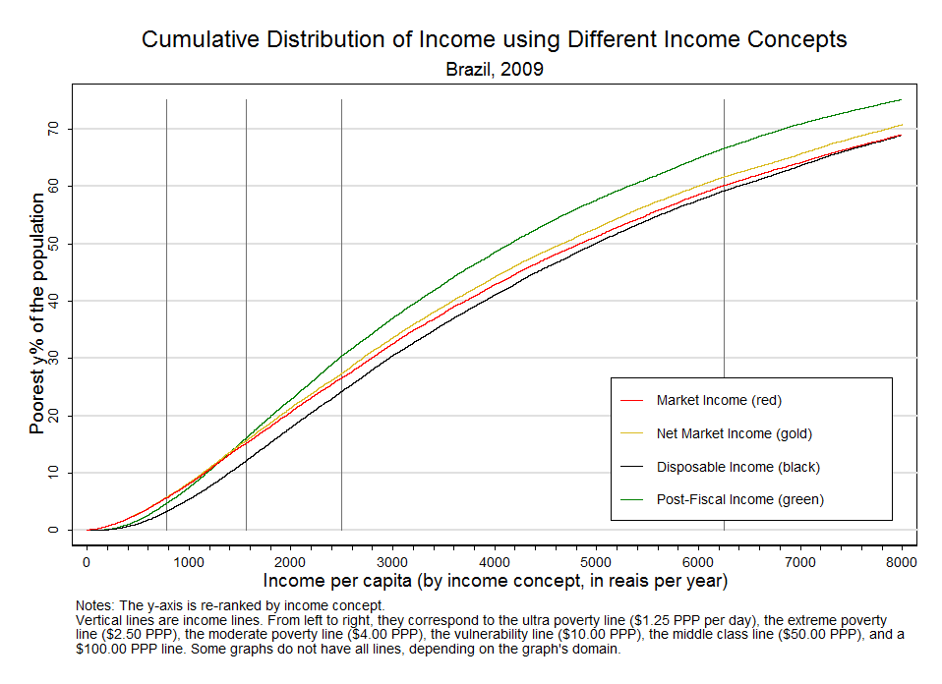
Brazil: Cumulative Distribution of Income
(“zoomed in”)

Slide 32
Brazil: Fiscal Mobility
Far too much downward fiscal mobility among the poor and vulnerable, caused primarily by indirect taxes!

Slide 33
Who Escapes Poverty?
Probit Analysis for Brazil
Poverty is concentrated in the Northeast, North and rural areas, children and less educated people. Transfers are more likely to bring people out of poverty in the Northeast and North, but not in rural areas or among children.

Slide 34
Brazil: Conclusions
Social spending played an important role to bring people out of poverty. 61.5% of the poor (69.3% of the extreme poor) are covered by at least one direct transfer.
Bolsa Família and BPC are highly progressive and contribute to a significant decrease in the market income Gini.
Bolsa Família is the single program with the highest coverage of the poor out of all countries studied -- but Mexico’s CCT “Oportunidades” performs better in terms of covering the extreme poor.

Slide 35
Brazil: Conclusions
The low eligibility cut-offs of Bolsa Família (140 reais per month in September, 2009, or approximately $2.70 PPP per day) and BPC (one fourth of one monthly minimum salary, or 116.25 reais in September, 2009, or approximately $2.25 PPP per day) imply that many families with household per capita income less than $4 PPP per day, who are thus poor by regional standards (CEDLAS and World Bank, 2011) are not eligible for any transfer.
Targeted transfers programs need to be improved, increasing coverage especially in rural areas. This is one goal of the new program Brasil Sem Miséria introduced in 2011.

Slide 36
Brazil: Conclusions
Targeted programs need to increase its size in order to eradicate poverty, especially Bolsa Familia – 0.39% of GDP. It is clear that Brazilian policymakers are not opposed to increasing its budget (see, for example, Britto and Soares, 2011). The focus should be on raising the low eligibility requirement, expanding coverage to the currently excluded, and potentially increasing the transfer size.
Indirect taxes are very high, especially on items important for poor families (food and domestic fuel). Food expenditures are 20 to 25% of the budget of the bottom 20%, and taxes on items in the basic food basket are highly regressive, making up 3.3% of the total expenditure of the poorest decile. When all food items (not just those in the basic basket) are considered, the poorest decile spends 4.8% of its expenditures on indirect food taxes.

Slide 37
Brazil: Main Policy Suggestions
Increase expenditures on education for children, which is very progressive.
Raise the low eligibility requirements and expand coverage of Bolsa Família and BPC.
The net effect of taxes and transfers is heavily affected by regressive indirect taxes—reforming the indirect tax system, especially with respect to taxes on basic food items, must be a high priority.

Slide 38
Thank you!

Slide 39
CEQ: An Application to Brazil
Are poverty gaps (monetary and human capital) close to zero?
Does the government collect and allocate enough resources to potentially eliminate the poverty gaps?
If yes, why do poverty gaps subsist?
  Doest it allocate resources equitably?
  Is the coverage of existing targeted programs universal?
  What is the profile of the “excluded” (i.e., the after transfers poor)?

Slide 40
CEQ: Argentina and Mexico (preliminary results)
Income poverty gaps:
  Extreme, below US$2.50ppp/day
  Total, below US$4ppp/day
Human Capital poverty gaps (HK):
  Education:
    Critical level: completing last year of high school; monetize it based on government spending and enrollment at each level
  Health:
    Critical level: basic health package (varies by country)

Slide 41
Argentina: Resources
Does the government allocate sufficient budgetary resources for redistributive spending purposes to potentially close the poverty gaps?
Government revenue, government spending, redistributive spending, and social spending are enough to close the total poverty (income using US$4ppp/day and human capital (HK)) gap and more than consistent with its level of development
However, spending on targeted anti-poverty programs (excluding the moratorium pensions) not enough to close the US$4 income poverty gap
If moratorium pensions are included, “targeted” spending is enough to close the US$4 income poverty gap

Slide 42
 | AR: TABLE 1. Resources: total resources available and needs (gaps)
 | Poverty line | Resources | Poverty & HK Gap | Poverty Gap | HK Gap |  |  | PG Shock
 |  |  | All | Income | Total HK | Education Gap² | Health Gap
 | Million pesos
Gap before transfers | <2.5 |  | 31,248 | 7,955 | 22,943 | 15,917 | 7,026 | 350
 | <4 |  | 59,182 | 19,170 | 39,168 | 27,267 | 11,901 | 844
Gap after transfers | <2.5 |  | 9896 | 1685 | 8,211 | 3,642 | 4,569
 | <4 |  | 21005 | 7488 | 13,517 | 6,000 | 7,516
 |  | Resources/Needs
Total Gov Expenditure | <2.5 | 459961 | 14.72 | 57.82
 | <4 |  | 7.77 | 23.99
Total Tax Revenue | <2.5 | 359729 | 11.51 | 45.22
 | <4 |  | 6.08 | 18.77

Slide 43
 | AR: TABLE 1. Resources: total resources available and needs (gaps)
 | Poverty line | Resources | Poverty & HK Gap | Poverty Gap | HK Gap |  |  | PG Shock
Gap before transfers | <4 |  | 59,182 | 19,170
 | Million pesos
 |  | Resources/Needs
Redistributive Spending | <2.5 | 246,728 | 7.90 | 31.01
 | <4 |  | 4.17 | 12.87
Redistributive Spending | <2.5 | 324,673 | 10.39 | 40.81
with Contr Pensions | <4 |  | 5.49 | 16.94
Social Spending | <2.5 | 301,045 | 9.63 | 37.84
 | <4 |  | 5.09 | 15.70
Targeted (anti-poverty) ¹ | <2.5 | 9,459 |  | 1.19
 | <4 |  |  | 0.49

Slide 44
 | AR: TABLE 1. Resources: total resources available and needs (gaps)
 | Poverty line | Resources | Poverty & HK Gap | Poverty Gap | HK Gap |  |  | PG Shock
 |  |  | All | Income | Total HK | Education Gap² | Health Gap
 | Million pesos
 |  | Resources/Needs
19,170
Social Security | <2.5 | 26,633 |  | 3.35
Non Contributory | <4 |  |  | 1.39
Targeted (anti-poverty plus | <2.5 | 36,092 |  | 4.54
SS Non-Contributory) | <4 |  |  | 1.88
Education | <2.5 | 58,787 |  |  |  | 3.69
 | <4 |  |  |  |  | 2.16
Health | <2.5 | 35,840 |  |  |  |  | 5.10
 | <4 |  |  |  |  |  | 3.01
Social Security | <2.5 | 77945
Contributory | <4
¹ Includes transfers accounted for explicitly in the EPH, JJHH, Familias, Becas, Unemployment Insurance and the simulation of the Asignacion Universal por Hijo (AUH)
² Education Gap, includes Early Childhood 0-4, Primary 5-12, Secondary, 13-18

Slide 45
Argentina: Resources
Targeted monetary transfers represent 0.8% of GDP and 2.9% of redistributive spending
This amount increases to 2.9% of GDP and 11.1% of redistributive spending when adding the “non-contributory” pensions that resulted from the governments pension moratorium

Slide 46
Argentina: Resources - Conclusion
GOVERNMENT REVENUES AND REDISTRIBUTIVE SPENDING ARE POTENTIALLY SUFFICIENT TO ERADICATE POVERTY (INCOME AND HK POVERTY)
WITHOUT MORATORIUM PENSIONS GOVERNMENT SPENDING IN MONETARY TRANSFERS IS NOT POTENTIALLY SUFFICIENT TO ERADICATE INCOME POVERTY
WITH MORATORIUM PENSIONS GOVERNMENT SPENDING IN MONETARY TRANSFERS IS POTENTIALLY SUFFICIENT TO ERADICATE INCOME POVERTY

Slide 47
Argentina: Equity
Is the proportion of redistributive spending allocated to the poor sufficient?
The proportion of redistributive spending allocated to the poor is sufficient to close the before net transfers total poverty gap (table 2).
  Total redistributive spending reaching the poor covers 139% of the extreme income and HK poverty gap and 122% of the moderate income and HK poverty gap.
However, targeted monetary transfers allocated to the poor are not enough to eradicate income poverty: targeted resources reaching the poor represent 46% (24%) of the extreme (total) poverty gap. This of course worsens if we take out the simulated Asig Univ por Hijo (AUH)

Slide 48
 | AR: TABLE 2. Equity: resources reaching the poor and needs (gaps)
 | Pov Line | Resources Reaching the Poor |  | Needs (gaps)
 |  |  |  | Poverty & HK Gap | Poverty Gap | HK Gap
 |  |  |  |  |  | Education Gap | Health Gap
 |  | Share of total (%) | Million pesos | Resources/Needs
Redistributive Spending | <2.5 | 17.6% | 43,523 | 1.39
 | <4 | 29.1% | 71,909 | 1.22
Redistributive Spending | <2.5 | 13.2% | 42,954 | 1.37
with Contr Pensions | <4 | 22.4% | 72,759 | 1.23
Targeted (anti-poverty) | <2.5 | 38.3% | 3,623 |  | 0.46
 | <4 | 49.1% | 4,644 |  | 0.24

Slide 49
Argentina: Equity
Progressivity of Net Transfers
The limited share of social and redistributive transfers received by the poor is explained by:
  relatively small share of targeted monetary transfers in the budget and
  equalizing effect of the more significant social transfers in kind which are pro-poor (basic education and health services for the uninsured) are cancelled out by other large transfers which largely exclude the poor (e.g., tertiary education as well as consumer and agricultural subsidies)

Slide 51
Argentina: Equity
Progressivity of Net Transfers
However, as you can see in next table, though not progressive in absolute terms, non-social subsidies represent a significant share (27.7%) of the incomes of the bottom 20%; eliminating them without compensatory measures would hurt the poor significantly

Slide 52
TABLE 3. Distribution and incidence of transfers
 | Transfers
 | Redistributive Spending
 | Total | Targeted Monetary | Simulated AUH | Non Contributory Pensions |  |  | Health |  | Non social spending (Subsidies)
 |  |  |  |  | Housing and Urban | Education |  | Other Social

Slide 53
Argentina: Equity
Are benefits going to the non-poor by design (i.e., intentional), or are there errors of inclusion (i.e., leakages to unintended beneficiaries)?
Targeted Monetary Transfers:
According to Table 4, on average , 50% of spending on Targeted Programs goes to the non-poor.
Some of these leakages are intentional and some are due to leakages to unintended beneficiaries.
AUH (Asignacion Universal por Hijo) of 40% to the non-poor is due to program design since these are simulated and not actual beneficiaries.
  In this case the “error of inclusion” is due to shortcomings in the targeting mechanism that chooses beneficiaries as a function of the number of children and the income threshold is set for the household as a whole so those beneficiaries with fewer children may actually be above the poverty line

Slide 54
AR: TABLE 4. Leakages and Coverage
 | Share of Benefits |  |  | Coverage
 | who go to those |  |  | (Beneficiaries/Poor Households)
 | Extreme poor 2.5 | Moderate poor 4.0 | Non-poor | Extreme poor 2.5 | Moderate poor 4.0
Jefas y Jefes de Hogar | 37.7% | 57.8% | 42.2% | 2.9% | 2.9%
Familias | 39.4% | 62.5% | 37.5% | 22.1% | 22.1%
Unemployment Insurance | 28.7% | 40.9% | 59.1% | 1.4% | 1.3%
Becas | 25.2% | 39.8% | 60.2% | 0.9% | 1.0%
Non Contributory Pensions | 38.8% | 48.1% | 51.9% | 54.7% | 44.6%
Food | 39.7% | 58.9% | 41.1% | 13.4% | 12.8%
Simulated AUH Asignacion Universal por Hijo | 37.6% | 60.0% | 40.0% | 31.2% | 34.7%
All without Simulated AUH and Nutrition | 38.3% | 49.1% | 50.9% | 75.5% | 65.7%
All with Simulated AUH and Nutrition | 38.4% | 51.1% | 48.9% | 86.3% | 79.9%

Slide 55
Argentina: Equity
Is coverage of the poor universal?
Considering all monetary transfer programs that benefit the poor (including the Pension Moratorium) but without the simulated AUH, the coverage of the extreme poor is 75.5%
Including the simulation of AUH benefits, the coverage increases to 86.3%.

Slide 56
AR: TABLE 4. Coverage and Leakages (2009 EPH)
 | Share of Benefits |  |  | Coverage
 | who go to those |  |  | (Beneficiaries/Poor Households)
 | Extreme poor 2.5 | Moderate poor 4.0 | Non-poor | Extreme poor 2.5 | Moderate poor 4.0
Jefas y Jefes de Hogar | 37.7% | 57.8% | 42.2% | 2.9% | 2.9%
Familias | 39.4% | 62.5% | 37.5% | 22.1% | 22.1%
Unemployment Insurance | 28.7% | 40.9% | 59.1% | 1.4% | 1.3%
Becas | 25.2% | 39.8% | 60.2% | 0.9% | 1.0%
Non Contributory Pensions | 38.8% | 48.1% | 51.9% | 54.7% | 44.6%
Food | 39.7% | 58.9% | 41.1% | 13.4% | 12.8%
Simulated AUH Asignacion Universal por Hijo | 37.6% | 60.0% | 40.0% | 31.2% | 34.7%
All without Simulated AUH and Nutrition | 38.3% | 49.1% | 50.9% | 75.5% | 65.7%
All with Simulated AUH and Nutrition | 38.4% | 51.1% | 48.9% | 86.3% | 79.9%

Slide 57
MX: Coverage and Leakages (2008)
 |  | Leakage (% resourses to poor and non-poor) |  |  | Coverage (beneficiaries/poor)
 |  | Extreme poor 2.5 | Moderate poor 4.0 | Non-poor | Extreme poor 2.5 | Moderate poor 4.0
Principal monetary transfers | At least one the three |  |  |  | 64.3% | 52.1%
 | Oportunidades | 41.9% | 23.1% | 35.0% | 58.1% | 35.9%
 | Adultos Mayores | 29.2% | 12.5% | 58.4% | 9.9% | 4.8%
 | Procampo | 32.3% | 11.6% | 56.2% | 12.0% | 3.9%
Becas (excl. Oportunidades) |  | 9.5% | 6.9% | 83.6% | 4.4% | 4.3%
Other social programs |  | 22.8% | 13.9% | 63.3% | 3.7% | 2.3%
Seguro Popular (Non–contributory health) |  |  |  |  | 41.5% | 33.7%
Contributory Health Insurance |  |  |  |  | 4.8% | 15.8%
Contributory Pensions |  |  |  |  | 10.6% | 9.1%

Slide 58
Argentina: Equity
If program/policy coverage is not 100 percent, what is the cause? Gaps in the safety net system? Do programs and policies intentionally leave out some of the poor? Who are they?
By design, targeted programs leave out some poor individuals: in particular, the younger individuals without children are not targeted by the main flagship programs in Argentina.
Figure “The Profile of the Excluded” shows that the probability of being poor after transfers changes signs for out of the labor force, males and with some tertiary education

Slide 59
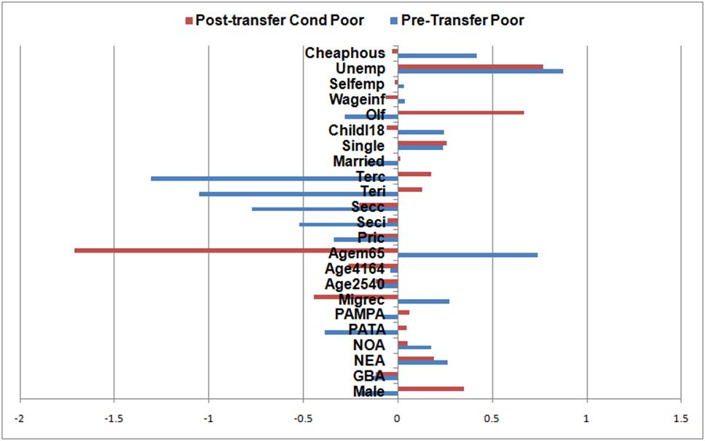
AR: The Profile of the Excluded

Slide 60
Argentina: Equity - Conclusions
Income Poverty Gap is not zero because:
Although coverage of the poor with existing safety net system is quite high (around 80%)…
The amount of Targeted Monetary Transfers reaching the poor are below the needs
  There are “errors” of inclusion by design (AUH)
  There are “errors” of exclusion by design due to gaps in safety net system
  The “excluded” tend to be male, outside the labor force and more educated

Slide 61
Argentina: Equity - Conclusions
Progressivity of transfers
Total redistributive spending is slightly progressive in absolute terms, but some of the social and economic subsidies are not; some of the latter are outright regressive (after transfers inequality is higher than before transfers; e.g., airline subsidies)
Thus, there is room to re-allocate benefits from the non-poor to the poor and eradicate the extreme poverty gap
Watch out:
-negative incentives
-impact on poor when eliminating some programs
-who bears the brunt of redistribution— political economy dynamics

Slide 62
First, there is no “Latin-America”
Extent and effectiveness of income redistribution and poverty reduction, revenue-collection, and spending patterns vary so significantly across countries that speaking of “Latin America” as a unit is misleading.
The (after direct taxes and transfers) Gini, for example, declines by over 10 percent in Argentina but by only 2.4 percent in Bolivia.
In Argentina, Brazil and Bolivia government revenues are close to 40 percent of GDP, whereas in Mexico and Peru they are around 20 percent.
Social spending (excluding contributory pensions) as a share of GDP ranges from 17 percent in Brazil to 5.2 percent in Peru.
See Table 1

Slide 63
Change in Gini (in %)

Slide 64
Change in Headcount Ratio (in %)

Slide 65
Second, social spending does not accrue to richest quintile.
On the contrary, concentration coefficients for social spending are highly negative (progressive in absolute terms) for Argentina and slightly so for Bolivia and Mexico.
In Brazil and Peru social spending is progressive in relative terms only.
See Tables 4 and 5; Figure 1

Slide 66
Share of Direct Transfers Going to Each Quintile (Poorest to Richest)

Slide 67
Share of In-kind Transfers (Education, Health, Urban&Housing) Going to Each Quintile

Slide 68
Zooming-in: Share of Transfers Going to Bottom 20 %

Slide 69
Third, no obvious correlation between size of government and redistribution (Table 1)

Slide 70
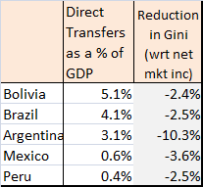

Slide 71
No apparent correlation between size of government and impact
Primary spending/GDP is similar for Argentina and Bolivia but they are on opposite sides in terms of the extent of redistribution.
Although Mexico spends 1/7th of Brazil in transfers/GDP, the Gini declines by more in the former.

Slide 72
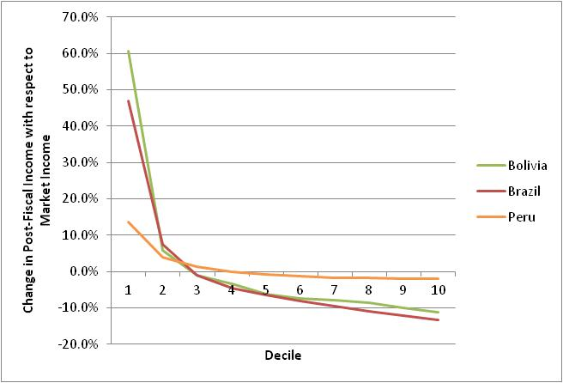
Fourth, due to indirect taxes households are net payers to the “fisc” beginning in the third decile in Bolivia and Brazil; for Peru this happens in the fifth decile.(Table 3)

Slide 73
Fifth, safety net system excludes substantial proportion of the poor by design

Slide 75
Methodological Highlights

Slide 76
Methodological Highlights
Definitions of income concepts and how they are constructed
  Methods
  When to scale-up
Static fiscal incidence analysis
Definition of “Progressive” and “Regressive”
Data: Household Surveys; See top rows of Appendix A

Slide 77
Fiscal Incidence Analysis: Definitions of Income Concepts
We attempt to assess the distributive impact of the full range of fiscal interventions.
Whenever possible from market or primary income and sequentially estimate the incidence of
  direct taxes and contributions to the social security system,
  direct cash transfers,
  indirect taxes and subsidies, and
  in-kind transfers in the form of free or quasi-free services such as education and health.

Slide 79
Fiscal Incidence Analysis: How Income Concepts are Constructed
Direct Identification Method
Household surveys do not always include information on direct taxes or transfers from specific programs (or, on expenditures needed to estimate indirect taxes):
Inference Method
Simulation Method
Imputation Method
Alternate Survey
Secondary Sources Method
Appendix A

Slide 80
Fiscal Incidence Analysis: Incidence Assumptions (Appendix A)
Payroll taxes and social security contributions are borne fully by labor in the form of lower wages.
Consumption taxes (VAT, excise taxes, consumption taxes) are borne by consumers of the taxed commodities; burdens are allocated in proportion to the shares of consumption of the taxed good.
Cash transfers accrue to beneficiary households.

Slide 81
Fiscal Incidence Analysis: Incidence Assumptions
Social Security/contributory pensions (and unemployment compensation of a contributory system) are included in Market Income.
SS pensions are not considered part of government transfers because in an actuarially fair system, pensions—on average—correspond to life-time contributions. (“Micro-simulation” project of Paris School of Economics; see Bourguignon, various papers).
What if there is a deficit in the year of analysis? Estimated the incidence of the “subsidy” separately.

Slide 82
Fiscal Incidence Analysis: Incidence Assumptions
Education transfers: calculated as the average cost per student at each level multiplied by the number of children in school at each level in every household.
Health transfers: depends on the system in the country.
Scaling-up:
Because these transfers are imputed based on totals from national or public accounts, market incomes and direct cash transfers (and taxes) need to be scaled-up to avoid overestimating the contribution of education and health transfers in the incidence analysis

Slide 83
Definition of CEQ Social Spending
CEQ Social Spending includes public spending on education, health and social assistance.
It does not include spending on contributory pensions except for the “subsidized” portion.
The “subsidy” is equal to the deficit of the pay-as-you-go pension system in the year of the survey.
If the contributory pension system did not have a deficit, the subsidy was taken to be equal to zero.

Slide 84
Definition of Redistributive “Effectiveness”
Effectiveness Indicator is defined as the redistributive effect (i.e., the relative decline in Gini or Headcount Ratio) of the taxes or transfers being analyzed divided by their relative size with respect to GDP.

Slide 85
Definition of Extreme and Total Poverty (to be confirmed)
Extreme poverty is measured using the international PPP US$2.50 a day poverty line which for Latin America corresponds to roughly the median of national extreme poverty lines.
Moderate poverty is measured using the international PPP US$4 a day poverty line which for Latin America corresponds to roughly the median of national moderate poverty lines.

Slide 86
Fiscal Incidence Analysis: Caveats
Does not incorporate potential systematic differences between average and marginal incidence effects.
Does not include behavioral responses or general equilibrium effects.
Does not analyze incidence or redistribution over the life-cycle.
Does not take into account differences in the quality of public spending.
Hence, this exercise should be viewed as a first-approximation of the impact of fiscal policy on inequality and poverty.

Slide 87
Summing-up (to be confirmed)
Argentina:
  incidence analysis for net market, disposable income and final income*.
  AUH transfers were constructed by simulation.
  Any information on direct and indirect taxes and indirect and non-social subsidies comes from secondary sources; imputation method.
  Health:

Slide 88
Summing-up
Bolivia:
  incidence analysis for net market, disposable income and final income* based on micro-data.
  Bolivia doesn’t have direct taxes or SS contributions so market and net market income are pretty similar.
  Juancito Pinto, etc., transfers were constructed by simulation.
  Any information on indirect taxes and indirect and non-social subsidies comes from secondary sources; imputation method for domestic gas.
  Health

Slide 89
Summing-up
Brazil:
  incidence analysis for market, net market, disposable income and final income* based on micro-data.
  Any information on indirect taxes and indirect and non-social subsidies comes from secondary sources.
  Health

Slide 90
Summing-up
Mexico:
  incidence analysis for net market, disposable income and final income* based on micro-data.
  Any information on direct and indirect taxes and indirect and non-social subsidies comes from secondary sources; imputation method for domestic gas.
  Health

Slide 91
Summing-up
Peru:
  incidence analysis for market, net market, disposable income, final and final income* based on micro-data.
  Health

Slide 92
Definitions of Progressive and Regressive Taxes and Transfers
No convention on how to call transfers whose concentration curves lie between the Lorenz curve and the perfect equality diagonal.
Here we decided to call them progressive in relative terms (and not regressive in absolute terms as some authors do).
Our choice is based on a simple rule: anything that makes the distribution of income more equal (unequal), should be called progressive (regressive).

Slide 93
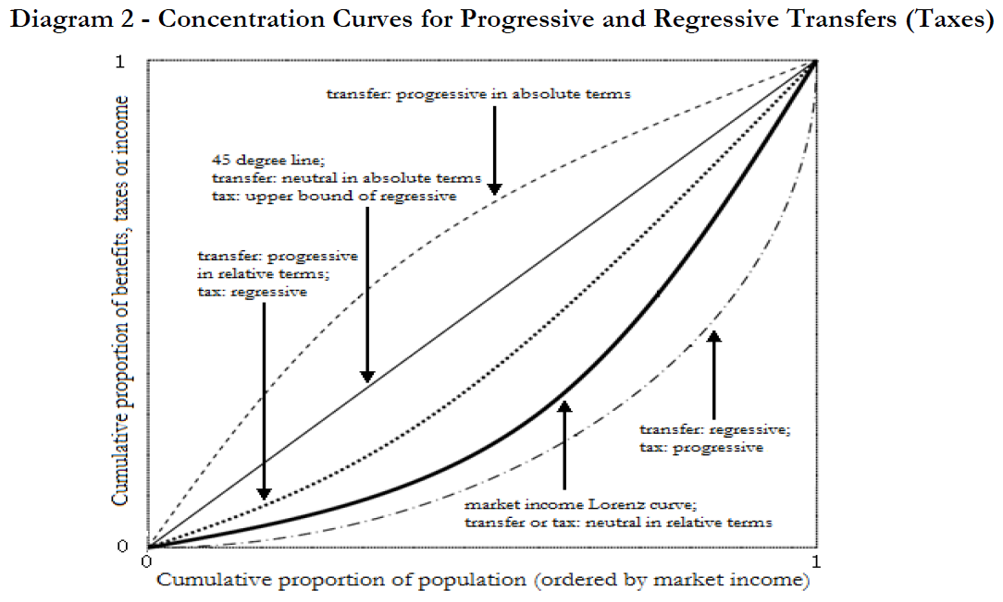

Slide 94
Concluding Remarks
How much redistribution (inequality and poverty reduction) do the countries accomplish through fiscal policy?
Does the extent of redistribution and redistributive effectiveness vary significantly across countries?
Is the extent of redistribution directly correlated with the size of government, social spending and spending on direct transfers as stated by existing research?
What accounts for “success” in terms of both the extent of redistribution and government effectiveness to achieve it?
Should governments collect more revenues, spend more or spend more progressively to increase redistribution and improve effectiveness?

Slide 95
Redistribution
Redistribution is still small when compared to advanced countries, particularly in Western Europe but this study finds higher levels of redistribution than previous ones.
Income inequality reduction varies a great deal among countries:
Taking account of direct taxes and all transfers (cash and in-kind in the form of imputed values for public education and health), final income inequality in Argentina measured by the Gini coefficient is 27 percent lower than the “pre-fisc” market income inequality (the Gini declines by 13 percentage points).
In contrast, Bolivia’s Gini declines by 11 percent (6 percentage points) in spite of the fact that social spending in Bolivia is roughly the same as in Argentina (about 15 percent of GDP) and that Bolivia spends more on direct transfers (5.1 percent of GDP vs. 3.1 percent in Argentina).

Slide 96
Redistribution
As would be expected, the redistributive effectiveness is also quite different across countries.
Argentina seems to get the most redistribution “for the buck” spent by the government followed by Mexico and Peru.
Compared to Brazil and Bolivia, on average, these three countries are about three times more effective in terms of the distributive impact of cash transfers and two times more effective when in-kind transfers are added.
In terms of effectiveness, Bolivia ranks worst.

Slide 97
Poverty Reduction
In Argentina, Brazil, Mexico and Peru, the “pre-fisc” headcount ratio for extreme poverty is between 13 and 15 percent. In Bolivia is above 20 percent.
Argentina’s fiscal policy reduces extreme poverty the most both in relative and absolute terms. Direct cash transfers in Argentina reduce extreme poverty by a staggering 63 percent; after direct transfers and taxes extreme poverty in Argentina is as low as 5 percent (headcount ratio).
At the other end of the spectrum is Peru where direct transfers reduce extreme poverty by only 8 percent. Bolivia is second to last.
Brazil and Mexico are in between: disposable income (that is, after direct net transfers) poverty is roughly 22 percent lower than market income extreme poverty.

Slide 98
Poverty Reduction
However, because Mexico’s and Peru’s direct transfers are better targeted than those in Argentina, the poverty reduction effectiveness is highest in Mexico followed by Peru.
By this measure, Argentina ranks third, and Brazil and Bolivia rank worst. Brazil has roughly the same headcount ratio as Mexico for “pre-fisc” extreme poverty (15.6 and 13.5 percent, respectively).
While Brazil spends about seven times more on direct cash transfers (as a share of GDP) than Mexico, fiscal policy reduces extreme poverty by 22 percent in both countries.

Slide 99
Fiscal “space”
If you take into account non-tax and provincial government revenues, the fiscal space to engage in redistribution can be quite large: in Brazil, total government revenues (as a share of GDP) surpass 50 percent while in Argentina and Bolivia the figure is close to 40 percent.
At the other end of the spectrum are Mexico and Peru where total revenues are just over 20 percent of GDP.Social spending (as a share of GDP) ranges from around 17 percent in Brazil to 5.2 percent in Peru.
Direct cash transfers as a share of GDP are different as well: at the bottom are Mexico and Peru where spending on direct transfers is around 0.5 percent while Argentina, Brazil and Bolivia spend 3.1, 4.1 and 5.1 percent of GDP, respectively.
The much larger size of cash transfers in these countries arises from various forms of non-contributory pension programs: the Pension Moratorium (2.3 percent of GDP) in Argentina, Special Circumstances Pension (2.3 percent of GDP) in Brazil, and Bono Sol (0.9 percent of GDP) and the left-over payments of the pay-as-you-go system which was scrapped in 1996 (3.6 percent of GDP) in Bolivia.
When these items are removed, cash transfers as a share of GDP in Argentina, Brazil and Bolivia decline to 0.8, 1.8 and 0.6 percent, respectively.

Slide 100
Country “prototypes” in terms of Equity (of CEQ 4 dimensions)
By government size, we end up with two distinct categories: large government countries (Argentina, Bolivia and Brazil) and small government countries (Mexico and Peru).
In terms of redistribution, each country represents a “prototype.”
The “Argentine prototype”: a country with very high government spending which redistributes a great deal both in absolute terms and in relation to what it spends.
The “Brazilian prototype”: a country with very high government spending which achieves moderate redistribution in absolute terms but not in relation to what it spends.
The “Bolivian prototype”: a country with very high government spending which redistributes little both in absolute terms and in relation to what it spends.
The “Mexican model”: a country with low government spending which achieves moderate redistribution in absolute terms and in relation to what it spends.
The “Peruvian prototype”: a country with low government spending which redistributes little in absolute terms but not in relation to what it spends.

Slide 101
Country “prototypes” in terms of Quality (of CEQ 4 dimensions)
Macro-sustainability, micro incentives, quality of services, accountability and transparency
  Argentina scores badly in all.
  Mexico and Peru score relatively well in four and not well in quality of services
  Bolivia and Brazil?

