Slide 1
Latin America’s Economic Challenges: Lessons for Emerging Economies
Nora Lustig (Tulane Univ) and Jaime Ros (UNAM)
Wrap-up Workshop “How can China avoid the middle-income trap?”
ADB/NSD Peking University
Beijing, February 24 and 25, 2011

Slide 2
What is the Latin American “middle-income trap?”

Slide 4
LA Economic Performance
In the last quarter of the 20th century, Latin America—like many other parts of the developing world—experienced a major shift in its development strategy.
From the aftermath of the Second World War up until the debt crisis of the 1980s, the region had embraced a strategy of state-led industrialization, largely oriented towards the domestic market: import substitution industrialization.
Following the 1980s debt crisis (and even earlier in a few countries), state-led industrialization was replaced by a new development model in which markets and integration with the global economy took center stage.

Slide 5
LA Economic Performance
The results of the new outward-oriented market-based development strategy have been disappointing (Figure 1).
Overall, the recent growth performance of Latin America has been lackluster even if we leave aside the “lost decade” of the 1980s.
For the period 1990-2008, the average of Latin America’s per capita GDP growth rate has been 1.8 percent per year, well below the 2.7 percent yearly growth rate of the period 1950-1980 and less than the average growth rate of the world economy.

Slide 6
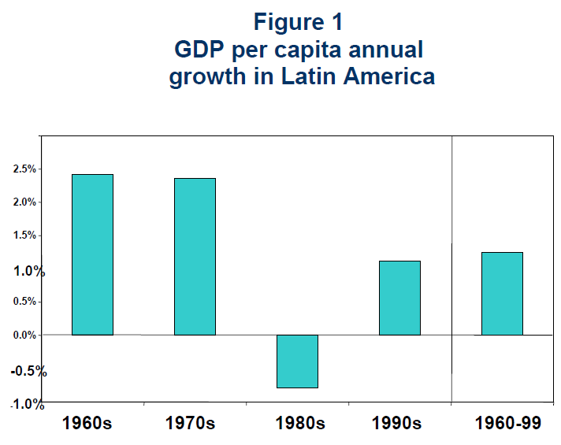

Slide 7
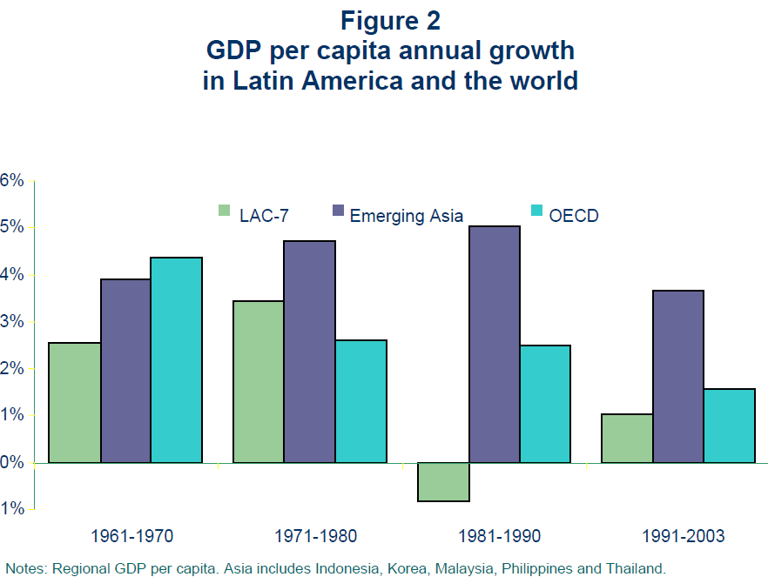

Slide 8
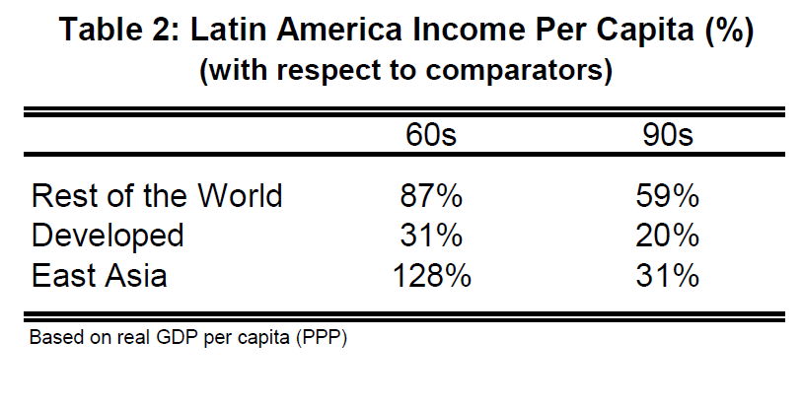
Diverging Income per Capita

Slide 9
What factors “explain” the middle-income trap?
Proximate factors:
  Inflationary bouts and recurrent economic crises (balance of payments, debt, banking, currency, financial crises)
  Slowdown in productivity growth; in particular, slowdown in labor productivity growth in the service sector
Fundamental factors:
  Conjectures about the role of high inequality/social and political exclusion of indigenous population

Slide 12
Macroeconomic Volatility and Financial Instability
Latin America has lived through macroeconomic crises driven either by excesses of the state or the market.
Fiscal crises affected countries such as Brazil and Mexico in the early 1980s under state-led import substitution.
But private-led financial crises affected the Southern cone countries (Argentina, Chile and Uruguay) in the early 1980s, Mexico (1994-95), Brazil (1999) and Argentina (2001-02) under market-oriented strategies.
There are lessons from crises which originated in the private/financial sector but in which the state often ended up with a large debt as a result of the insolvency of the former.
Financial and capital account liberalization have their pitfalls and Latin America learned about them the hard way.

Slide 13
Macroeconomic Volatility and Financial Instability: Lessons for China?
Fiscal crises--or fiscal duress--can “sneak in” through the back door:
  Rescue of systemically critical sectors:
    Financial sector
  Rescue of subnational governments
  Unfunded spending commitments (public pensions)
Underscores the importance of prudential regulation in financial sector; monitoring and/or controlling volatile capital inflows; monitoring the potential development of “asset bubbles;” assess risks and contingent liabilities in sensitive sectors (social insurance and private pension plans; guarantees for privately held debt)

Slide 14
Inflation Targeting and Exchange Rate Management
Latin America has experimented with every exchange rate regime on earth: fixed exchange rates, crawling pegs, currency boards, dollarization and flexible exchange rates
In 1990s and 2000s there has been a shift towards flexible exchange-rate regimes(see Figure 2.1).
The move went together with the adoption of inflation targeting monetary regimes.

Slide 16
Exchange Rate Management: Lessons for China?
Flexible exchange rates-cum-inflation targeting has been successful in
  Keeping inflation under control
  Weather external shocks
  Deal better with volatility of capital flows
Caveat: there will be periods of real appreciation that may hurt growth

Slide 19
The link between inequality and the middle-income trap in LA
Latin America is the most unequal region in the world
Using Gini coefficient,
  19 percent more unequal than Sub-Saharan Africa
  37 percent more unequal than East Asia
  65 percent more unequal than developed countries

Slide 20
Gini Coefficient by Region (in %), 2004

Slide 21
Was high inequality a “fundamental” cause of the middle-income trap in LA?
Political Economy Dynamics: High inequality coupled with high expectations of workers and pent-up demands of secularly disenfranchised groups resulted in:
  macroeconomic populism
    high inflation and state-led balance of payments crises: Argentina in early 1970s; Brazil in early 1980s; Mexico 1976 and 1982; Peru in mid-1980s
  Which triggered:
  military coups and center-right regimes
    free-market fundamentalism (liberalization of capital and financial markets) => market-led financial/balance of payments crises: Argentina in late 1970s; Mexico 1994/95; Argentina 2001/02

Slide 22
Was high inequality a “fundamental” cause of the middle-income trap in LA?
  High inequality also resulted in democratically elected radical left regimes (Chile in early 1970s; Nicaragua in late 1970s) and Marxist guerrilla movements, which triggered:
    right-wing military coups => free-market fundamentalism (liberalization of capital and financial markets) => market-led financial/balance of payments crises: Uruguay in late 1970s; Chile in early 1980s
    civil conflict and civil wars => growth collapses in Central America in the 1980s and early 1990s

Slide 23
Was high inequality a “fundamental” cause of the middle-income trap in LA?
  Economic crises, particularly the 1980 debt crisis, civil wars and alienation of private sector
  => low levels of capital accumulation => slower productivity growth because sectors with increasing returns, economies of scale and/or externalities failed to expand
  Recurrent crises and inflationary bouts
  => exchange rate as a price-stabilizer => periodic real appreciations => lower profitability: domestic firms found it harder to compete with imports and export-oriented firms find it hard to compete in the international markets
  => Ill-conceived market-oriented reforms which, with the exception of Chile, ended up hurting productivity growth

Slide 24
In 1980s and 1990s, inequality was on the rise (Gini coefficient, 2009)

Slide 25
But, in the last ten years…
Inequality in most Latin American countries (12 out of 17) has declined (roughly at 1% a year).
Decline is robust to period selected.
Decline has continued despite global financial crisis.
While inequality declined in most of LA, it rose in other parts of the world.

Slide 26
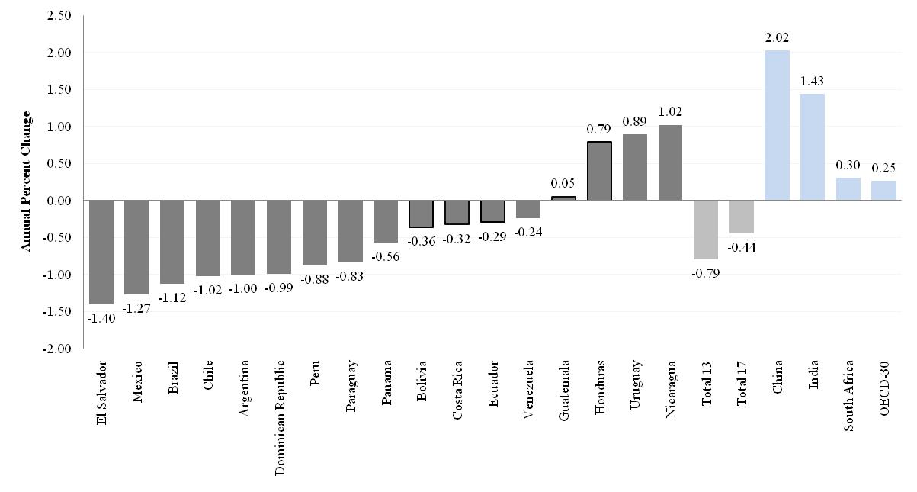
Change in Gini Coefficient: 2000-2007
(in %)

Slide 27
Change in Gini Coefficient: Three yr averages at end points

Slide 28
Change in Gini Coefficient: 2000-2009 (includes info for global recession year when feasible)

Slide 31
The decline in inequality has been widespread
The decline took place in:
Persistently high inequality countries (Brazil) and normally low inequality countries (Argentina)
Fast growing countries (Chile and Peru), slow growing countries (Brazil and Mexico) and countries recovering from crisis (Argentina and Venezuela)
Countries with left populist governments (Argentina), left social-democratic governments (e.g., Brazil, Chile) and center-right governments (e.g., Mexico and Peru)

Slide 32
Main Questions: Why has inequality declined in Latin America? Are there factors in common?
In-depth analysis in four countries:
  Argentina (urban; 2/3 of pop)
  Brazil
  Mexico
  Peru
  Source: Lopez-Calva and Lustig, eds., Declining Inequality in Latin America: a Decade of Progress?, Brookings Institution Press, 2010

Slide 33
Argentina (urban areas)

Slide 34
1981-2009

Slide 35
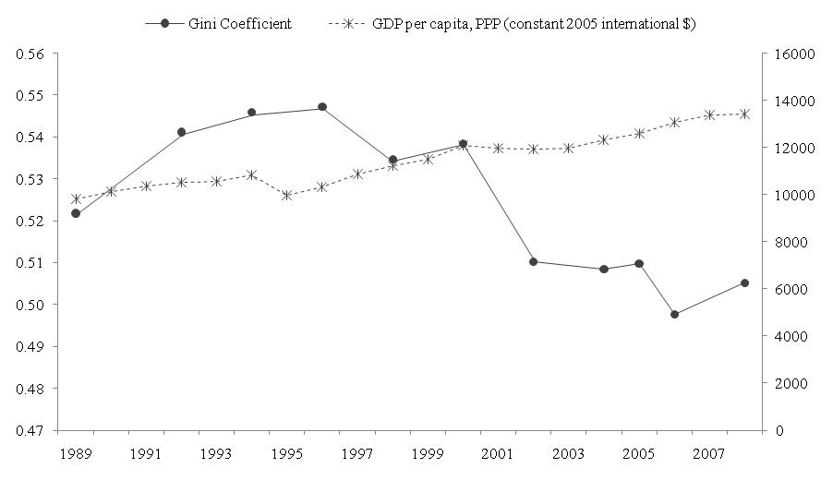
Mexico

Slide 36
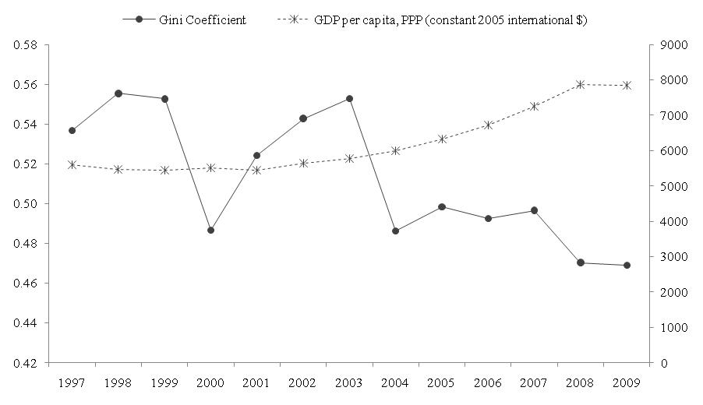
Peru

Slide 37
Decline is robust
Decline in inequality is statistically significant and significant in terms of order of magnitude
There is Lorenz dominance (unambiguous decline independently of choice of inequality measure)
Robust to income concept (e.g., monetary vs. total)

Slide 38
Over the last years, the income of the Brazilian poor has been growing as fast as per capita GDP in China while the income of the richest has been growing as fast as per capita GDP in Germany
Notes:
38

Slide 39
Proximate and fundamental determinants of changes in inequality
Useful framework: to consider the ‘proximate’ factors that affect the distribution of income at the individual and household level:
  Socio-demographic factors
  Distribution of assets and personal characteristics
  Return to assets and characteristics
  Transfers (private and public)

Slide 40
Decomposition results
Demographics: Changes in the ratio of adults per household were equalizing, albeit the orders of magnitude were generally small except for Peru.
Labor force participation: With the exception of Peru, changes in labor force participation (the proportion of working adults) were equalizing. This effect was stronger in Argentina.

Slide 41
Decomposition results
Labor income (Earnings): In Argentina, Brazil, and Mexico between 44% and 65% of the decline in overall inequality is due to a reduction in inequality in earnings per working adult . In Peru, however, changes in earnings inequality were unequalizing at the household level (but not so at the individual workers’ level).
Non-labor income: Changes in the distribution of non-labor income were equalizing; the contribution of this factor was quite high in Brazil and Peru (45% and 90%, respectively).

Slide 42
Why has earnings inequality declined?
Educational upgrading and a more equal distribution of educational attainment have been equalizing (quantity effect). No “paradox of progress” this time.
Changes in the steepness of the returns to education curve have been equalizing at the individual workers level (price effect). Except for Peru, they have been equalizing at the household level too.

Slide 43
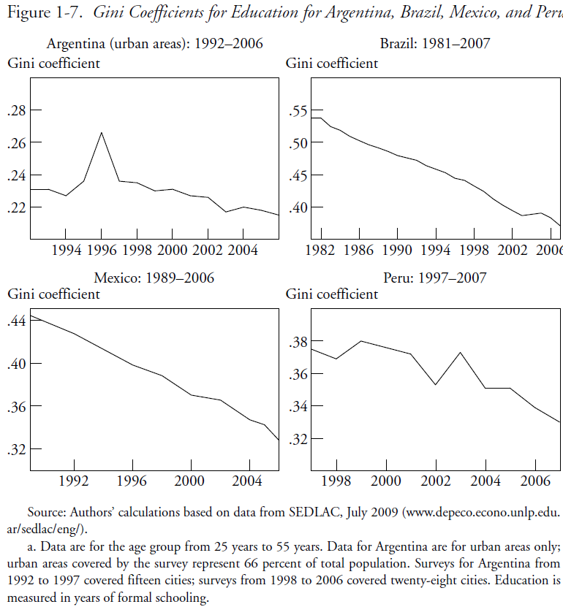

Slide 44
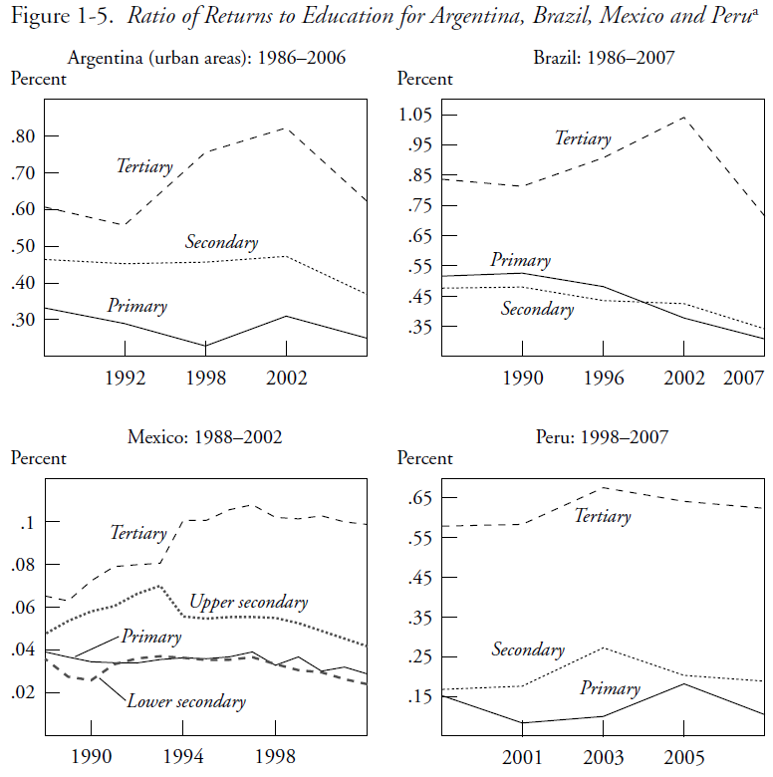

Slide 45
Why has the skill premium declined?
Increase in relative demand for skilled labor petered out: Fading of the unequalizing effect of skill-biased technical change in the 1990s: Argentina, Mexico & Peru.
Decline in relative supply of low-skilled workers: Expansion of basic education since the 1990s: Brazil, Mexico and Peru .

Slide 47
Why has non-labor income inequality declined?
The equalizing contribution of government transfers increased over time (both at the national level as well as for urban and, especially, rural households). By 2006 transfers became the income source with the largest equalizing effect of all the income sources considered.
Remittances became more equalizing too but with a smaller effect than government transfers.
Both more than offset the increasingly unequalizing impact of pensions.

Slide 48
Why has inequality in non-labor incomes declined?
In the four countries government transfers to the poor rose and public spending became more progressive
    In Argentina, the safety net program Jefes y Jefas de Hogar.
    In Brazil and Mexico, large-scale conditional cash transfers Bolsa Familia and Oportunidades => can account for between 10 and 20 percent of reduction in overall inequality. An effective redistributive machine because they cost around .5% of GDP.
    In Peru, in-kind transfers for food programs and health. Also access to basic infrastructure for the poor rose.

Slide 49
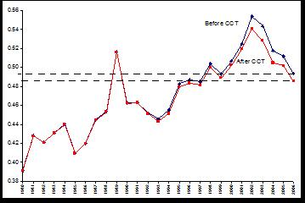
Argentina: Distributional impact of Conditional cash transfers

Slide 50
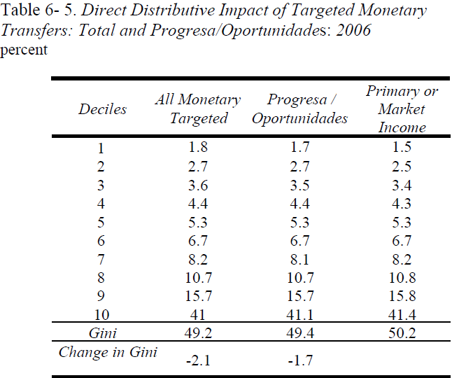

Slide 51
Conclusions
In the race between skill-biased technological change and educational upgrading, in the last ten years the latter has taken the lead (Tinbergen’s hypothesis)
Perhaps as a consequence of democratization and political competition, government (cash and in-kind) transfers have become more generous and targeted to the poor

Slide 52
Is Inequality Likely to Continue to Fall?
Despite the observed progress, inequality continues to be very high and the bulk of government spending is not progressive.
The decline in inequality resulting from the educational upgrade of the population will eventually hit the ‘access to tertiary education barrier’ which is much more difficult to overcome: inequality in quality and ‘opportunity cost’ are high and costly to address.
Making public spending more progressive in the future is likely to face more political resistance (entitlements of some powerful groups).

Slide 53
Has the link between high inequality and bad political economy dynamics been broken?
Inequality has been on the decline, but is the decline sufficient to prevent bad policies?
Too early to declare victory, evidence is mixed:
  in 2000s elections were won by “risky” policymakers in Argentina, Bolivia, Ecuador, Nicaragua and Venezuela;
  however, elections were won also by a “new” social democratic left which succeeded in combining macro stability, redistribution and growth (Brazil, Chile, Paraguay and Uruguay)

Slide 54
Thank you!

