Slide 1
Taxes, Transfers, Inequality and Poverty in Latin America
Nora Lustig
Tulane University
Brown University, April 19, 2012

Slide 2
Acknowledgments
Lustig, Nora (coordinator). “Fiscal Policy and Income Redistribution in Latin America: Challenging the Conventional Wisdom,” Argentina: Carola Pessino; Bolivia: George Gray Molina, Wilson Jimenez, Verónica Paz, Ernesto Yañez; Brazil: Claudiney Pereira, Sean Higgins; Mexico: John Scott; Peru: Miguel Jaramillo. , Economics Department, Working Paper 1202, New Orleans, Louisiana, April 2012. Forthcoming.
Commitment to Equity (CEQ) Initiative; Inter-American Dialogue and Tulane University’s CIPR and Dept. of Economics.
Currently: 12 countries
5 finished: Argentina (2009), Bolivia (2007), Brazil (2009), Mexico (2008) and Peru (2009) (year of HH survey)
7 in progress: Chile, Colombia, Costa Rica, El Salvador, Guatemala, Paraguay and Uruguay

Slide 3
Outline
How much poverty reduction and redistribution LA achieves through fiscal policy?
Standard Incidence Analysis/Caveats
Results:
  Heterogeneous LA
  Little correlation between size of government and extent of redistribution
  Direct Taxes, practically “useless”
  Cash Transfers, can reduce poverty significantly
  Indirect taxes can make poor become net payers to the government (even after cash transfers)

Slide 5
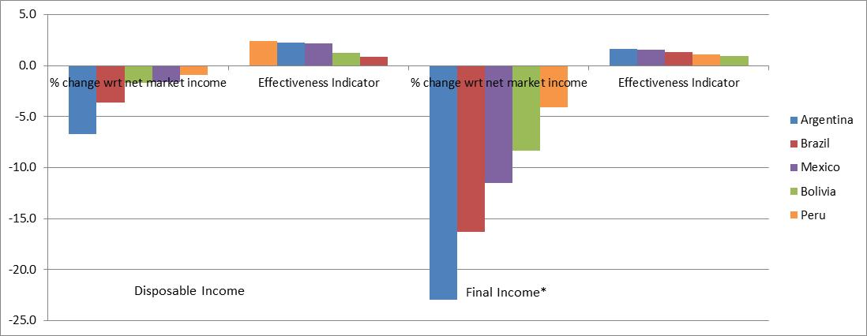
Decline in Gini and Effectiveness: Heterogeneous LA

Slide 6
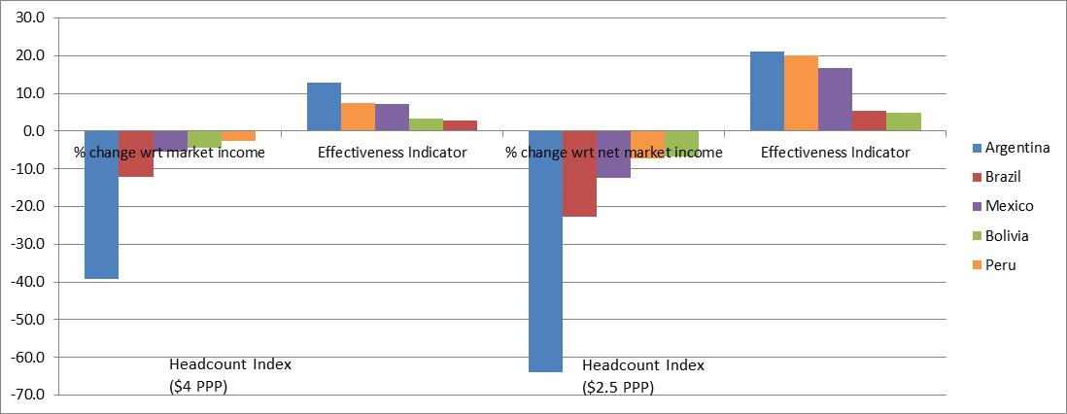
Decline in Headcount Ratio and Effectiveness: Heterogeneous LA

Slide 7
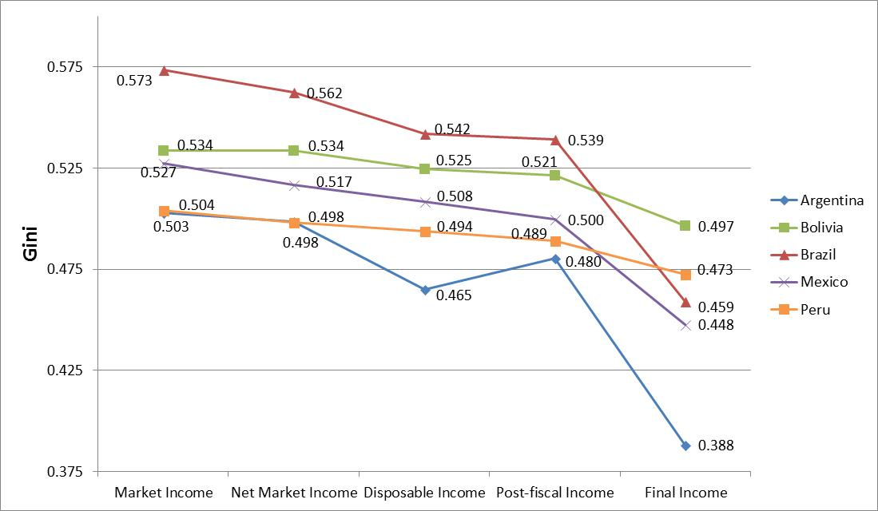
Fiscal Policy and Decline in Gini

Slide 8
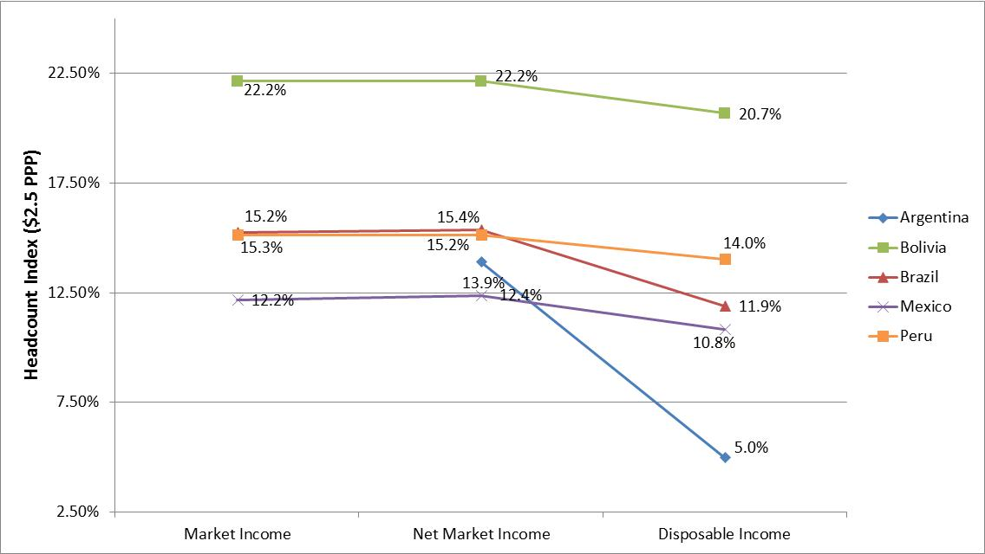
Decline in Headcount Ratio (PL: 2.50 dollars a day in PPP)

Slide 9
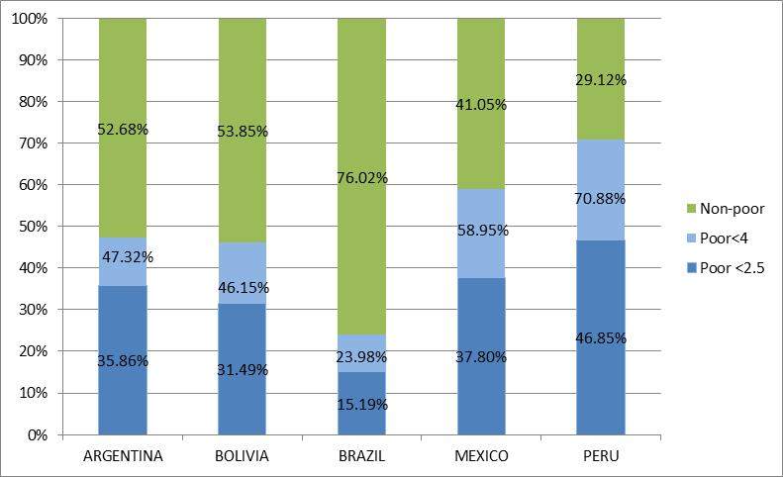
“Leakages” to Non-poor

Slide 10
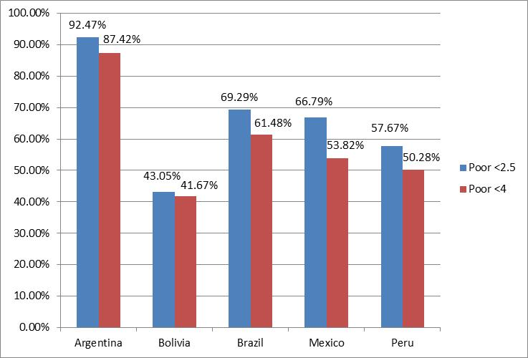
Coverage of the Extreme and Total Poor

Slide 11
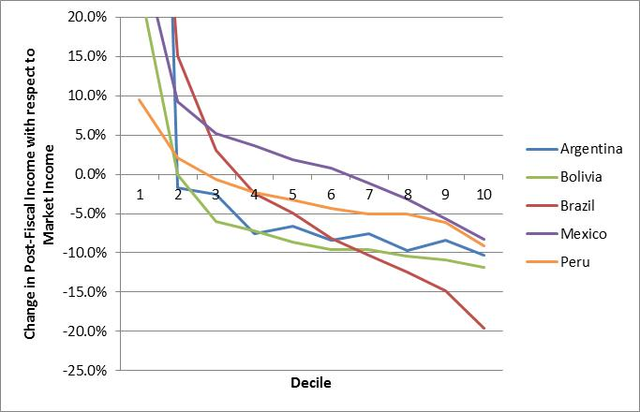
Impact of Indirect Taxes

Slide 12
Conclusions
First, Latin America is heterogenous; can’t talk of “a Latin America”
  The extent and effectiveness of income redistribution and poverty reduction, government size, and spending patterns vary significantly across countries.

Slide 13
Conclusions
Second, there is little correlation between government size and the extent and effectiveness of redistribution and poverty reduction.

Slide 14
Conclusions
Third, direct taxes achieve little in the form of redistribution.
Caveat:
The rich are excluded from analysis using household surveys; need governments to share information from tax returns (anonymous of course) as all advanced countries do (except for NIC’s)
  Fiscal Transparency for Efficiency and Equity Campaign

Slide 15
Conclusions
Fourth, large-scale targeted cash transfers can achieve significant reductions in extreme poverty.
The extent of poverty reduction depends on:
  size of per capita transfer
  coverage of the poor

Slide 16
Conclusions
Fifth, when indirect taxes are taken into account, the moderate poor and the near poor become net payers to the fiscal system.

