Slide 1
Fiscal Policy and Redistribution in Latin America: Challenging Conventional Wisdom
Nora Lustig
Tulane University, CGD, IAD
Commitment to Equity Workshop
Washington, DC
November 3 and 4, 2011

Slide 2
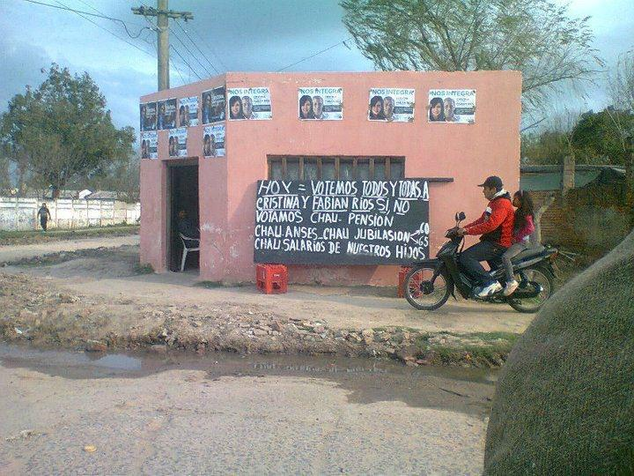
Corrientes, Argentina, August 2011: “Today let’s vote for Cristina [Fernandez], if we don’t, good-by to pensions, good-by to current retirement age, good-by to wages for our children.”

Slide 3
Outline
Summary of Results
Methodological Highlights
Conclusions

Slide 4
Summary of Results

Slide 5
Fiscal Policy & Redistribution in LA
Conventional wisdom states that fiscal policy redistributes little in Latin America. (Breceda et al., 2008; Goñi et al., 2011)
Lower tax revenues and – above all – lower and less progressive transfers have been identified as the main cause.
Through an in-depth fiscal incidence analysis applied to Argentina, Bolivia, Brazil, Mexico and Peru we argue that conventional wisdom may be wrong.

Slide 6
First, there is no “Latin-America”
Extent and effectiveness of income redistribution and poverty reduction, revenue-collection, and spending patterns vary so significantly across countries that speaking of “Latin America” as a unit is misleading.
The (after direct taxes and transfers) Gini, for example, declines by over 10 percent in Argentina but by only 2.4 percent in Bolivia.
In Argentina, Brazil and Bolivia government revenues are close to 40 percent of GDP, whereas in Mexico and Peru they are around 20 percent.
Social spending (excluding contributory pensions) as a share of GDP ranges from 17 percent in Brazil to 5.2 percent in Peru.
See Table 1

Slide 7
Change in Gini (in %)

Slide 8
Change in Headcount Ratio (in %)

Slide 9
Second, social spending does not accrue to richest quintile.
On the contrary, concentration coefficients for social spending are highly negative (progressive in absolute terms) for Argentina and slightly so for Bolivia and Mexico.
In Brazil and Peru social spending is progressive in relative terms only.
See Tables 4 and 5; Figure 1

Slide 10
Share of Direct Transfers Going to Each Quintile (Poorest to Richest)

Slide 11
Share of In-kind Transfers (Education, Health, Urban&Housing) Going to Each Quintile

Slide 12
Zooming-in: Share of Transfers Going to Bottom 20 %

Slide 13
Third, no obvious correlation between size of government and redistribution (Table 1)

Slide 14
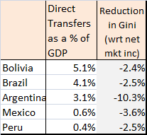

Slide 15
No apparent correlation between size of government and impact
Primary spending/GDP is similar for Argentina and Bolivia but they are on opposite sides in terms of the extent of redistribution.
Although Mexico spends 1/7th of Brazil in transfers/GDP, the Gini declines by more in the former.

Slide 16
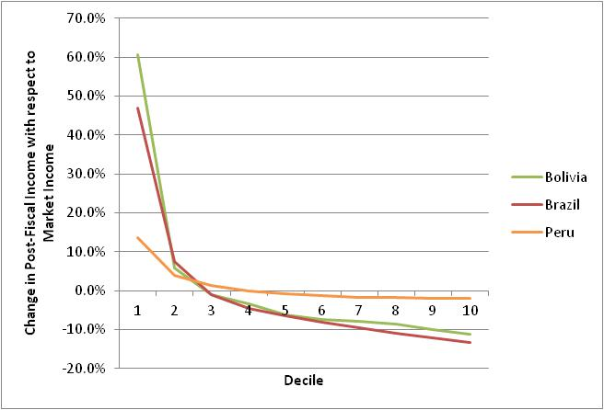
Fourth, due to indirect taxes households are net payers to the “fisc” beginning in the third decile in Bolivia and Brazil; for Peru this happens in the fifth decile.(Table 3)

Slide 19
Fifth, safety net system excludes substantial proportion of the poor by design

Slide 21
Methodological Highlights

Slide 22
Methodological Highlights
Definitions of income concepts and how they are constructed
  Methods
  When to scale-up
Static fiscal incidence analysis
Definition of “Progressive” and “Regressive”
Data: Household Surveys; See top rows of Appendix A

Slide 23
Fiscal Incidence Analysis: Definitions of Income Concepts
We attempt to assess the distributive impact of the full range of fiscal interventions.
Whenever possible from market or primary income and sequentially estimate the incidence of
  direct taxes and contributions to the social security system,
  direct cash transfers,
  indirect taxes and subsidies, and
  in-kind transfers in the form of free or quasi-free services such as education and health.

Slide 25
Fiscal Incidence Analysis: How Income Concepts are Constructed
Direct Identification Method
Household surveys do not always include information on direct taxes or transfers from specific programs (or, on expenditures needed to estimate indirect taxes):
Inference Method
Simulation Method
Imputation Method
Alternate Survey
Secondary Sources Method
Appendix A

Slide 26
Fiscal Incidence Analysis: Incidence Assumptions (Appendix A)
Payroll taxes and social security contributions are borne fully by labor in the form of lower wages.
Consumption taxes (VAT, excise taxes, consumption taxes) are borne by consumers of the taxed commodities; burdens are allocated in proportion to the shares of consumption of the taxed good.
Cash transfers accrue to beneficiary households.

Slide 27
Fiscal Incidence Analysis: Incidence Assumptions
Social Security/contributory pensions (and unemployment compensation of a contributory system) are included in Market Income.
SS pensions are not considered part of government transfers because in an actuarially fair system, pensions—on average—correspond to life-time contributions. (“Micro-simulation” project of Paris School of Economics; see Bourguignon, various papers).
What if there is a deficit in the year of analysis? Estimated the incidence of the “subsidy” separately.

Slide 28
Fiscal Incidence Analysis: Incidence Assumptions
Education transfers: calculated as the average cost per student at each level multiplied by the number of children in school at each level in every household.
Health transfers: depends on the system in the country.
Scaling-up:
Because these transfers are imputed based on totals from national or public accounts, market incomes and direct cash transfers (and taxes) need to be scaled-up to avoid overestimating the contribution of education and health transfers in the incidence analysis

Slide 29
Definition of CEQ Social Spending
CEQ Social Spending includes public spending on education, health and social assistance.
It does not include spending on contributory pensions except for the “subsidized” portion.
The “subsidy” is equal to the deficit of the pay-as-you-go pension system in the year of the survey.
If the contributory pension system did not have a deficit, the subsidy was taken to be equal to zero.

Slide 30
Definition of Redistributive “Effectiveness”
Effectiveness Indicator is defined as the redistributive effect (i.e., the relative decline in Gini or Headcount Ratio) of the taxes or transfers being analyzed divided by their relative size with respect to GDP.

Slide 31
Definition of Extreme and Total Poverty
Extreme poverty is measured using the international PPP US$2.50 a day poverty line which for Latin America corresponds to roughly the median of national extreme poverty lines.
Moderate poverty is measured using the international PPP US$4 a day poverty line which for Latin America corresponds to roughly the median of national moderate poverty lines.

Slide 32
Fiscal Incidence Analysis: Caveats
Does not incorporate potential systematic differences between average and marginal incidence effects.
Does not include behavioral responses or general equilibrium effects.
Does not analyze incidence or redistribution over the life-cycle.
Does not take into account differences in the quality of public spending.
Hence, this exercise should be viewed as a first-approximation of the impact of fiscal policy on inequality and poverty.

Slide 33
Definitions of Progressive and Regressive Taxes and Transfers
No convention on how to call transfers whose concentration curves lie between the Lorenz curve and the perfect equality diagonal.
Here we decided to call them progressive in relative terms (and not regressive in absolute terms as some authors do).
Our choice is based on a simple rule: anything that makes the distribution of income more equal (unequal), should be called progressive (regressive).

Slide 34
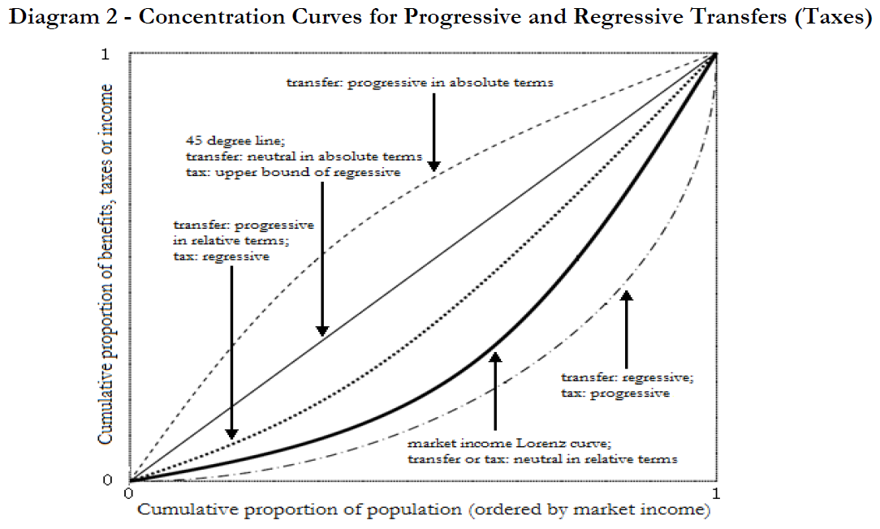

Slide 35
Conclusions

Slide 36
Main Questions
How much redistribution (inequality and poverty reduction) do the countries accomplish through fiscal policy?
Does the extent of redistribution and redistributive effectiveness vary significantly across countries?
Is the extent of redistribution directly correlated with the size of government, social spending and spending on direct transfers as stated by existing research?
What accounts for “success” in terms of both the extent of redistribution and government effectiveness to achieve it?
Policy implications?

Slide 37
Redistribution
Redistribution is still small when compared to advanced countries, particularly in Western Europe but this study finds higher levels of redistribution than previous ones.
Income inequality reduction varies a great deal among countries:
Taking account of direct taxes and all transfers (cash and in-kind in the form of imputed values for public education and health), final income inequality in Argentina measured by the Gini coefficient is 27 percent lower than the “pre-fisc” market income inequality (the Gini declines by 13 percentage points).
In contrast, Bolivia’s Gini declines by 11 percent (6 percentage points) in spite of the fact that social spending in Bolivia is roughly the same as in Argentina (about 15 percent of GDP) and that Bolivia spends more on direct transfers (5.1 percent of GDP vs. 3.1 percent in Argentina).

Slide 38
Redistribution
As would be expected, the redistributive effectiveness is also quite different across countries.
Argentina seems to get the most redistribution “for the buck” spent by the government followed by Mexico and Peru.
Compared to Brazil and Bolivia, on average, these three countries are about three times more effective in terms of the distributive impact of cash transfers and two times more effective when in-kind transfers are added.
In terms of effectiveness, Bolivia ranks worst.

Slide 39
Poverty Reduction
In Argentina, Brazil, Mexico and Peru, the “pre-fisc” headcount ratio for extreme poverty is between 13 and 15 percent. In Bolivia is above 20 percent.
Argentina’s fiscal policy reduces extreme poverty the most both in relative and absolute terms. Direct cash transfers in Argentina reduce extreme poverty by a staggering 63 percent; after direct transfers and taxes extreme poverty in Argentina is as low as 5 percent (headcount ratio).
At the other end of the spectrum is Peru where direct transfers reduce extreme poverty by only 8 percent. Bolivia is second to last.
Brazil and Mexico are in between: disposable income (that is, after direct net transfers) poverty is roughly 22 percent lower than market income extreme poverty.

Slide 40
Poverty Reduction
However, because Mexico’s and Peru’s direct transfers are better targeted than those in Argentina, the poverty reduction effectiveness is highest in Mexico followed by Peru.
By this measure, Argentina ranks third, and Brazil and Bolivia rank worst. Brazil has roughly the same headcount ratio as Mexico for “pre-fisc” extreme poverty (15.6 and 13.5 percent, respectively).
While Brazil spends about seven times more on direct cash transfers (as a share of GDP) than Mexico, fiscal policy reduces extreme poverty by 22 percent in both countries.

Slide 41
Fiscal “space”
If you take into account non-tax and provincial government revenues, the fiscal space to engage in redistribution can be quite large: in Brazil, total government revenues (as a share of GDP) surpass 50 percent while in Argentina and Bolivia the figure is close to 40 percent.
At the other end of the spectrum are Mexico and Peru where total revenues are just over 20 percent of GDP.Social spending (as a share of GDP) ranges from around 17 percent in Brazil to 5.2 percent in Peru.
Direct cash transfers as a share of GDP are different as well: at the bottom are Mexico and Peru where spending on direct transfers is around 0.5 percent while Argentina, Brazil and Bolivia spend 3.1, 4.1 and 5.1 percent of GDP, respectively.
The much larger size of cash transfers in these countries arises from various forms of non-contributory pension programs: the Pension Moratorium (2.3 percent of GDP) in Argentina, Special Circumstances Pension (2.3 percent of GDP) in Brazil, and Bono Sol (0.9 percent of GDP) and the left-over payments of the pay-as-you-go system which was scrapped in 1996 (3.6 percent of GDP) in Bolivia.
When these items are removed, cash transfers as a share of GDP in Argentina, Brazil and Bolivia decline to 0.8, 1.8 and 0.6 percent, respectively.

Slide 42
Country “prototypes” in terms of Equity (of CEQ 4 dimensions)
By government size, we end up with two distinct categories: large government countries (Argentina, Bolivia and Brazil) and small government countries (Mexico and Peru).
In terms of redistribution, each country represents a “prototype.”
The “Argentine prototype”: a country with very high government spending which redistributes a great deal both in absolute terms and in relation to what it spends.
The “Brazilian prototype”: a country with very high government spending which achieves moderate redistribution in absolute terms but not in relation to what it spends.
The “Bolivian prototype”: a country with very high government spending which redistributes little both in absolute terms and in relation to what it spends.
The “Mexican model”: a country with low government spending which achieves moderate redistribution in absolute terms and in relation to what it spends.
The “Peruvian prototype”: a country with low government spending which redistributes little in absolute terms but not in relation to what it spends.

Slide 43
Country “prototypes” in terms of Quality (of CEQ 4 dimensions)
Macro-sustainability, micro incentives, quality of services, accountability and transparency
  Argentina scores badly in all.
  Mexico and Peru score relatively well in four and not well in quality of services.

