Slide 1
Commitment to Equity (CEQ):
A Diagnostic Framework to Assess Governments’ Fiscal Policies
Nora Lustig
Dept. of Economics, Tulane University
Non-resident Fellow, CGD & IAD
Inter-American Development Bank Washington DC - March 2, 2011

Slide 2
Background
Joint project Inter-American Dialogue and Tulane University’s CIPR and Economics Dept.
Develop diagnostic and ranking tools to quantify, compare, and publicize the extent to which Latin American governments use fiscal policies to reduce poverty and inequality
Financial Support from the Canadian International Development Agency (primary funder), the Norwegian Ministry of Foreign Affairs, the United Nations Development Programme’s Regional Bureau for Latin America and the Caribbean, and the General Electric Foundation

Slide 3
Presentation Outline
Motivation
CEQ Assessment
  methodological framework
  questionnaire
  indicators
  Lustig (2011)“Commitment to Equity (CEQ): A Diagnostic Framework to Assess Governments’ Fiscal Policies .” (distributed)
Pilot studies: preliminary results
  Argentina (Carola Pessino, Univ. Torcuato di Tella, 2011)
  Mexico (John Scott, CIDE & CONEVAL, 2011)

Slide 4
Inequality, Poverty and Fiscal Policy in LA
Thanks to the expansion of education, macro stability and monetary transfers, inequality and poverty have been falling since approx. 2000
However,
  Latin America is still relatively very unequal
  extreme poverty is too high for its level of per capita GDP
  redistributive power of the state through fiscal policy is grossly underutilized

Slide 5
Inequality has been declining: 2000-2009
(Annual Change in Gini; Lopez-Calva & Lustig, 2011)

Slide 6
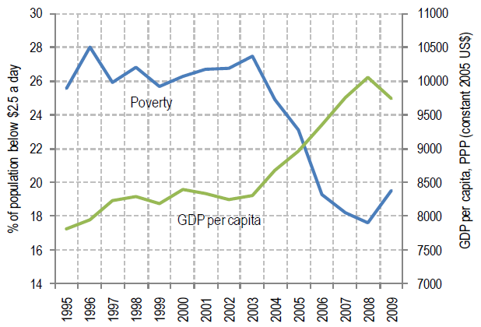
Poverty has been declining: headcount ratio 1995-2009 (IDB, 2011)

Slide 7
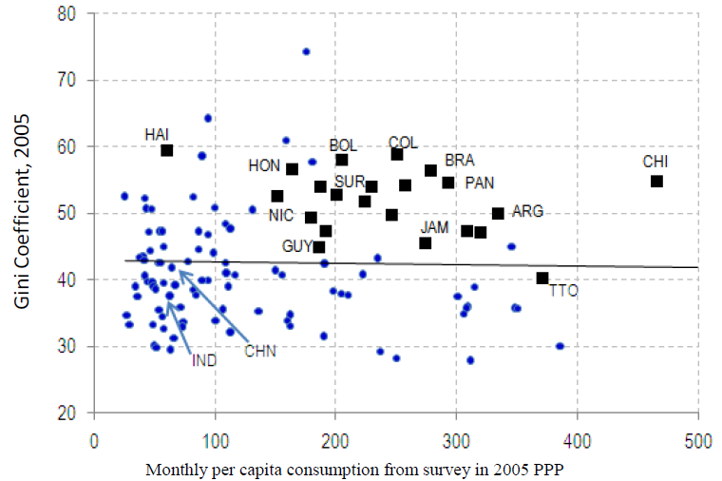
Latin America’s Relatively High Inequality (IDB, 2011)

Slide 8
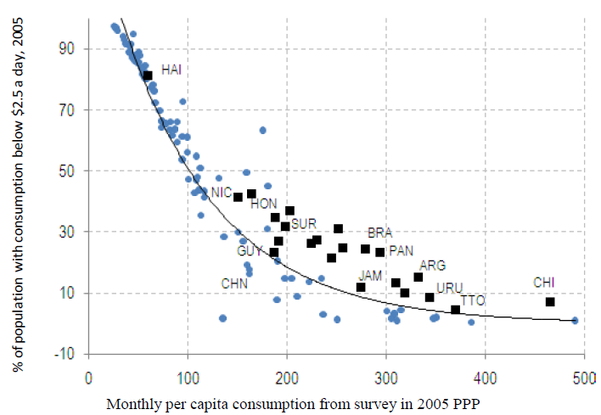
Latin America’s Excess Poverty (IDB, 2011)

Slide 9
Europe after taxes & transfers
Europe before taxes & transfers

Slide 10
Fiscal Policy: Little Redistribution and Poverty Reduction
Before direct taxes and monetary transfers Gini for LA is 13 percent higher than the European average while disposable income Gini is 60 percent higher in LA:
  Caveat: estimate assumes away behavioral responses (in Europe, pensions are a large portion of transfers)
  Includes only monetary transfers which are a relatively small share of transfers; in-kind transfers are more frequent
Adding in-kind transfers (spending on education and health), the redistributive impact for LA is larger than for monetary transfers but still limited.
  Incidence analysis finds a fairly flat distribution of social spending across income quintiles in Latin America

Slide 11
Objectives of the welfare state as threefold (Nicholas Barr,2004) :
  support a minimum living standard
  reduce income inequality
  enhance efficiency

Slide 12
Supporting a minimum living standard, in turn
  poverty reduction: ensuring that everyone has a minimum level of consumption
  insurance: preventing individuals from falling (or falling further) below the minimum level of consumption due to adverse shocks, both idiosyncratic (unemployment, illness, bad harvests, etc.) and systemic (economic crises, natural disasters, spikes in food prices, etc.)
  income smoothing: ensuring that a minimum level of consumption is achieved throughout an individual’s life-cycle (maternity/paternity leave and retirement, in particular)
  We added:
  building poor people’s human capital: ensuring that everyone has a minimum level of education and health.

Slide 13
Governments can support a minimum living standard through four main channels:
taxes and transfers (fiscal policy)
non-budgetary/regulatory interventions
redistribution of assets
interventions that change the distribution of voice and power among different groups in society and alter cultural norms.

Slide 14
Supporting a minimum living standard
Government actions will affect living standards through growth and distribution, either by their effect on market (primary) incomes and/or post-fiscal (after net transfers) incomes
Develop an instrument that confines the assessment of government actions on post-fiscal incomes

Slide 15
What is the Commitment to Equity Assessment?
A diagnostic framework to evaluate:
  how aligned fiscal policies are with supporting a minimum living standard
  in ways that reduce inequality and are broadly consistent with macroeconomic stability, microeconomic efficiency and growth

Slide 16
What is the Commitment to Equity Assessment?
CEQ is an analytical exercise; has similarities to Hausmann, Rodrik and Velasco’s growth diagnostics. HRV (2006)
Focuses on government efforts rather than outcomes
Relies significantly on primary sources of information and research
Based on “hard” data and not perceptions
Ideal component of Country Programming exercises

Slide 17
CEQ evaluates efforts based on whether governments:
collect and allocate enough resources to support a minimum living standard for all
collect and distribute resources equitably
ensure spending is fiscally sustainable and that programs are incentive compatible
collect and publish relevant information as well as are subject to independent evaluations

Slide 18
What can CEQ Assessments be used for?
To inform governments of how their public finances affect their equity goals
Recommend practical measures
Enhance accountability and transparency through better data collection and evaluation systems
Participatory budgeting processes
Non-governmental social observatories
Construct performance indexes to rank countries and monitor their performance over time

Slide 19
What can CEQ Assessments be used for?
In the case of Heavily Indebted Poor Countries (HIPC) and very poor countries more broadly, CEQ can inform donors:
  orders of magnitude of resource shortfalls to achieve certain goals (for example, reducing poverty by half and universal coverage of primary education)
  actual use and ability of foreign aid to help achieve equity goals

Slide 20
Why CEQ would be useful for IDB?
IDB through lending program affects the level and composition of public expenditure and revenue
As an institution, one would like to know where you have the highest pay-off in terms of poverty and inequality reduction
Evidence-based dialogue with the authorities in the country regarding the bank’s strategy in the country
Mapping of a strategy onto specific operations

Slide 21
CEQ Assessments
Tell you:
  what the problems are
  where the problems are
  how big the problems are
Not a substitute for impact evaluation of specific programs
Help you identify priorities; which in turn helps you select interventions; but the interventions will still have to be evaluated
You will still need ex-ante designed impact evaluation components in your projects

Slide 22
CEQ: Dianostic Framework
Main question: Does a government make substantial efforts to support a minimum standard of living and build the human capital of the poor?
Define “substantial effort:” when the after net transfers income and human capital poverty gaps are “close to” zero
“Close to” zero is defined in comparison to the average after net transfers poverty gaps in the countries where the latter is the lowest.

Slide 23
Suppose, as in most developing countries, that the poverty gap is not close to zero
In searching for the causes, we follow a logical sequence that will help us to identify the contributing factors and binding constraints.
In middle-income countries, insufficient total fiscal resources are not likely to be a cause for not bringing the poverty gaps close to zero.
One possible cause is that within redistributive spending, fiscal resources devoted to the poor are not enough. There are at least three main reasons:
  benefits to the non-poor are too high
  coverage of the poor is not universal
  average per capita transfers to the poor fall short

Slide 24
Dianostic Framework
In turn, for example, insufficient coverage could be caused either by design--that is, the range of existing programs leave some groups out intentionally (for example, undocumented immigrants are not eligible to receive any transfers)--or “true” errors of exclusion.
The latter could be caused by failures in design or implementation, clientelistic politics, geographic isolation, high administrative costs, leakages, lack of accrediting documentation, self-selection, or other factors.

Slide 25
CEQ: Diagnostic Framework

Slide 26
Policy Instruments Considered
Monetary transfers
Subsidies to consumption goods and (some) inputs
In-kind transfers through the fully or partially subsidized provision of goods and services particularly in the area of education and health
Taxes on income, consumption and assets (including tax expenditures)

Slide 27
CEQ: What form does it take?
A questionnaire whose underpinning can be found in:
  Economics of the welfare state
  Best practices in quality assurance and accountability
Indicators derived from standard poverty and inequality analysis, fiscal incidence analysis and public finance
It uses ‘static’ incidence analysis; it does not include behavioral responses or general equilibrium effects (but they could be incorporated)

Slide 28
CEQ: Data requirements
Household (Income/Expenditure)Surveys
Detailed public sector accounts
“External” information on macroeconomic sustainability, cost effectiveness, program evaluations, data accessibility and accountability mechanisms

Slide 29
CEQ: Indicators
Calculate market, disposable, post-fiscal and final income (described below)
  Imputation methods for in-kind income (health and education services provided by government free or quasi free)
  Estimation of impact of indirect taxes (including tax expenditures) and subsidies requires consumption data at the household level
Government Revenues and Redistributive Spending
Calculate poverty gaps
Estimate/calculate incidence of public revenues and spending

Slide 31
Definition: Redistributive Spending
Redistributive spending: all monetary transfers, direct and indirect subsidies, and in-kind transfers PLUS consumer subsidies, some producer subsidies and “social” tax expenditures MINUS non-subsidized portion of social security pensions
In countries where spending at the provincial or state level is important, the total will include redistributive spending by governments at the subnational level

Slide 33
Definitions of Progressiveness & Regressiveness

Slide 34
Definition of Government Revenue
Includes the total budgetary income of the federal government:
  tax and non-tax revenue
  plus income generated by direct budgetary controlled entities or public enterprises
In countries where revenue collected at the provincial or state level is “important,” the total will include the revenues obtained by governments at the subnational level

Slide 35
CEQ: Argentina (Pessino, 2010)

Slide 36
Decline in Non-labor Income Inequality: Cash Transfers since 2002
Emergency Employment Program (Jefes y jefas de hogar)– 2002
Pension Moratorium (Moratoria previsional)– 2007
Universal “Subsidy” per Child (Asignacion universal por hijo) – 2009

Slide 37
Pessino (2010)

Slide 38
Pessino (2010)

Slide 39
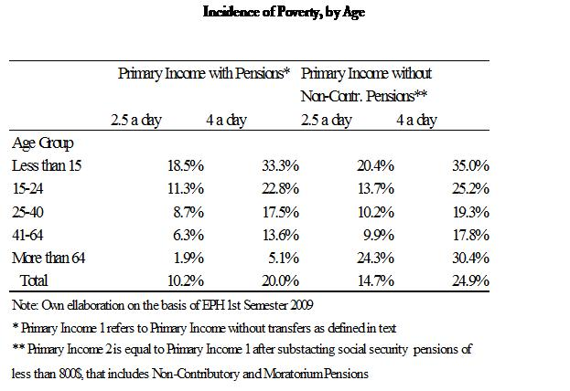
Pessino (2010)

Slide 40
Cash Transfer Programs: Total Beneficiaries
(Gasparini y Cruces, 2010)

Slide 41
Monthly Benefits per Household (with 3 children) – In 2010 pesos
(Gasparini y Cruces, 2010)

Slide 42
Impact of Transfers on Poverty and Inequality - 2009

Slide 43
Pessino (2010)

Slide 44
The “excluded”

Slide 45
The “excluded” (probits)
Before transfers poverty is associated with being a woman, living in shantytowns, migrant from neighbouring countries, older than 65, less educated, from the north and unemployed
After transfers poverty is associated with being male, not living in shantytowns, not being a recent migrant, younger than 41, and more educated

Slide 47
Redistribution and Fiscal Sustainability
Closing the extreme (pov line US$2.50) and total poverty (pov line US$4) gaps--with perfect targeting--would cost:
  0.7 and 1.7 percent of GDP, respectively
  2.2 and 5.3 percent of tax revenues, respectively
  3.2 and 7.8 percent of redistributive spending, respectively
Seems compatible with fiscal sustainability

Slide 49
CEQ Mexico (Scott, 2010)

Slide 50
Total resources available and needs (gaps)
 | Line | Resources (million pesos) | Needs (gaps)
 |  |  | Poverty & HK Gap | Poverty Gap | HK Gap |  |  | Pension Gap | PG Shock 2008-2009
 |  |  |  |  | Total | Education Gap | Health Gap
Gap after transfers | <2.5 |  |  |  | 52,235 | 34,388 | 13,660 | 4,187
 | <4 |  |  |  | 99,678 | 62,607 | 29,267 | 7,804
Gap before transfers | <2.5 |  | 231,888 | 42,138 | 159,413 | 105,132 | 54,280 | 15,133 | 15,204
 | <4 |  | 532,896 | 134,824 | 309,430 | 197,341 | 112,089 | 39,998 | 48,645
 |  |  | Resources/Gaps
Total Revenue | <2.5 | 2,824,741 | 12.18 | 67.03 | 17.72 | 26.87 | 52.04 | 186.66 | 185.79
 | <4 |  | 5.30 | 20.95 | 9.13 | 14.31 | 25.20 | 70.62 | 58.07
Redistributive Spending | <2.5 | 1,699,091 | 7.33 | 40.32 | 10.66 | 16.16 | 31.30 | 112.27 | 111.76
 | <4 |  | 3.19 | 12.60 | 5.49 | 8.61 | 15.16 | 42.48 | 34.93
Social Spending | <2.5 | 1,326,540 | 5.72 | 31.48 | 8.32 | 12.62 | 24.44 | 87.66 | 87.25
 | <4 |  | 2.49 | 9.84 | 4.29 | 6.72 | 11.83 | 33.17 | 27.27
Targeted (anti-poverty, net of admin 10%) | <2.5 | 183,009 | 0.79 | 4.34 | 1.15 | 1.74 | 3.37 | 12.09 | 12.04
 | <4 |  | 0.34 | 1.36 | 0.59 | 0.93 | 1.63 | 4.58 | 3.76
Education | <2.5 | 432,446 |  |  |  | 4.11
 | <4 |  |  |  |  | 2.19
Health | <2.5 | 324,201 |  |  |  |  | 5.97
 | <4 |  |  |  |  |  | 2.89
Social Security: Old Age | <2.5 | 338,483 |  |  |  |  |  | 22.37
 | <4 |  |  |  |  |  |  | 8.46

Slide 51
Resources reaching the poor and needs (gaps)
 | Line | Resources reaching the poor |  | Needs (gaps)
 |  |  |  | Poverty & HK Gap | Poverty Gap | HK Gap |  |  | Pension Gap | PG Shock 2008-2009
 |  | Share of total spent (%) | Million pesos |  |  | Total | Education Gap | Health Gap
Gap after transfers | <2.5 |  |  |  |  | 52,235 | 34,388 | 13,660 | 4,187
 | <4 |  |  |  |  | 99,678 | 62,607 | 29,267 | 7,804
Gap before transfers | <2.5 |  |  | 231,888 | 42,138 | 159,413 | 105,132 | 54,280 | 15,133 | 15,204
 | <4 |  |  | 532,896 | 134,824 | 309,430 | 197,341 | 112,089 | 39,998 | 48,645
 |  |  |  | Resources/Gaps
Redistributive Spending | <2.5 | 10.5% | 177,610 | 0.77 | 4.21 | 1.11 | 1.69 | 3.27 | 11.74 | 11.68
 | <4 | 21.1% | 358,442 | 0.67 | 2.66 | 1.16 | 1.82 | 3.20 | 8.96 | 7.37
Social Spending | <2.5 | 12.5% | 165,508 | 0.71 | 3.93 | 1.04 | 1.57 | 3.05 | 10.94 | 10.89
 | <4 | 24.6% | 326,229 | 0.61 | 2.42 | 1.05 | 1.65 | 2.91 | 8.16 | 6.71
Targeted (anti-poverty, net of admin 10%) | <2.5 | 37.2% | 68,014 | 0.29 | 1.61 | 0.43 | 0.65 | 1.25 | 4.49 | 4.47
 | <4 | 59.4% | 108,713 | 0.20 | 0.81 | 0.35 | 0.55 | 0.97 | 2.72 | 2.23
Education | <2.5 | 16.4% | 70,744 |  |  |  | 0.67
 | <4 | 31.2% | 134,734 |  |  |  | 0.68
Health | <2.5 | 12.5% | 40,620 |  |  |  |  | 0.75
 | <4 | 25.5% | 82,822 |  |  |  |  | 0.74
Social Security: Old Age | <2.5 | 3.2% | 10,946 |  |  |  |  |  | 0.72
 | <4 | 9.5% | 32,193 |  |  |  |  |  | 0.80

Slide 52
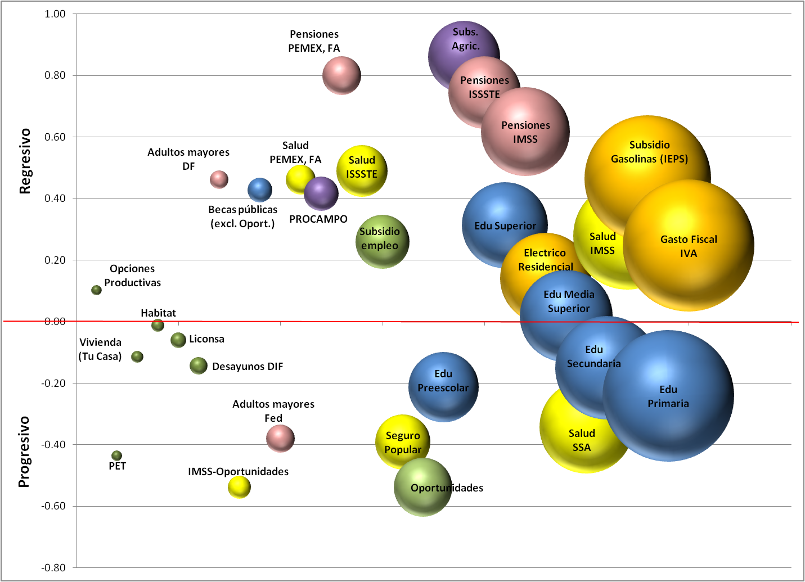
Most redistributive spending is not progressive in absolute terms (and some of it is regressive—shown in next slide--): concentration indeces (vertical) and budgetary effort (size of bubbles) in principal redistributive programs (color)

Slide 53
Concentration Coefficients

Slide 56
Proportion of poor households not covered by transfers (in %)
Living below US$2.5/day ………….. 37.2
Living below US$4/day ………….. 49.3
Memo: Percentage of poor households not covered by Oportunidades, Procampo and Minimum Pension (non-contributory)

Slide 57
The “excluded” (probit)

Slide 58
The “excluded” (probit)
Before transfers poverty is associated with living in the south, rural and indigenous
After transfers poverty is associated with living in urban areas, young, indigenous and more educated households

Slide 59
Thank you

