Slide 1
Inequality and Poverty in Mexico: 1982-2010
Nora Lustig
Samuel Z. Stone Professor of Latin American Economics
Tulane University
New Orleans, November 17, 2011

Slide 2
Inequality and Poverty Trends
Two distinct phases:
  1982-1994 - Debt crisis and structural reforms: inequality and poverty rose.
  1994-2006 - Post-NAFTA, economic crisis, recovery and slow-growth: inequality and poverty declined.
More recently
  2006-2010 - Great Recession: poverty rose and the decline in inequality lost steam.
Sources: Lustig (2010), Campos, Esquivel and Lustig (2011, in progress)

Slide 3
Inequality (Gini) and Poverty (Headcount): 1984-1992
Gini Coefficient
Headcount Ratio

Slide 4
Rise in Poverty: Debt Crisis or Policy?
Debt crisis would have caused an increase in poverty no matter what. However:
Evidence of “overadjustment:” fiscal policy more contractionary than required to restore macroeconomic balance.
Brunt of adjustment was placed on Mexico; no “haircuts” for creditors until ten years later.
Fiscal cuts did not protect spending on the poor.
Elimination of general subsidies on staples and dismantling of agricultural support schemes were not replaced by compensatory programs
=> Policies exacerbated the impact of debt crisis on poverty.

Slide 5
Slight Decline in Poverty in the Early 1990s: Did Policy Help?
Poverty declined slightly nationally, but rose in rural areas and the South and Southeast.
Coincided with rural uprisings and revolts; Zapatista uprising the most salient.
PRONASOL—Salinas’ administration flagship anti-poverty program– focused on building infrastructure in rural communities.
But no safety nets to deal with sharp fall in international coffee prices and dismantling of price support and subsidies in agriculture.
=> Policy did not help.

Slide 6
Inequality (Gini) and Poverty (Headcount): 1984-1992
Gini Coefficient
Headcount Ratio

Slide 7
Rise in Inequality: 1980s and Early 1990s Market Forces or Policy?
Unequalizing effect of increase in skilled/unskilled wage gap:
  Between 1984 and 1995, real wages for skilled workers rose by around 8 percent and unskilled wages decreased by around 22 percent.
Increase in wage gap (skill premium) was linked to:
  Trade liberalization and other factors which shifted labor demand towards workers with higher skills.
  Reduction in real minimum wages and weaker unions.
=> Policy contributed to increase in earnings--and hence overall--inequality.

Slide 8
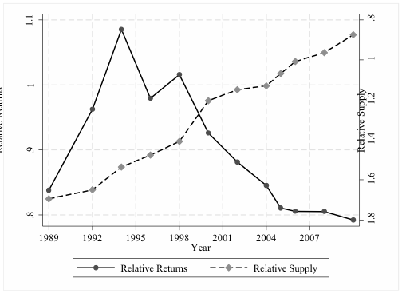
Relative Returns and Relative Supply

Slide 9
Decomposition of Differences in the Distribution of Earnings: 1989-1994
Returns (Wage gap)

Slide 10
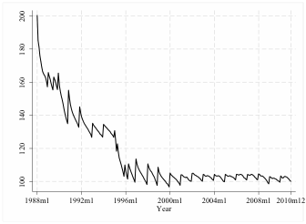
Real Minimum Wage Index (Dec. 2010=100)

Slide 11
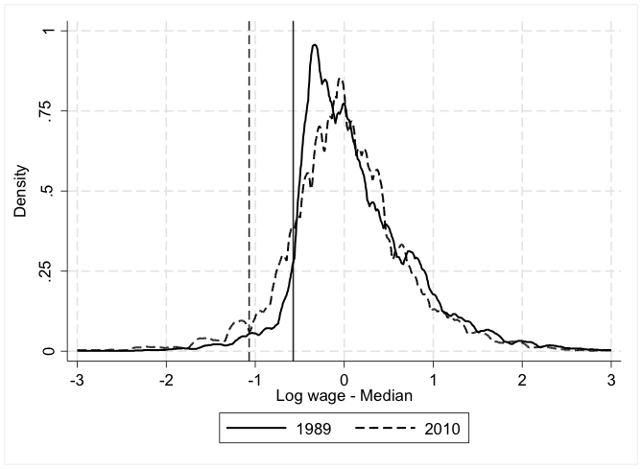
Wage distribution with respect to median: 1989 and 2010
Real Minimum Wage 2010=100

Slide 12
Unionization Rate

Slide 13
Decline in Inequality: 1994/96-2006
Market Forces or Policy?
Labor earnings, government transfers and remittances have been equalizing.
Labor earnings have been equalizing because skilled/unskilled wage gap decline.
Decline in wage gap linked to rise in relative supply of skilled workers.
Real minimum wages remained constant; irrelevant to earnings inequality trends.
With launching of CCT Progresa/Oportunidades, government transfers became more progressive.

Slide 14
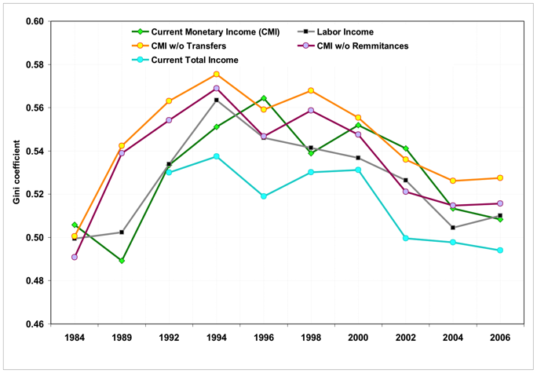
Gini Coefficient: 1984-2006

Slide 15
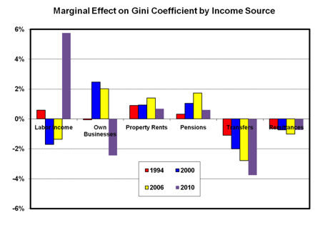

Slide 16
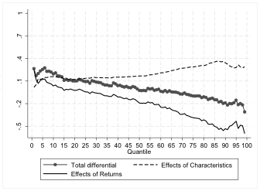
Decomposition of Differences in the Distribution of Earnings: 1994-2006
Returns (Wages gap)

Slide 17
Relative Returns and Relative Supply

Slide 18
Wage distribution with respect to median: 1989 and 2010

Slide 19
Decline in Inequality Loses Steam: 2006-2010
New Trend or Great Recession? Too early to tell.
But, could be the result of slowing down of educational upgrading; barriers to tertiary education access due to low quality of basic education and opportunity cost of not working

Slide 20
Decomposition of Differences in the Distribution of Earnings: 2006 - 2010
Returns (Wage Gap)

Slide 21
Government Transfers: Change in Gini (Mexico 2008; in %)

Slide 22
Government Transfers: Change in Headcount Ratio (Mexico 2008; in %)

Slide 24
Conclusions
Rise in poverty and inequality in 1980s and early 1990s:
  Debt crisis
  Overadjustment: excessive fiscal contraction.
  Labor market policy: falling minimum wage and unionization rate.
  Structural reforms-cum-wrong type of/missing safety nets: trade liberalization, dismantling of general subsidies with flagship anti-poverty program not focused on income support (PRONASOL).

Slide 25
Conclusions
Decline in poverty and, particularly, inequality in post-NAFTA 1994-2006:
  Mild growth.
  Educational expansion resulted in a reduction of skilled/unskilled wage gap.
  Government transfers became more progressive and helped increase incomes of the poorest: Conditional Cash Transfer Program PROGRESA/OPORTUNIDADES.
  However, there is still a large share of extreme poor not covered by existing safety net.

Slide 26
Conclusions
Decline in inequality loses steam: 2006-2010; poverty increases in 2008 and 2010.
  Educational upgrading might be constrained by both demand and supply factors => skilled/unskilled wage gap will not continue to decline and it may start rising again.
  Safety nets not designed to cope with shocks: rising food prices and falling employment and incomes due to macroeconomic shock (Great Recession).

Slide 27
THANK YOU

