Slide 1
Declining Inequality in Latin America:
How Much, Since When and Why
Nora Lustig
Professor, Tulane University
Nonresident Fellow, CGD and IAD
China Development Research Foundation
Beijing, July 2, 2012

Slide 2
Gini Coefficient by Region (in %), 2004

Slide 3
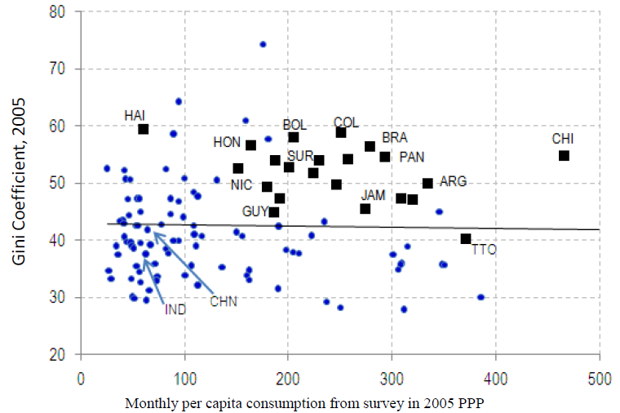
Excess Inequality (IDB, 2011)

Slide 4
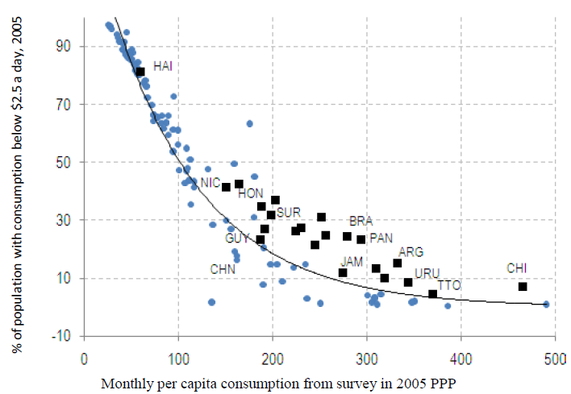
Excess Poverty (IDB, 2011)

Slide 5
Declining Inequality in LA: How Much?
Inequality in all Latin American countries has declined between (circa) 2000 and (circa) 2011
Decline continued through the global financial crisis in 2009
Inequality declined in LA while it rose in other regions

Slide 6
Inequality in LA: 1980-2010
Gini coefficient – Household per capita income
Unweighted averages
Source: own estimates based on SEDLAC (CEDLAS and World Bank).

Slide 7
A consistent fall in inequality in the 2000s
Gini coefficient – Household per capita income
Unweighted averages
Source: own estimates based on SEDLAC (CEDLAS and World Bank).

Slide 8
Poverty, growth and inequality
Latin America, 4 USD PPP international poverty line
Source: own estimates based on SEDLAC (CEDLAS and World Bank).

Slide 9
Decomposition of poverty changes
Source: Gasparini et al. (2012).

Slide 10
More homogeneity in the 2000s
Change in Gini coefficient

Slide 11
First Year in Which Inequality Started to Decline (Lustig et al, 2011)

Slide 12
The decline in inequality has been widespread
Fast growing countries (Chile and Peru), slow growing countries (Brazil and Mexico) and countries recovering from crisis (Argentina and Venezuela)
Persistently high inequality countries (Brazil) and normally low inequality countries (Argentina)
Countries with left “populist” governments (Argentina), left social-democratic governments (e.g., Brazil, Chile) and center/center-right governments (e.g., Mexico and Peru)

Slide 13
Driving Factors
Decline in labor income inequality associated with a fall in the so-called premium to skills
  Decomposition exercises reveal that the quantity effect was unequalizing in many countries (Paradox of progress in education) but the price effect (change in skill premium) was equalizing
Decline in non-labor income inequality associated with more generous and targeted cash transfers

Slide 14
What explains decline in skill premium
Not the same in all countries:
  Relative demand of educated workers rose more slowly in the 2000’s ( several countries)
  Relative supply of educated workers rose faster than demand in the 2000’s (Mexico)
  Minimum wages, unions (Argentina, Ecuador, Venezuela)
  Reduction in unemployment/commodity boom
  “Degraded” tertiary (Chile)

Slide 15
Wage premium: 1990s and 2000s
Annual change in skilled/unskilled conditional wage gap
Latin America (16 countries)
Source: Gasparini, Galiani, Cruces and Acosta (2011).

Slide 16
Relative supplies increasing at similar rates for the average of 16 countries; Mexico, however, supply rose faster in the 2000s
Annual changes in skilled/unskilled wage gap, and relative supplies
Latin America (16 countries)
Source: Gasparini, Galiani, Cruces and Acosta (2011).

Slide 17
More active labor policy
Minimum wage, unions, income policies
Increase in real value of minimum wage (2002-2010)

Slide 18
Employment
Reduction in unemployment
Increase in female labor market participation (especially poor)
Unemployment rate (Latin America)

Slide 19
Taxes, Transfers and Income Redistribution
Ongoing project for 12 countries; results are available for 6
Standard Fiscal Incidence Analysis
Household surveys from around 2008-2011

Slide 20
Cash Transfers and Inequality (decline in Gini in %)

Slide 21
Cash Transfer and Decline in Ext Poverty (Change in headcount ratio in %)

Slide 22
Coverage of Cash Transfers among Extreme Poor (in %)

Slide 23
Taxes and Cash and in-kind Transfers (Gini)

Slide 24
References:
Declining Inequality in Latin America: A Decade of Progress? Edited by Luis F. López-Calva and Nora Lustig, Brookings Institution and UNDP, 2010.
“Declining Inequality in Latin America: How Much, Since When and Why?,” Lustig, Lopez-Calva and Ortiz, Working Paper, Tulane University, 2011. http://ideas.repec.org/p/tul/wpaper/1118.html
“The Rise and Fall of Income Inequality in Mexico: 1989-2010,” Campos, Esquivel and Lustig, Working Paper, WIDER, January 2012.http://www.wider.unu.edu/publications/working-papers/2012/en_GB/wp2012-010/
“Recent trends in inequality in LA,” ppt presentation by Leonardo Gasparini, Universidad Carlos III, Madrid, May 2012.
“Taxes, transfers and income redistribution in Latin America,” Lustig, N. (c00rdinator), 2012

Slide 26
THANK YOU

