Slide 1
Declining Inequality in Latin America
Nora Lustig
Samuel Z. Stone Professor of Latin American Economics, Tulane University
Nonresident Fellow, CGD and IAD
GDN Global Policy Dialogue Series: Vignettes in Global Development
Friday, 13 January 2012; New Delhi, INDIA

Slide 2
Sponsors and sources:
UNDP-Sponsored Project (coordinated with Luis F. Lopez-Calva)
Declining Inequality in Latin America: A Decade of Progress? Edited by Luis F. López-Calva and Nora Lustig, Brookings Institution and UNDP, 2010
“Declining Inequality in Latin America: Some Economics, Some Politics,” Birdsall, Lustig and McLeod in Handbook of Latin American Politics, forthcoming
“Declining Inequality in Latin America: How Much, Since When and Why?,” Lustig, Lopez-Calva and Ortiz, working paper, Tulane University.
“Poverty and Inequality under Latin America’s New Left Regimes,” McLeod, Darryl and Nora Lustig (2010). Paper prepared for the 15th Annual LACEA Meeting, Medellin, Colombia: Universidad de Antioquia and Universidad Eafit. Under revision, 2011
“Cambios en la desigualdad del ingreso en América Latina. Contribución de sus principales determinantes: 1995 – 2006” (2009) Alejo et al., PNUD

Slide 4
Outline
Declining Inequality in LA: How Much? Since When?
Declining Inequality: Why?
  Argentina, Brazil, Mexico and Peru
    Falling skill premia
    More progressive government transfers
The Future: Will Inequality Continue to Decline?

Slide 5
Gini Coefficient by Region (in %), 2004

Slide 6
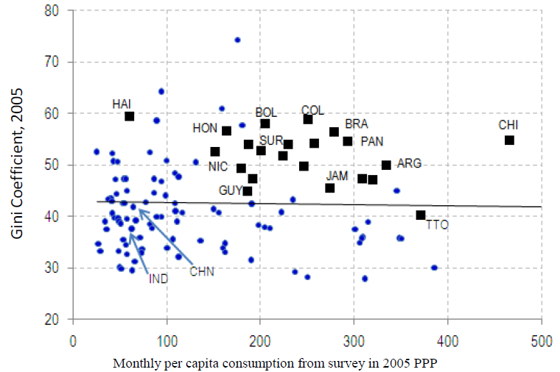
Excess Inequality (IDB, 2011)

Slide 7
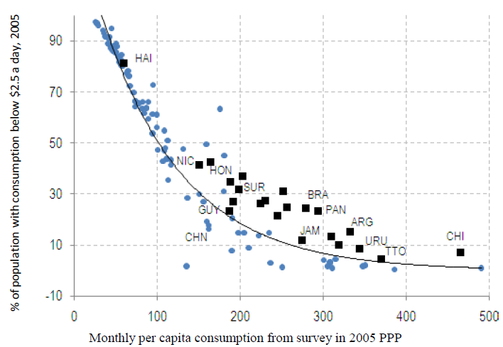
Excess Poverty (IDB, 2011)

Slide 8
Declining Inequality in LA
Inequality in most Latin American countries (13 out of 17) has declined (roughly 1% a year) between (circa) 2000 and (circa) 2008
Decline is statistically significant
Decline continued through the global financial crisis in 2009
Inequality declined in LA while it rose in other regions

Slide 9
Trends in Inequality
Gini Coefficient Early 1990’s-Late 2000’s
Light Grey: Countries with Falling Ineq (Lustig et al., 2011)

Slide 10
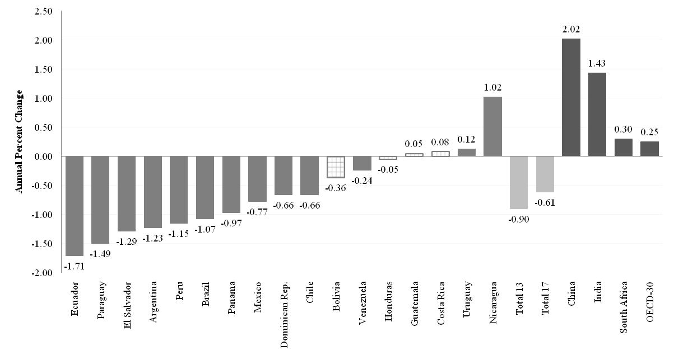
Change in Gini Coefficient by Country: circa 2000-2009 (yearly change in percent)

Slide 11
Comparing the Increase in the 1990’s with Decline in the 2000’s (Lustig et al., 2011)

Slide 12
Declining Inequality in LA: Since When?
In three countries, during second half of 1990s: Mexico, Brazil and Chile
In six, started in 2002-2003: Argentina, Bolivia, El Salvador, Paraguay, Panama and Peru
In others, although there are fluctuations, inequality between 2000 and 2009 increased: Costa Rica, Honduras and Uruguay

Slide 13
First Year in Which Inequality Started to Decline (Lustig et al, 2011)

Slide 14
The decline in inequality has been widespread
The decline took place in:
Persistently high inequality countries (Brazil) and normally low inequality countries (Argentina)
Fast growing countries (Chile and Peru), slow growing countries (Brazil and Mexico) and countries recovering from crisis (Argentina and Venezuela)
Countries with left “populist” governments (Argentina), left social-democratic governments (e.g., Brazil, Chile) and center/center-right governments (e.g., Mexico and Peru)

Slide 15
Why has inequality declined in Latin America? Are there factors in common?
In-depth analysis in four countries:
  Argentina (Gasparini and Cruces) (urban; 2/3 of pop)
  Brazil (Barros, Carvalho, Mendoca & Franco)
  Mexico (Esquivel, Lustig and Scott)
  Peru (Jaramillo & Saavedra)
  Source: Lopez-Calva and Lustig (2010)

Slide 16
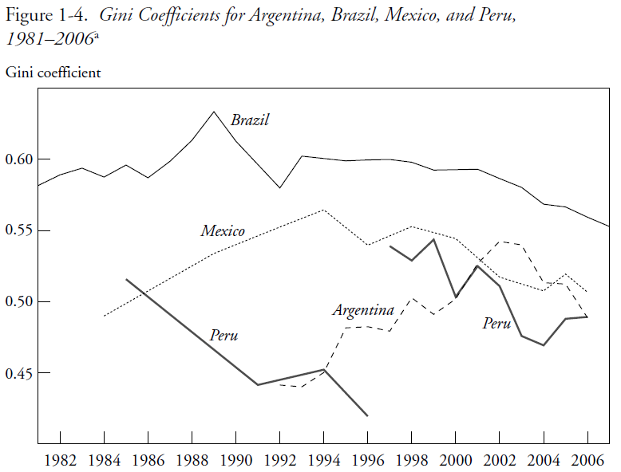

Slide 17
Sample Representative of High and Low Growth Countries
Argentina and Peru were growing at around 6 percent a year since 2003
Brazil and Mexico were growing at less than 3 percent a year (Brazil’s growth rate picked up only from 2008 onwards)

Slide 18
Income of the Brazilian poor has been growing as fast as per capita GDP in China while income of the richest ten percent has been growing like Germany’s per capita GDP
Notes:
18

Slide 19
Mexico: Growth Incidence Curve 2000-2008

Slide 20
Peru: Growth Incidence Curve 2001-2009

Slide 21
Proximate and fundamental determinants of changes in inequality
There are many different factors that affect the distribution of income over time: “… the evolution of the distribution of income is the result of many different effects—some of them quite large—which may offset one another in whole or in part.” (Bourguignon et al., 2005)
Useful framework: to consider the ‘proximate’ factors that affect the distribution of income at the individual and household level:
  Socio-demographic factors: dependency ratios and proportion of working adults
  Distribution of assets and personal characteristics.
  Return to assets and characteristics
  Transfers (private and public)

Slide 22
Decomposition results (Alejo et al., 2009):
Demographics: Changes in the ratio of adults per household were equalizing, albeit the orders of magnitude were generally smaller except for Peru.
Labor force participation: With the exception of Peru, changes in labor force participation (the proportion of working adults) were equalizing. This effect was stronger in Argentina.

Slide 23
Decomposition results (Alejo et al., 2009):
Labor income (Earnings):
  In Argentina, Brazil, and Mexico between 44% and 65% of the decline in overall inequality is due to a reduction in earnings per working adult inequality.
  In Peru, changes in earnings inequality were unequalizing at the household level but not so at the individual workers’ level.
Non-labor income: Changes in the distribution of non-labor income were equalizing; the contribution of this factor was quite high in Brazil and Peru (45% and 90%, respectively).

Slide 24
Decomposition results (Alejo et al., 2009):
=> Decline in labor inc0me (except for Peru at the household level) and non-labor income inequality important determinants of the decline in overall income inequality (in per capita household income)

Slide 25
Why has inequality declined? Main findings
Educational upgrading and a more equal distribution of educational attainment have been equalizing (quantity effect).
Changes in the steepness of the returns to education curve have been equalizing at the individual workers level (price effect). Except for Peru, they have been equalizing at the household level too.
Changes in government transfers were equalizing: more progressive government transfers (monetary and in-kind transfers); expansion of coverage, increase in the amount of transfers per capita, better targeting.

Slide 26
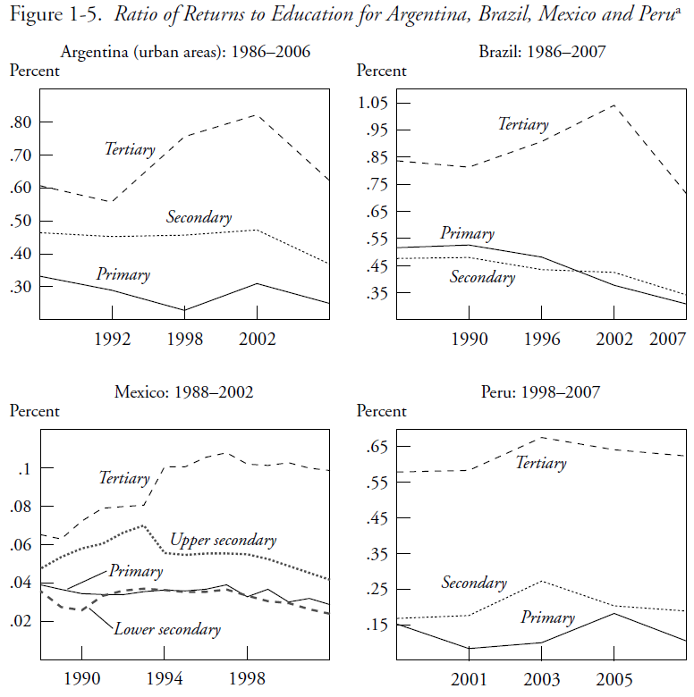

Slide 27
Why has the skill premium declined?
Increase in relative demand for skilled labor petered out: Fading of the unequalizing effect of skill-biased technical change in the 1990s: Argentina, Mexico & Peru.
Decline in relative supply of low-skilled workers: Expansion of basic education since the 1990s: Brazil, Mexico and Peru .

Slide 29
Why has earnings inequality declined?
Other effects:
Decline in spatial labor market segmentation in Brazil.
In Argentina, the decline also driven by a pro-union government stance and by the impetus to low-skill intensive sectors from devaluation. In Brazil, increase in minimum wages.

Slide 30
Why has inequality in non-labor incomes declined?
In the four countries government transfers to the poor rose and public spending became more progressive
    In Argentina, the safety net program Jefes y Jefas de Hogar, Universal Child Allowances, pension moratorium.
    In Brazil and Mexico, large-scale conditional cash transfers (Bolsa Familia and BPC in Brazil and Oportunidades in Mexico) can account for between 10 and 20 percent of reduction in overall inequality. An effective redistributive machine because they cost around .5% of GDP.
    In Peru, in-kind transfers for food programs and health. Also access to basic infrastructure for the poor rose.

Slide 31
Conclusions
In the race between skill-biased technological change and educational upgrading, in the last ten years the latter has taken the lead (Tinbergen’s hypothesis)
Perhaps as a consequence of democratization and political competition, government (cash and in-kind) transfers have become more generous and better targeted to the poor

Slide 32
Is Inequality Likely to Continue to Fall?
Despite the observed progress, inequality continues to be very high and the bulk of government spending is not progressive enough.
The decline in inequality resulting from educational upgrading will eventually hit the ‘access to tertiary education barrier’ which is much harder to overcome: inequality in quality and ‘opportunity cost’ are high and costly to address.
=> United States experience should serve as warning (Goldin and Katz, 2008)

Slide 33
THANK YOU

