Slide 1
Declining Inequality in Latin America:
How Much, Since When and Why
Nora Lustig
Professor, Tulane University
Nonresident Fellow, CGD and IAD
Latin America in a New Global Economic Order
CAF and University of Oxford
February 17, 2012

Slide 2
References:
Declining Inequality in Latin America: A Decade of Progress? Edited by Luis F. López-Calva and Nora Lustig, Brookings Institution and UNDP, 2010.
“Declining Inequality in Latin America: How Much, Since When and Why?,” Lustig, Lopez-Calva and Ortiz, Working Paper, Tulane University, 2011. http://ideas.repec.org/p/tul/wpaper/1118.html
The Rise and Fall of Income Inequality in Mexico: 1989-2010, Campos, Esquivel and Lustig, Working Paper, WIDER, January 2012.http://www.wider.unu.edu/publications/working-papers/2012/en_GB/wp2012-010/

Slide 4
Outline
Declining inequality in LA:
  How much?
  Since when?
Declining inequality: Why?
  Argentina, Brazil, Mexico and Peru
    Fall in skill premium
    More progressive government transfers
The future: Will inequality continue to decline?
  Mexico trends after 2006 not optimistic

Slide 5
Gini Coefficient by Region (in %), 2004

Slide 6
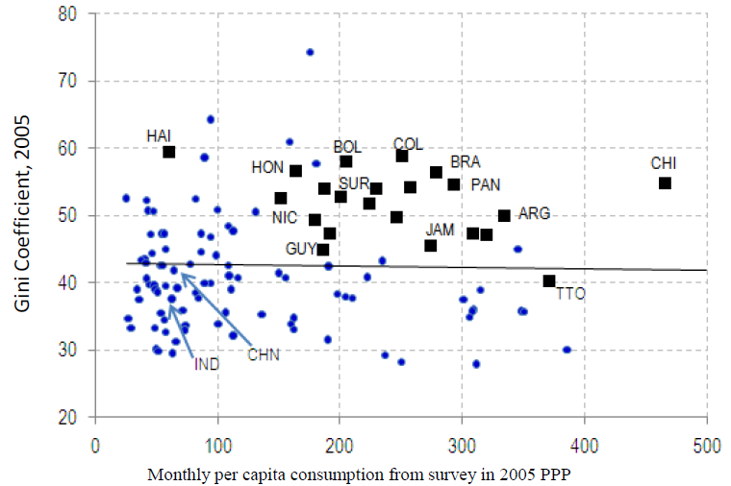
Excess Inequality (IDB, 2011)

Slide 7
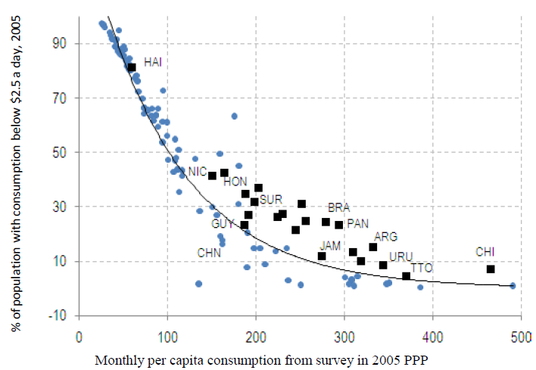
Excess Poverty (IDB, 2011)

Slide 8
Declining Inequality in LA: How Much?
Inequality in most Latin American countries (13 out of 17) has declined (roughly 1% a year) between (circa) 2000 and (circa) 2009
Decline continued through the global financial crisis in 2009
Inequality declined in LA while it rose in other regions

Slide 9
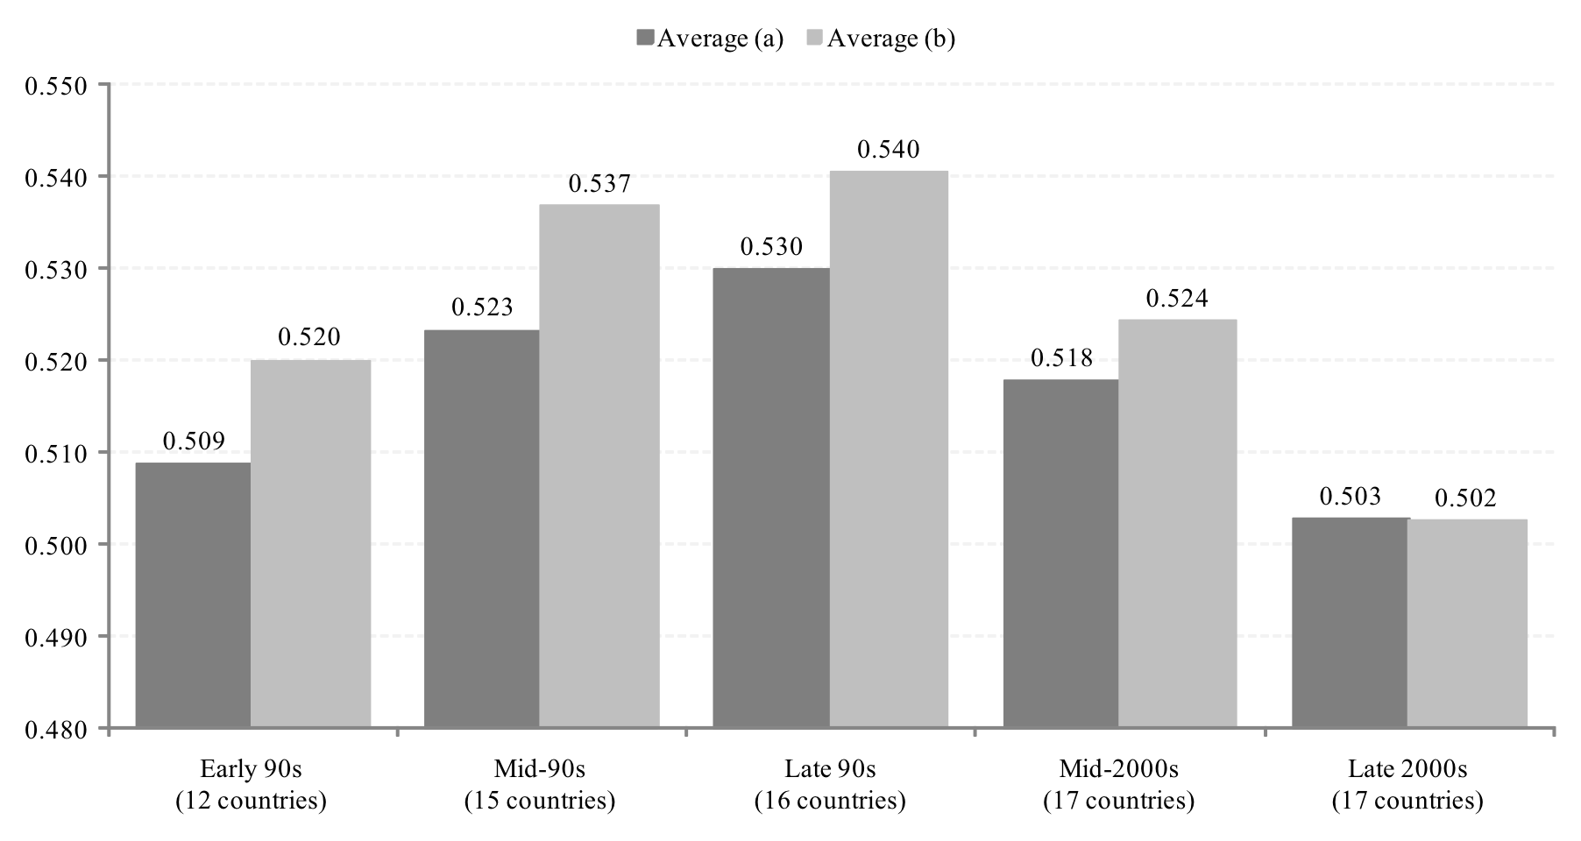
Trends in Inequality
Gini Coefficient Early 1990’s-Late 2000’s (Unweighted ave.)
Light Grey: Countries with Falling Ineq (Lustig et al., 2011)

Slide 10
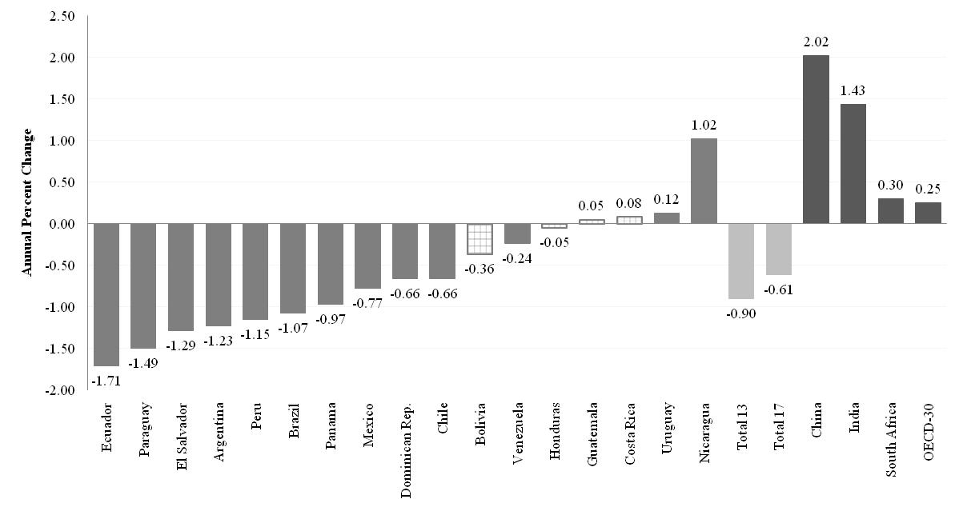
Change in Gini Coefficient by Country: circa 2000-2009 (yearly change in percent)

Slide 11
Comparing the Increase in the 1990’s with Decline in the 2000’s (Lustig et al., 2011)

Slide 12
Declining Inequality in LA: Since When?
In three countries, during second half of 1990s: Mexico, Brazil and Chile
In six, started in 2002-2003: Argentina, Bolivia, El Salvador, Paraguay, Panama and Peru
In others, although there are fluctuations, inequality between 2000 and 2009 increased: Costa Rica, Honduras and Uruguay

Slide 13
Gini 1996=100 (Lustig et al, 2011)

Slide 14
Gini 1999=100 (Lustig et al, 2011)

Slide 15
Rising Inequality 2000-2009

Slide 16
First Year in Which Inequality Started to Decline (Lustig et al, 2011)

Slide 17
The decline in inequality has been widespread
Fast growing countries (Chile and Peru), slow growing countries (Brazil and Mexico) and countries recovering from crisis (Argentina and Venezuela)
Persistently high inequality countries (Brazil) and normally low inequality countries (Argentina)
Countries with left “populist” governments (Argentina), left social-democratic governments (e.g., Brazil, Chile) and center/center-right governments (e.g., Mexico and Peru)

Slide 18
Gini (Circa 2000)

Slide 19
Yearly Change in Gini: Left and Non-left Regimes (circa 2000-2009)

Slide 20
Why has inequality declined in Latin America? Are there factors in common?
In-depth analysis in four countries:
  Argentina (Gasparini and Cruces) (urban; 2/3 of pop)
  Brazil (Barros, Carvalho, Mendoca & Franco)
  Mexico (Esquivel, Lustig and Scott)
  Peru (Jaramillo & Saavedra)
  Source: Lopez-Calva and Lustig (2010)

Slide 21
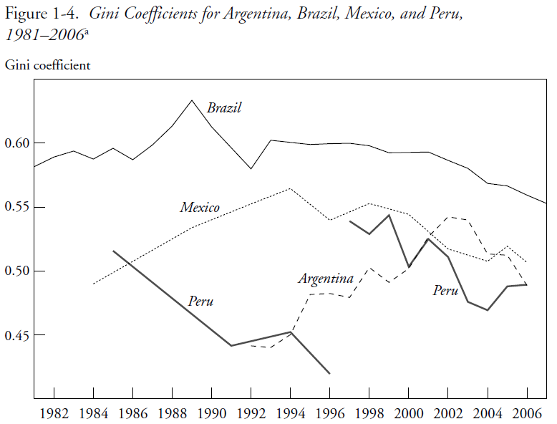

Slide 22
Decline is robust
Statistically significant and significant in terms of order of magnitude
Lorenz dominance (unambiguous decline independently of choice of inequality measure)
Robust to income concept (e.g., monetary vs. total—which includes nonmonetary elements--)

Slide 23
Four countries are a ...
Sample of Latin American diversity:
  High (Brazil)/medium (Mx & Peru)/low ineq (Arg)
  High (Arg and Peru)/low growth (Brazil & Mx)
  Left (Arg & Bra) and nonleft (Mx & Peru) governments

Slide 24
Sample Representative of High and Low Growth Countries
Argentina and Peru were growing at around 6 percent a year since 2003
Brazil and Mexico were growing at less than 3 percent a year (Brazil’s growth rate picked up only from 2008 onwards)

Slide 25
Income of the Brazilian poor has been growing as fast as per capita GDP in China while income of the richest ten percent has been growing like Germany’s per capita GDP
Notes:
25

Slide 26
Mexico: Growth Incidence Curve 2000-2008

Slide 27
Peru: Growth Incidence Curve 2001-2009

Slide 28
Proximate and fundamental determinants of changes in inequality
There are many different factors that affect the distribution of income over time: “… the evolution of the distribution of income is the result of many different effects—some of them quite large—which may offset one another in whole or in part.” (Bourguignon et al., 2005)
Useful framework: to consider the ‘proximate’ factors that affect the distribution of income at the individual and household level:
  Distribution of assets and personal characteristics
  Return to assets and characteristics
  Utilization of assets and characteristics
  Transfers (private and public)
  Socio-demographic factors

Slide 29
Household per capita income and its determinants
DEMOGRAPHIC
Per capita household income
Proportion of adults in the household
FERTILITY
Household income per adult
DEMOGRAPHIC
MARKET
POLITICS/INST./SOC. NORMS
STATE
(EDUCATION)
MARKET
POLITICS/
INST.
STATE
Household non-labor income per adult
RENTS & PROFITS
REMITTANCES
GOV. TRANSFFERS
Household labor income per adult
Proportion of working adults
PARTICIPATION IN LABOR FORCE
EMPLOYMENT OPPORT
Labor income per working adult in the household
WAGES BY SKILL/OTHER
HOURS WORKED
DEMOGRAPHIC
MARKET

Slide 30
Decomposition results (Alejo et al., 2009):
Demographics:
  Changes in the ratio of adults per household were equalizing, albeit the orders of magnitude were generally smaller except for Peru.

Slide 31
Decomposition results (Alejo et al., 2009):
Labor force participation:
  With the exception of Peru, changes in labor force participation (the proportion of working adults) were equalizing.
  This effect was stronger in Argentina.

Slide 32
Decomposition results (Alejo et al., 2009):
Labor income (Earnings):
  In Argentina, Brazil, and Mexico between 44% and 65% of the decline in overall inequality is due to a reduction in earnings per working adult inequality.
  In Peru, however, changes in earnings inequality were unequalizing at the household level but not at the individual workers’ level.
=> decline in skill premium a driving force

Slide 33
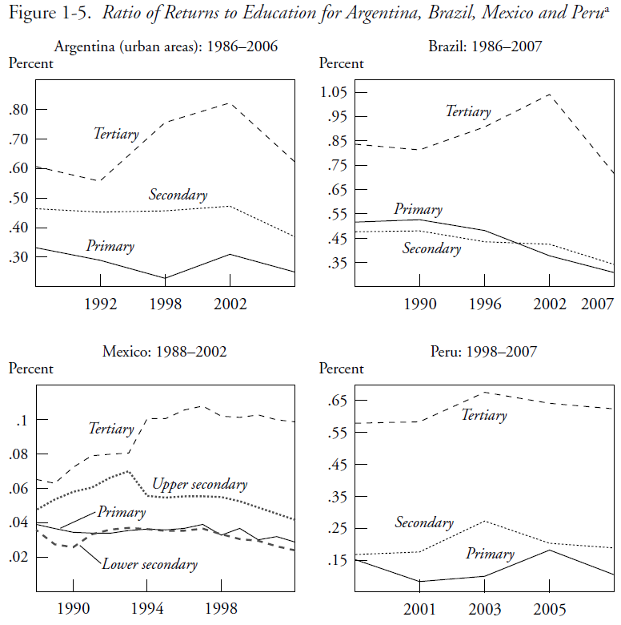

Slide 34
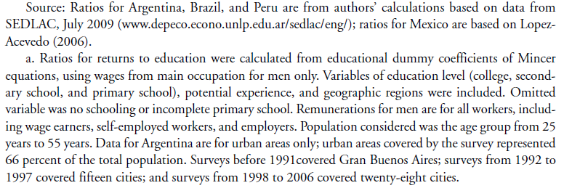

Slide 35
Decomposition results (Alejo et al., 2009):
Non-labor income:
  Changes in the distribution of non-labor income were equalizing;
  the contribution of this factor was quite high in Brazil and Peru (45% and 90%, respectively).
=> more generous and progressive transfers, an important factor

Slide 36
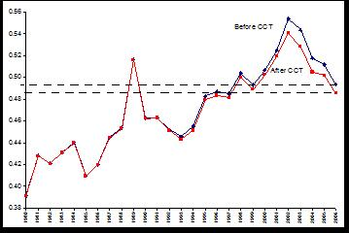
Argentina: Distributional impact of Conditional cash transfers

Slide 37
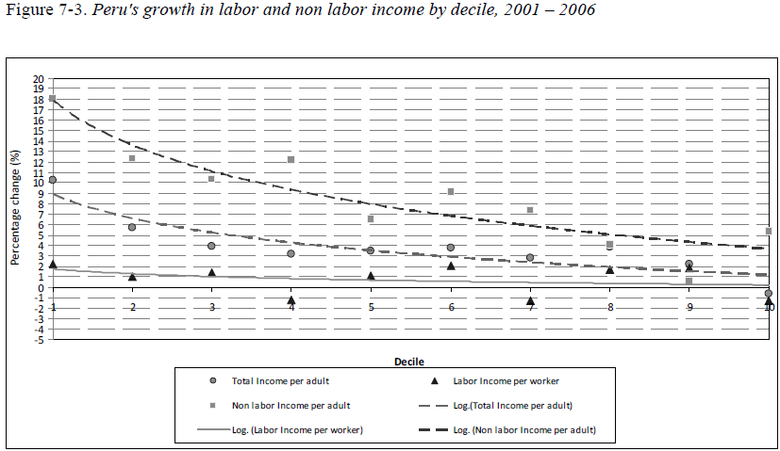
Peru: Decline in non-labor income inequality: progressivity rose in non-monetary transfers

Slide 38
Why has the skill premium declined?
Increase in relative supply of high-skilled workers
Decline in relative demand for skilled labor petered out
Institutional factors that compress the wage structure: minimum wages and unionization

Slide 40
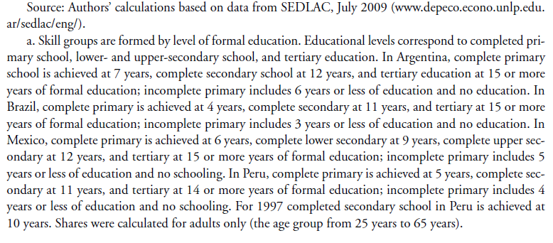

Slide 41
Other factors specific to country
Argentina: Pro-union government stance and by the impetus to low-skill intensive sectors from devaluation. Increase in minimum wages.
Brazil: Decline in spatial labor market segmentation and increase in minimum wage.
Mexico: The expansion of post-NAFTA maquiladoras.

Slide 42
Why has inequality in non-labor incomes declined?
Government transfers became more progressive and generous for the poor:
  In Argentina, the safety net program Jefes y Jefas de Hogar.
  In Brazil and Mexico, large-scale conditional cash transfers => can account for between 10 and 20 percent of reduction in overall inequality. An effective redistributive machine because they cost around .5% of GDP.
  In Peru, in-kind transfers for food programs and health. Also access to basic infrastructure for the poor rose..

Slide 43
Conclusions
In the race between skill-biased technological change and educational upgrading, in the last ten years the latter has taken the lead (Tinbergen’s hypothesis)
Perhaps as a consequence of democratization and political competition, government (cash and in-kind) transfers have become more generous and targeted to the poor

Slide 44
Is Inequality Likely to Continue to Fall?
Despite the observed progress, inequality continues to be very high and the bulk of government spending is not progressive enough.

Slide 45
Is Inequality Likely to Continue to Fall?
The decline in inequality resulting from the educational upgrading of the population will eventually hit the ‘access to tertiary education barrier’ which is much more difficult to overcome: inequality in quality and ‘opportunity cost’ are high and costly to address.
=> United States experience should serve as warning (Goldin and Katz, 2008)

Slide 46
Could declining inequality in Mexico have lost its momentum already?
Since mid-2000’s decline in inequality has lost momentum.
There is preliminary evidence that the relative demand for low-skilled labor is falling.
Could this be a transitory effect related to the financial crisis or a bad omen of things to come?

Slide 47
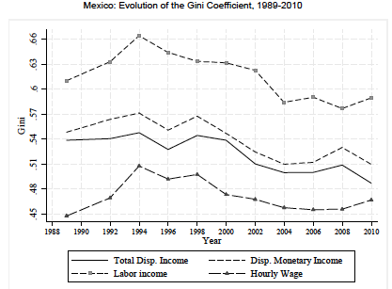

Slide 48
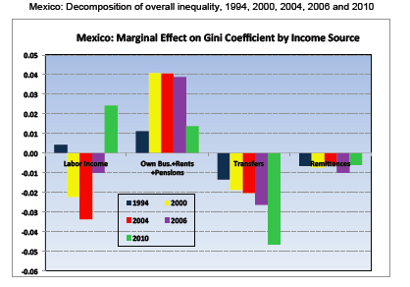

Slide 49
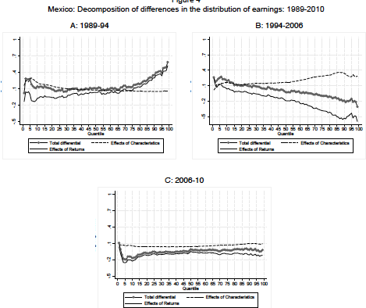

Slide 50
THANK YOU

