Slide 1
Declining Inequality in Latin America:
How Much, Since When and Why
Nora Lustig
Professor, Tulane University
Nonresident Fellow, CGD and IAD
School of International and Public Affairs (SIPA)
Columbia University
13 October, 2011

Slide 2
Sponsor and sources:
UNDP-Sponsored Project (coordinated with Luis F. Lopez-Calva)
Declining Inequality in Latin America: A Decade of Progress? Edited by Luis F. López-Calva and Nora Lustig, Brookings Institution and UNDP, 2010
“Declining Inequality in Latin America: Some Economics, Some Politics,” Birdsall, Lustig and McLeod in Handbook of Latin American Politics, forthcoming
“Declining Inequality in Latin America: How Much, Since When and Why?,” Lustig, Lopez-Calva and Ortiz, working paper, Tulane University.
“Poverty and Inequality under Latin America’s New Left Regimes,” McLeod, Darryl and Nora Lustig (2010). Paper prepared for the 15th Annual LACEA Meeting, Medellin, Colombia: Universidad de Antioquia and Universidad Eafit. Under revision, 2011
“Cambios en la desigualdad del ingreso en América Latina. Contribución de sus principales determinantes: 1995 – 2006” (2009) Alejo et al., PNUD

Slide 4
Outline
Declining Inequality in LA:
  How Much?
  Since When?
Declining Inequality: Why?
  Argentina, Brazil, Mexico and Peru
    Falling skill premia
    More progressive government transfers
Caveat: Under-reporting of Top Incomes and Inequality Trends
The Future: Will Inequality Continue to Decline?

Slide 5
Gini Coefficient by Region (in %), 2004

Slide 6
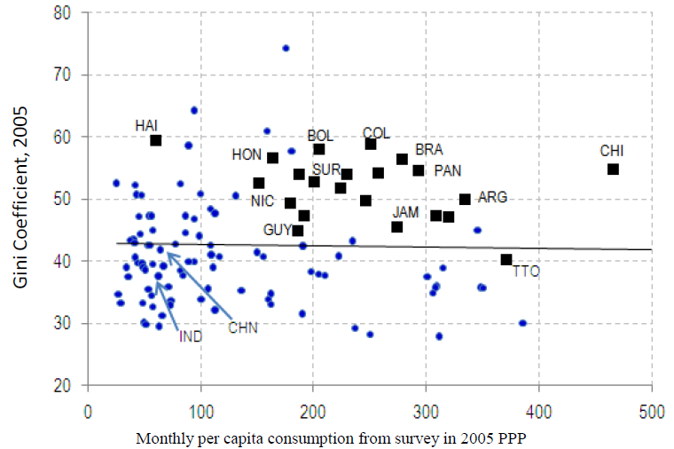
Excess Inequality (IDB, 2011)

Slide 7
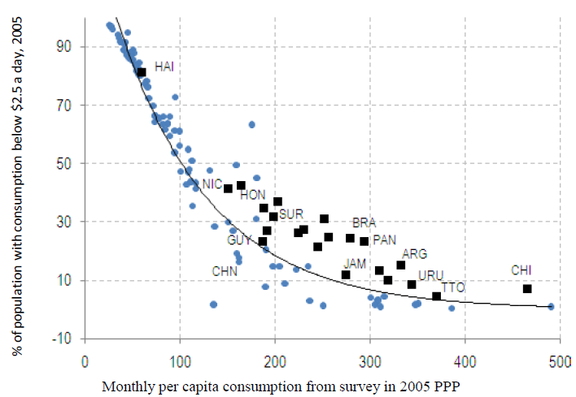
Excess Poverty (IDB, 2011)

Slide 8
Declining Inequality in LA: How Much?
Inequality in most Latin American countries (13 out of 17) has declined (roughly 1% a year) between (circa) 2000 and (circa) 2008
Decline is statistically significant
Decline continued through the global financial crisis in 2009
Inequality declined in LA while it rose in other regions

Slide 9
Trends in Inequality
Gini Coefficient Early 1990’s-Late 2000’s
Light Grey: Countries with Falling Ineq (Lustig et al., 2011)

Slide 10
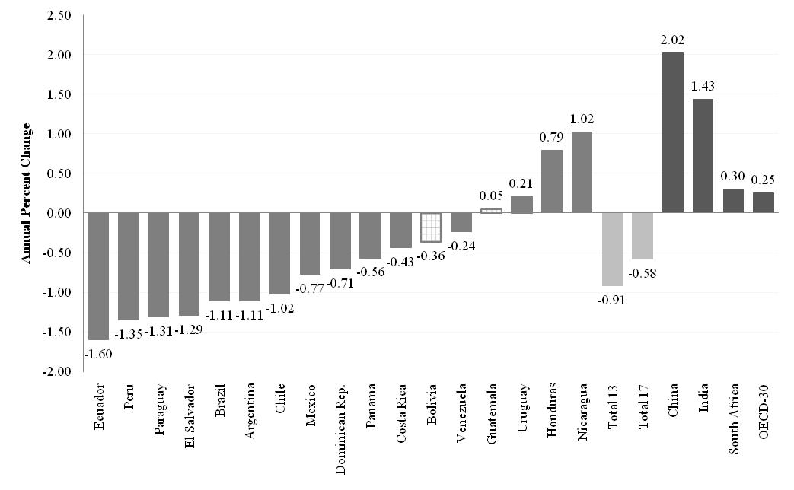
Change in Gini Coefficient by Country: circa 2000-2008 (yearly change in percent)

Slide 11
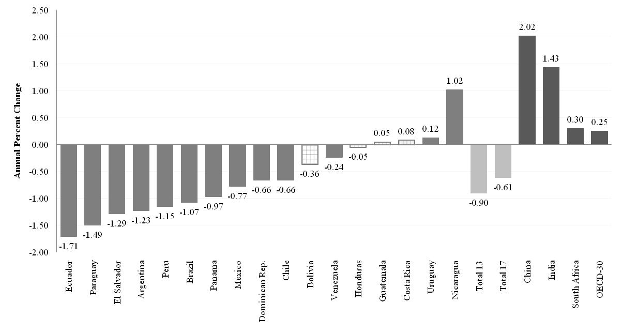
Change in Gini Coefficient by Country: circa 2000-2009 (yearly change in percent)

Slide 12
Comparing the Increase in the 1990’s with Decline in the 2000’s (Lustig et al., 2011)

Slide 13
Declining Inequality in LA: Since When?
In three countries, during second half of 1990s: Mexico, Brazil and Chile
In six, started in 2002-2003: Argentina, Bolivia, El Salvador, Paraguay, Panama and Peru
In others, although there are fluctuations, inequality between 2000 and 2009 increased: Costa Rica, Honduras and Uruguay

Slide 14
Gini 1996=100 (Lustig et al, 2011)

Slide 15
Gini 1999=100 (Lustig et al, 2011)

Slide 16
Rising Inequality 2000-2009

Slide 17
First Year in Which Inequality Started to Decline (Lustig et al, 2011)

Slide 18
The decline in inequality has been widespread
The decline took place in:
Persistently high inequality countries (Brazil) and normally low inequality countries (Argentina)
Fast growing countries (Chile and Peru), slow growing countries (Brazil and Mexico) and countries recovering from crisis (Argentina and Venezuela)
Countries with left “populist” governments (Argentina), left social-democratic governments (e.g., Brazil, Chile) and center/center-right governments (e.g., Mexico and Peru)

Slide 19
Gini (Circa 2000)

Slide 20
Yearly Change in Gini: Left and Non-left Regimes (circa 2000-2009)

Slide 22
Why has inequality declined in Latin America? Are there factors in common?
In-depth analysis in four countries:
  Argentina (Gasparini and Cruces) (urban; 2/3 of pop)
  Brazil (Barros, Carvalho, Mendoca & Franco)
  Mexico (Esquivel, Lustig and Scott)
  Peru (Jaramillo & Saavedra)
  Source: Lopez-Calva and Lustig (2010)

Slide 23
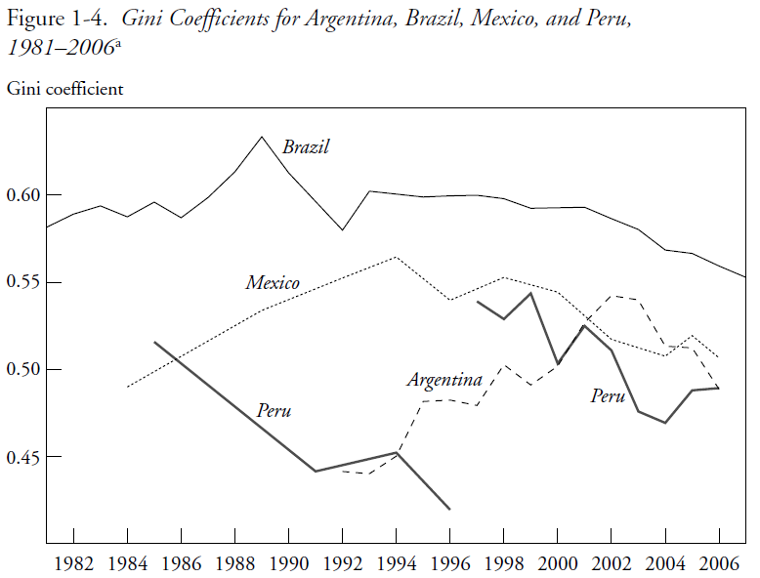

Slide 24
Decline is robust
Decline in inequality is statistically significant and significant in terms of order of magnitude
There is Lorenz dominance (unambiguous decline independently of choice of inequality measure)
Robust to income concept (e.g., monetary vs. total)

Slide 25
Four countries are a ...
Representative sample of Latin American diversity:
  high/medium/low ineq
  high/low growth
  Populist/social democratic/center-center-right governments

Slide 26
Sample Representative of High and Low Inequality Countries
(Latin America: Gini Coefficient by Country; circa 2007; in percent)

Slide 27
Sample Representative of High and Low Growth Countries
Argentina and Peru were growing at around 6 percent a year since 2003
Brazil and Mexico were growing at less than 3 percent a year (Brazil’s growth rate picked up only from 2008 onwards)

Slide 28
Income of the Brazilian poor has been growing as fast as per capita GDP in China while income of the richest ten percent has been growing like Germany’s per capita GDP
Notes:
28

Slide 29
Mexico: Growth Incidence Curve 2000-2008

Slide 30
Mexico: Growth Incidence Curve 2001-2009

Slide 31
Proximate and fundamental determinants of changes in inequality
There are many different factors that affect the distribution of income over time: “… the evolution of the distribution of income is the result of many different effects—some of them quite large—which may offset one another in whole or in part.” (Bourguignon et al., 2005)
Useful framework: to consider the ‘proximate’ factors that affect the distribution of income at the individual and household level:
  Distribution of assets and personal characteristics
  Return to assets and characteristics
  Utilization of assets and characteristics
  Transfers (private and public)
  Socio-demographic factors

Slide 32
Four countries share two relevant socio-demographic changes
Proportion of working adults as a share of the total number of adults (and total household members) rose; partly linked to the sharp increase in female labor force participation:1990-2006 by 18.1 p.pts in Mexico, 14.2 in Argentina, 12.0 in Brazil and 5.8 in Peru.
  Dependency ratios improved proportionately more for low incomes.
  Working adults (except for Peru) became more equally distributed (female adults participated proportionately more for low incomes)
Average years of schooling rose faster for the bottom quintile than for the top quintile.
  => Distribution of education (human capital) became more equal in all four countries

Slide 34
Household per capita income and its determinants
DEMOGRAPHIC
Per capita household income
Proportion of adults in the household
FERTILITY
Household income per adult
DEMOGRAPHIC
MARKET
POLITICS/INST./SOC. NORMS
STATE
(EDUCATION)
MARKET
POLITICS/
INST.
STATE
Household non-labor income per adult
RENTS & PROFITS
REMITTANCES
GOV. TRANSFFERS
Household labor income per adult
Proportion of working adults
PARTICIPATION IN LABOR FORCE
EMPLOYMENT OPPORT
Labor income per working adult in the household
WAGES BY SKILL/OTHER
HOURS WORKED
DEMOGRAPHIC
MARKET

Slide 35
Decomposition results (Alejo et al., 2009):
Demographics: Changes in the ratio of adults per household were equalizing, albeit the orders of magnitude were generally smaller except for Peru.
Labor force participation: With the exception of Peru, changes in labor force participation (the proportion of working adults) were equalizing. This effect was stronger in Argentina.

Slide 36
Decomposition results (Alejo et al., 2009):
Labor income (Earnings): In Argentina, Brazil, and Mexico between 44% and 65% of the decline in overall inequality is due to a reduction in earnings per working adult inequality. In Peru, however, changes in earnings inequality were unequalizing at the household level but not so at the individual workers’ level.
Non-labor income: Changes in the distribution of non-labor income were equalizing; the contribution of this factor was quite high in Brazil and Peru (45% and 90%, respectively).

Slide 37
Decomposition results (Alejo et al., 2009):
=> Decline in labor inc0me (except for Peru at the household level) and non-labor income inequality important determinants of the decline in overall income inequality (in per capita household income)

Slide 38
Argentina: 2004-06
(Gasparini & Cruces)
Decline in labor income inequality:
employment generated by recovery: open unemployment fell from 14.8% in 2000 to 9.6% in 2006
shift in favor of more low-skilled, labor-intensive sectors as a result of the devaluation
rise in the influence of labor unions which compresses wages
fading of the one-time effect of skill-biased technical change that occurred in the 1990s
Decline in non-labor income inequality:
more progressive government transfers: Jefes y Jefas de Hogar program launched in 2002

Slide 40
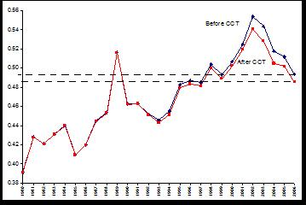
Argentina: Distributional impact of Conditional cash transfers

Slide 41
Brazil: 2001-2007
(Barros et al.)
Decline in labor income inequality:
  About 50% accounted for by decline in attainment inequality (quantity effect) and less steep returns --wage gap by skill narrows—(price effect). Latter dominant. (See Gini for years of schooling and returns by skill in next two slides)
  About 25% accounted for by decline in spatial segmentation; especially, reduction in wage differentials between metropolitan areas and medium/small municipalities. Also, decline in sectoral segmentation.

Slide 42
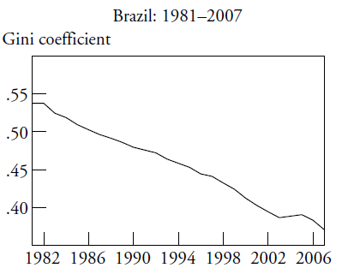

Slide 43
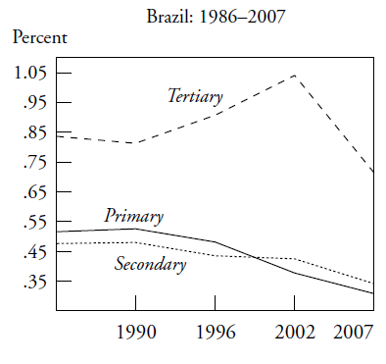

Slide 45
Decline in non-labor income inequality
Contribution of changes in the distribution of income from assets (rents, interest and dividends) and private transfers was unequalizing but limited.
Most of the impact of non-labor income on the reduction of overall income inequality was due to changes in the distribution of public transfers: changes in size, coverage and distribution of public transfers. Bolsa Familia accounts for close to 10 percent of the decline in household per capita income inequality.

Slide 46
Mexico: 2000-2006
(Esquivel, Lustig & Scott, 2009)
Decline in labor income inequality:
  Educational attainment became more equal and returns less steep.
  The latter seems to be associated with the decline in relative supply of workers with low educational levels. Between 1989 and 2006, the share of workers with less than lower-secondary education fell from 55% to around 33%.
  It coincides with the period in which government gave a big push to basic education.
    Between 1992 and 2002 spending per student in tertiary education expanded in real terms by 7.5 percent while it rose by 63 percent for primary education.
    The relative ratio of spending per student in tertiary vs. primary education thus declined from a historical maximum of 12 in 1983-1988, to less than 6 in 1994-2000 (by comparison, the average ratio for high-income OECD countries is close to 2).
  Next two slides show: Gini for yrs. of schooling and returns to schooling

Slide 47
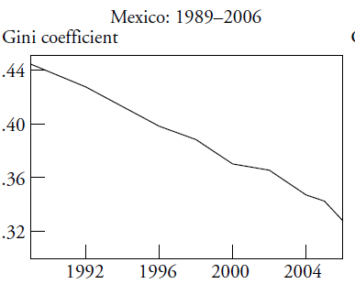

Slide 48
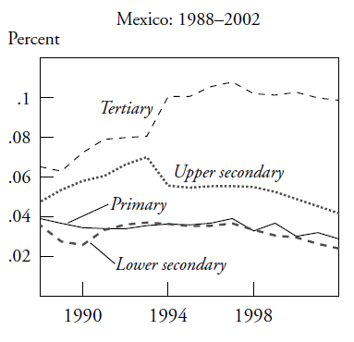

Slide 49
Decline in non-labor income inequality
The equalizing contribution of government transfers increased over time (both at the national level as well as for urban and, especially, rural households). By 2006 transfers became the income source with the largest equalizing effect of all the income sources considered.
Remittances became more equalizing too but with a smaller effect than government transfers.
Both more than offset the increasingly unequalizing impact of pensions.

Slide 50
Decline in non-labor income inequality
The sharp rise in the role and equalizing impact of public transfers was a consequence of a significant policy shift in 1997, when the government launched the conditional cash transfer program Progresa/Oportunidades.
During 1996-2006 the size of public transfers increased; they became more equally distributed among recipients, and the recipients of transfers increasingly belonged to relatively poorer segments of the population.

Slide 51
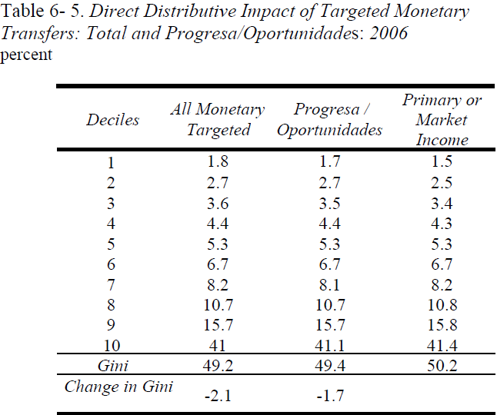

Slide 52
Peru: 1997-2006
(Jaramillo & Saavedra, 2009)
Labor income inequality:
  Changes in educational structure were equalizing at the household and individual workers levels.
  Changes in returns to education, however, were equalizing at the individual workers level but not at the household level. Changes in assortative matching might have been a factor.
  Earnings gap by skill narrowed at the individual workers level as in the other countries. Fading out of skill-biased technical change and a more equal distribution of education/educational upgrading.
  Next two slides show the Gini for years of schooling and the returns to schooling.

Slide 53
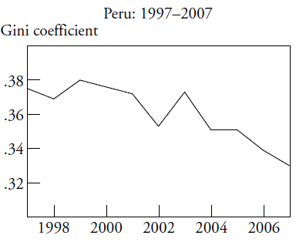
Peru: Gini coefficient for yrs of schooling

Slide 54
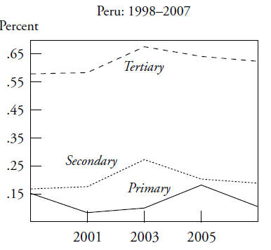
Peru: Returns to Schooling

Slide 55
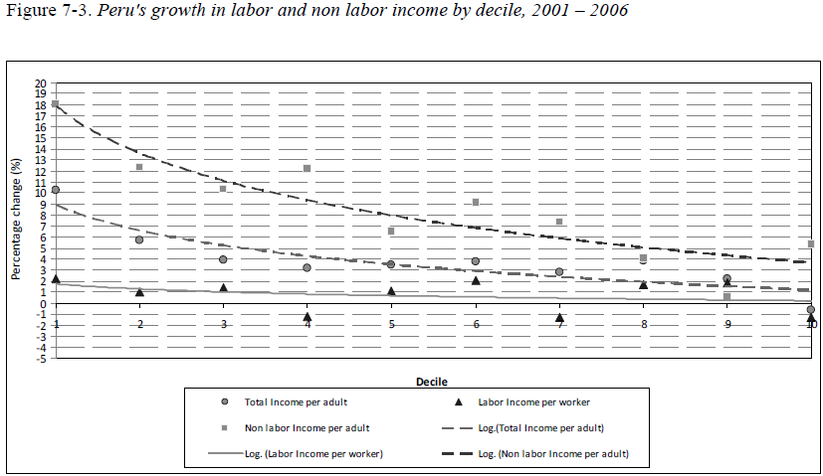
Peru: Decline in non-labor income inequality: progressivity rose in non-monetary transfers

Slide 56
Why has inequality declined? Main findings
Educational upgrading and a more equal distribution of educational attainment have been equalizing (quantity effect). No “paradox of progress” this time.
Changes in the steepness of the returns to education curve have been equalizing at the individual workers level (price effect). Except for Peru, they have been equalizing at the household level too.
Changes in government transfers were equalizing: more progressive government transfers (monetary and in-kind transfers); expansion of coverage, increase in the amount of transfers per capita, better targeting.

Slide 57
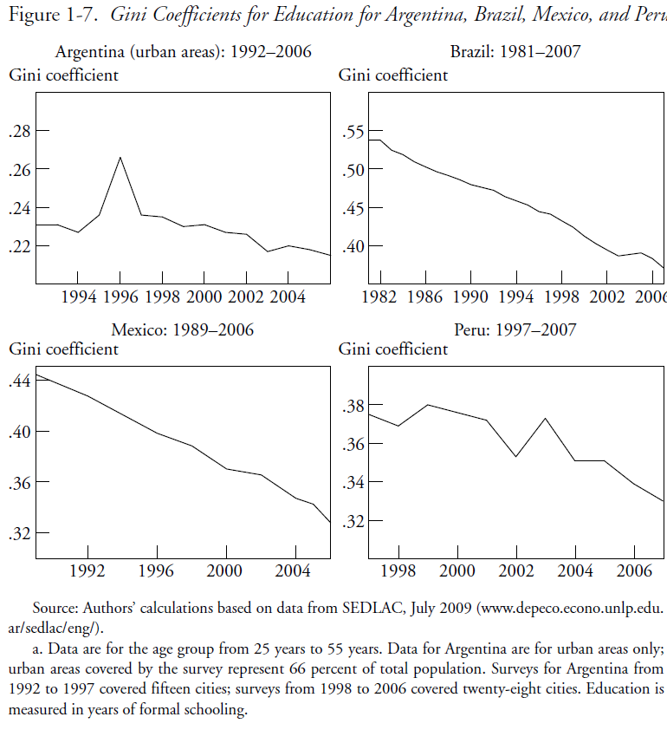

Slide 58
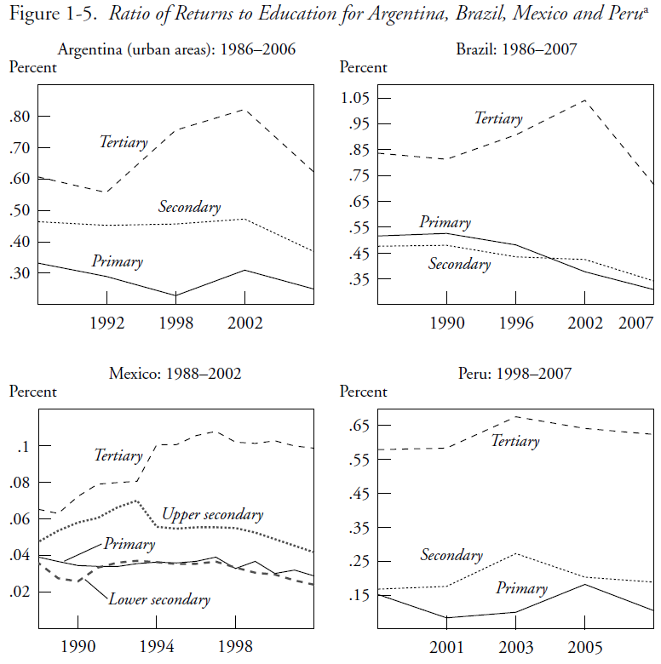

Slide 59
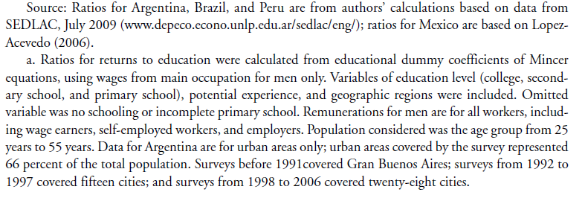

Slide 60
Why has the skill premium declined?
Increase in relative demand for skilled labor petered out: Fading of the unequalizing effect of skill-biased technical change in the 1990s: Argentina, Mexico & Peru.
Decline in relative supply of low-skilled workers: Expansion of basic education since the 1990s: Brazil, Mexico and Peru .

Slide 62
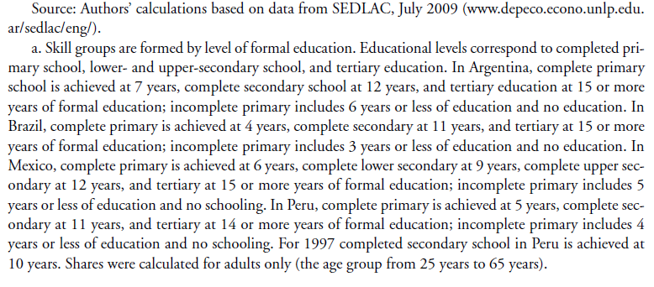

Slide 63
Why has earnings inequality declined?
Other effects:
Decline in spatial labor market segmentation in Brazil.
In Argentina, the decline also driven by a pro-union government stance and by the impetus to low-skill intensive sectors from devaluation. In Brazil, increase in minimum wages.

Slide 64
Why has inequality in non-labor incomes declined?
In the four countries government transfers to the poor rose and public spending became more progressive
    In Argentina, the safety net program Jefes y Jefas de Hogar.
    In Brazil and Mexico, large-scale conditional cash transfers => can account for between 10 and 20 percent of reduction in overall inequality. An effective redistributive machine because they cost around .5% of GDP.
    In Peru, in-kind transfers for food programs and health. Also access to basic infrastructure for the poor rose.

Slide 65
Conclusions
In the race between skill-biased technological change and educational upgrading, in the last ten years the latter has taken the lead (Tinbergen’s hypothesis)
Perhaps as a consequence of democratization and political competition, government (cash and in-kind) transfers have become more generous and targeted to the poor

Slide 66
Is Inequality Likely to Continue to Fall?
Despite the observed progress, inequality continues to be very high and the bulk of government spending is not progressive.
The decline in inequality resulting from the educational upgrading of the population will eventually hit the ‘access to tertiary education barrier’ which is much more difficult to overcome: inequality in quality and ‘opportunity cost’ are high and costly to address.
  => United States experience should serve as warning (Goldin and Katz, 2008)

Slide 67
THANK YOU

