Slide 1
Inequality, Poverty and Public Policy in Latin America
Nora Lustig
Professor, Tulane University
Nonresident Fellow, Center for Global Development and Inter-American Dialogue
Red Interamericana de Protección Social (RIPSO)
Mexico, DF, August 10, 2011

Slide 2
Gini Coefficient by Region (in %), 2004

Slide 3
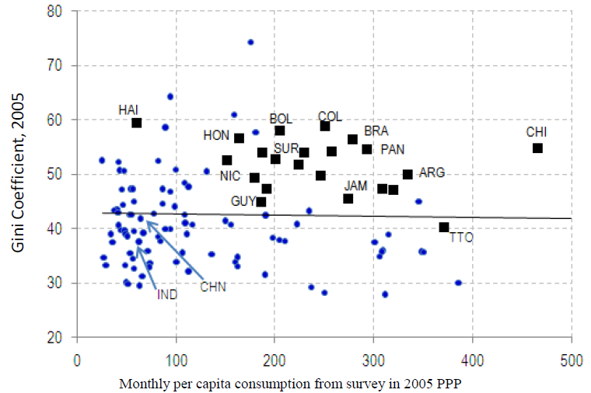
Excess Inequality (IDB, 2011)

Slide 4
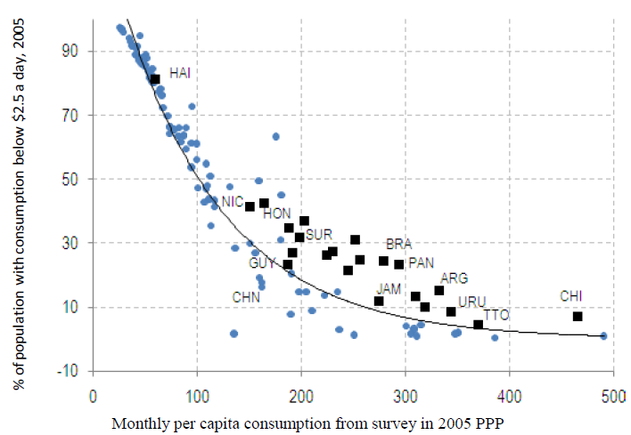
Excess Poverty (IDB, 2011)

Slide 5
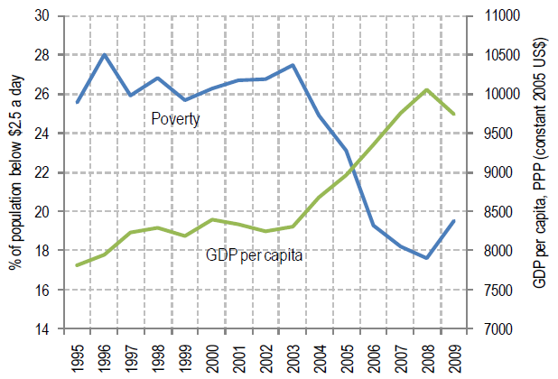
Trends in Poverty: 1995-2009 (IDB, 2011)

Slide 6
Declining Inequality in LA:
  How Much?
  Since When?
  Why?
  Will it continue?

Slide 7
Extension of findings in our 2010 book and UNDP-sponsored project:

Slide 8
Trends in Inequality
Gini Coefficient Early 1990’s-Late 2000’s
Light Grey: Countries with Falling Ineq (Lustig et al., 2011)

Slide 9
Gini Coefficient Early 1990’s-Late 2000’s (same countries throughout)

Slide 10
Declining Inequality in LA: How Much? Decline is significant
Inequality has declined in 13 out of 17 countries (roughly 1% a year) between (circa) 2000 and (circa) 2008;
Decline is statistically significant in all but one case
Decline occurred while inequality in other parts of the world has been on the rise
Decline continued through the global financial crisis in 2009
Order of magnitude: higher (and in some cases much more so) than increase in previous period, for example
Growth has been notoriously “pro-poor”

Slide 11
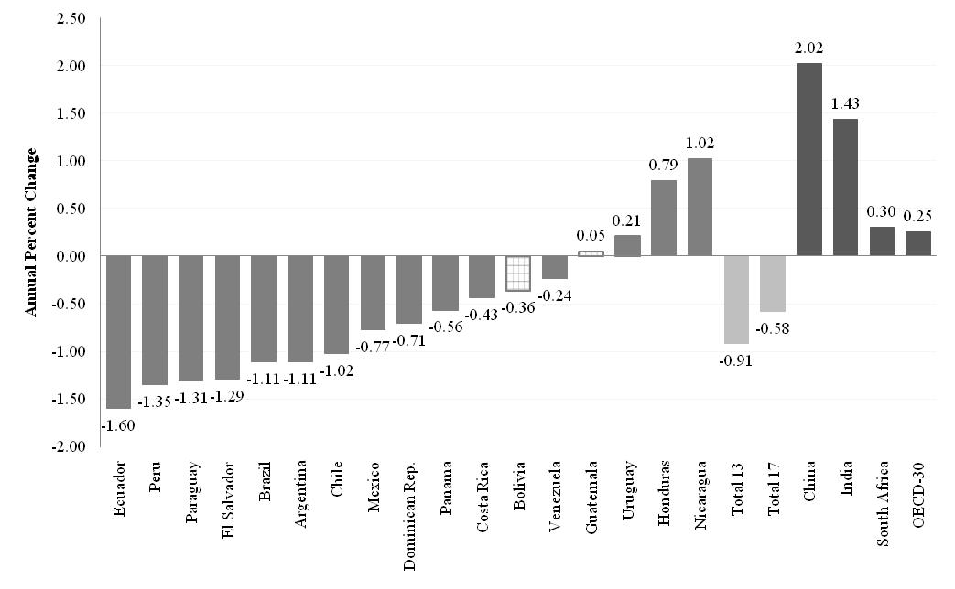
Change in Gini Coefficient by Country: circa 2000-2008 (yearly change in percent) SEDLAC

Slide 12
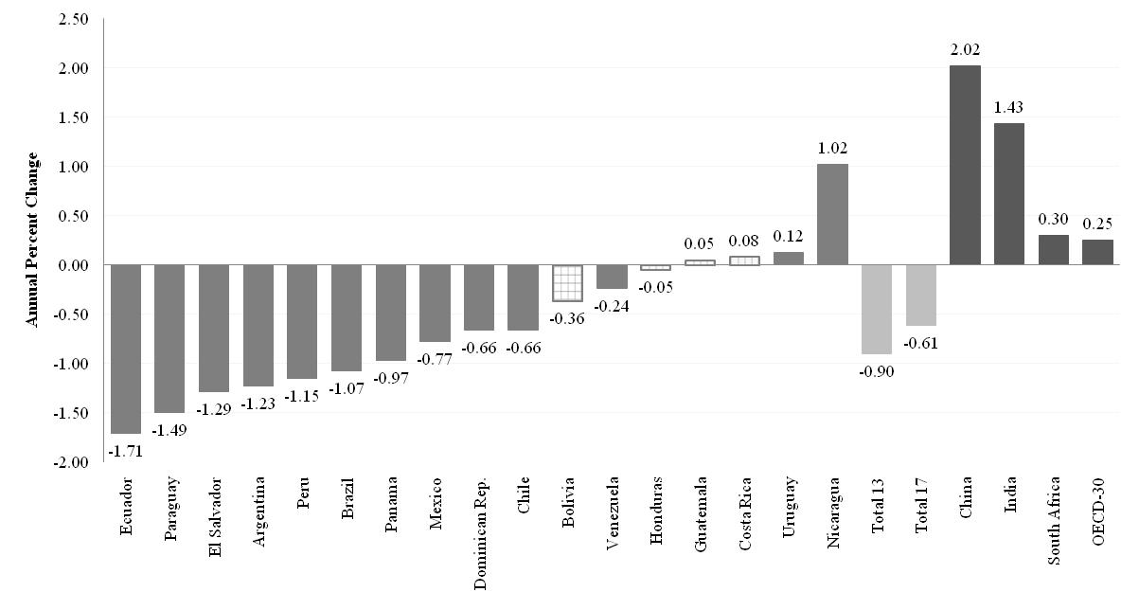
Change in Gini Coefficient by Country: circa 2000-2009 (yearly change in percent) SEDLAC

Slide 13
Comparing the Increase in the 1990’s with Decline in the 2000’s

Slide 14
Income of the Brazilian poor has been growing as fast as per capita GDP in China while income of the richest ten percent has been growing like Germany’s per capita GDP
Notes:
14

Slide 15
Declining Inequality in LA: How Much? Decline is Robust
Definition of income (monetary or total)/per capita or AEU/consumption
End years
Inequality indicator
Data source (UNECLAC or SEDLAC, the latter is used here)

Slide 16
Yearly Change in Gini: Three yr averages at end pts. (in %)

Slide 18
Change in Gini Coefficient by Country: circa 2000-2008 (yearly change in percent) UNECLAC

Slide 19
Declining Inequality in LA: Since When?
For more than/almost a decade
In three countries, during second half of 1990s: Mexico, Brazil and Chile
In six, started in 2002-2003: Argentina, Bolivia, El Salvador, Paraguay, Panama and Peru

Slide 20
First Year in Which Inequality Started to Decline

Slide 21
Declining Inequality in LA: How Much?
Decline in has been widespread
Persistently high inequality countries (Brazil) and normally low inequality countries (Argentina and Venezuela)
Fast growing countries (Chile and Peru), slow growing countries (Brazil and Mexico) and countries recovering from crisis (Argentina and Venezuela)
Countries with left “populist” governments (Argentina), left social-democratic governments (e.g., Brazil, Chile) and center/center-right governments (e.g., Mexico and Peru)

Slide 22
Gini (Circa 2000)

Slide 23
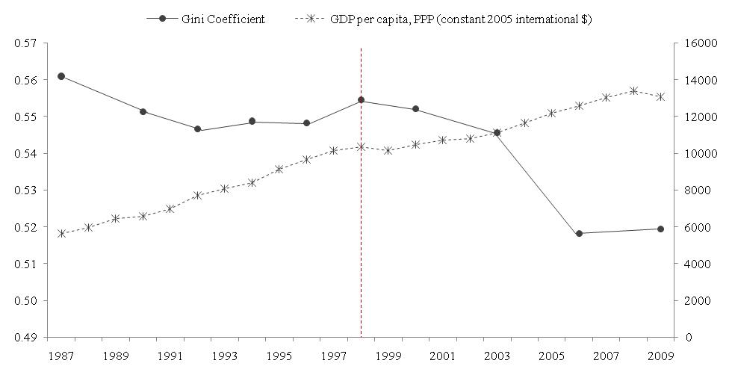
Growth and Inequality: Chile

Slide 24
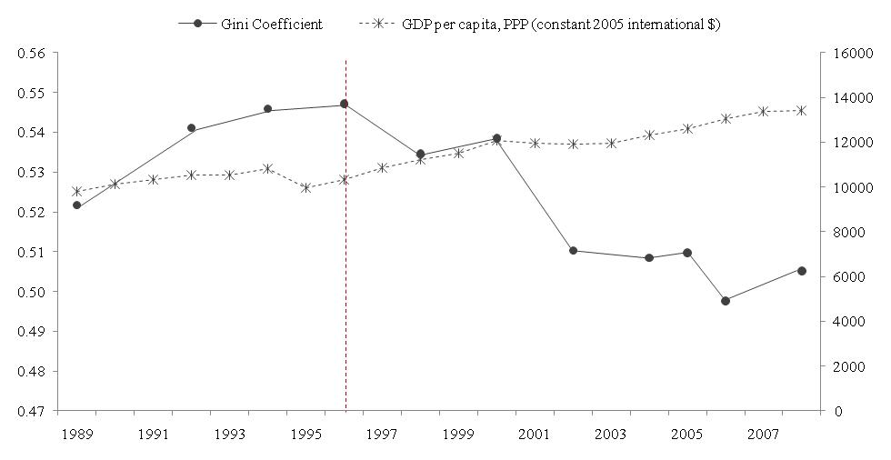
Growth and Inequality: Mexico

Slide 25
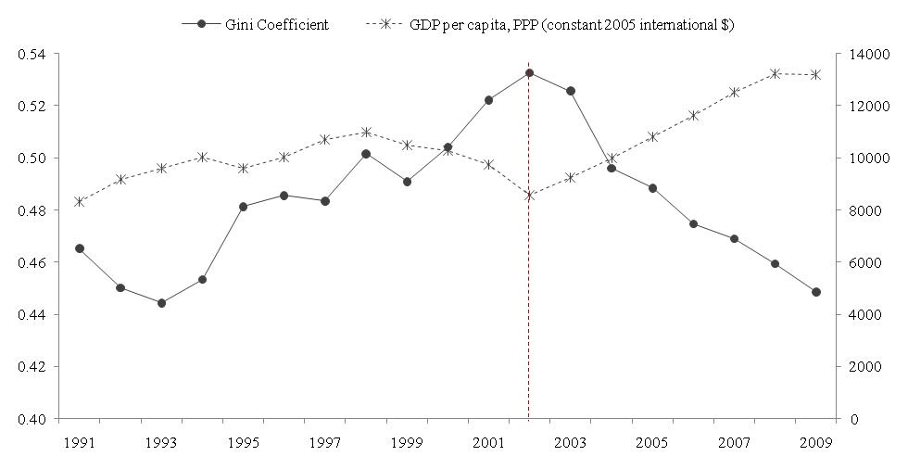
Growth and Inequality: Argentina (Greater Buenos Aires)

Slide 26
Yearly Change in Gini: Left and Non-left Regimes (circa 2000-2009)

Slide 27
Why has inequality declined in Latin America? Are there factors in common?
In-depth analysis (Lopez-Calva and Lustig, 2010 and UNDP project paper for Chile and Uruguay):
  Argentina (Gasparini and Cruces) (urban; 2/3 of pop)
  Brazil (Barros, Carvalho, Mendoca & Franco)
  Chile (Eberhard and Engel) (labor earnings)
  Mexico (Esquivel, Lustig and Scott)
  Peru (Jaramillo & Saavedra)
  Uruguay (Alves, Amarante, Salas and Vigorito); rising inequality most of the period; declines in 07-09

Slide 28
Why has inequality declined? Main findings
Educational upgrading and a more equal distribution of educational attainment have been equalizing (quantity effect). No “paradox of progress” this time.
Changes in the steepness of the returns to education curve have been equalizing at the individual workers level (price effect). Except for Peru, they have been equalizing at the household level too.

Slide 30
Schooling inequality cont.: Chile

Slide 32
Returns to educ (cont.): Chile

Slide 33
Why has inequality declined? Main findings
Changes in government transfers were equalizing:
  more progressive government transfers (monetary and in-kind transfers); better targeting
  expansion of coverage
  increase in the amount of transfers per capita

Slide 34
Why has the skill premium declined? Conjecture:
Increase in relative demand for skilled labor petered out: Fading of the unequalizing effect of skill-biased technical change in the 1990s: Argentina, Mexico & Peru
Decline in relative supply of low-skilled workers: Expansion of basic education since the 1990s: Brazil, Mexico and Peru; expansion of access to post-secondary in Chile
Supply vs. Demand: THIS SHOULD BE THE FOCUS OF FUTURE RESEARCH

Slide 36
Composition of adult pop cont.: Chile

Slide 37
Why has earnings inequality declined?
Other effects:
Decline in spatial labor market segmentation in Brazil. FUTURE RESEARCH: PATTERNS OF GROWTH AND DECLINING SPATIAL WAGE DIFFERENTIALS
In the case of Argentina, the decline also driven by a pro-union government stance and by the impetus to low-skill intensive sectors from devaluation. In Brazil, increase in minimum wages. FUTURE RESEARCH: DISENTANGLE INSTITUTIONAL FROM MARKET FACTORS

Slide 38
Why has inequality in non-labor incomes declined?
New forms of SOCIAL PROTECTION have been key
In particular, Conditional (and Unconditional) Cash Transfers: Bolsa Familia (Brazil) and Oportunidades (Mexico); Jefes y Jefas y Asignacion Universal por Hijo (Argentina); Juancito Pinto (Bolivia); etc.
    In Brazil and Mexico, large-scale conditional cash transfers => can account for between 10 and 20 percent of reduction in overall inequality. An effective redistributive machine because they cost around .5% of GDP.

Slide 39
Conclusions
It appears that in the race between skill-biased technological change and educational upgrading (Tinbergen’s theory), in the last ten years the latter has taken the lead; the opposite of what has happened in the US (Goldin and Katz, 2008)
Perhaps as a consequence of democratization and political competition, government (cash and in-kind) transfers have become more generous and targeted to the poor (Robinson, 2010)

Slide 40
Conclusions
Trends in declining skill-premium continued through 2009 (most recent data points available) for the most part
Also, since 2008/9, Argentina and Brazil expanded spending on programs targeted to the poor; Pension Moratorium and Universal per Child Transfers in Argentina are potentially very redistributive

Slide 41
Is Inequality Likely to Continue to Fall?
Despite the observed progress, inequality continues to be very high and the bulk of government spending is not progressive.
The decline in inequality resulting from the educational upgrade of the population will eventually hit the ‘access to tertiary education barrier’ which is much more difficult to overcome: inequality in quality and ‘opportunity cost’ are high and costly to address.
Making public spending more progressive in the future is likely to face more political resistance (entitlements of some powerful groups).

Slide 42
The Big Challenge of Social Protection
Coping with adverse shocks:
  Economic Crises: unemployment, falling incomes
  Natural Disasters
  Spikes in Food Prices

Slide 43
Role of Networks such as RIPSO
Crucial
Exchange of know-how; what works; what doesn’t extremely valuable for:
  Efficiency and efficacy of programs
  Political survival of programs
Access to high quality education; instruments to cope with systemic shocks; how to deal with tensions between programs who target the poor and universal coverage/middle class social protection
Integrate evaluation results to the exchange; better measures of inequality

Slide 44
Gracias!

