Slide 1
Fiscal Policy and Equalizing Opportunities: Addressing Methodological Hurdles
Nora Lustig
Tulane University
CGD and IAD
LCSPE Workshop on Fiscal Incidence Analysis
World Bank, Washington, DC
May 10, 2012

Slide 2
Outline
Commitment to Equity Project: Results
Methodological Issues
Main questions

Slide 3
Commitment to Equity (CEQ) Project
Inter-American Dialogue and Tulane University’s CIPR and Dept. of Economics.
Currently: 12 countries
6 finished: Argentina (2009), Bolivia (2007), Brazil (2009), Mexico (2008), Peru (2009) and Uruguay (year of HH survey)
6 in progress: Chile, Colombia, Costa Rica, El Salvador, Guatemala, Paraguay

Slide 4
References
Lustig, Nora (coordinator). Fiscal Policy and Income Redistribution in Latin America: Challenging the Conventional Wisdom, Argentina: Carola Pessino; Bolivia: George Gray Molina, Wilson Jimenez, Verónica Paz, Ernesto Yañez; Brazil: Claudiney Pereira, Sean Higgins; Mexico: John Scott; Peru: Miguel Jaramillo. , Economics Department, Tulane University, Working Paper. 2011. Revised: Forthcoming.

Slide 5
References
Lustig, N. and S. Higgins. Fiscal Incidence, Fiscal Mobility and the Poor: a New Approach. Economics Department, Tulane University, Working Paper. 2012.
Bucheli, M., N. Lustig, M. Rossi and F. Amabile Social Spending, Taxes and Income Redistribution in Uruguay. Economics Department, Tulane University, Working Paper. Forthcoming.

Slide 6
Fiscal Incidence: “Plain vanilla” case
No modeling:
  No behavioral responses (or almost none)
  No inter-temporal dimensions
  No general equilibrium effects
  No fiscal sustainability analysis
  Welfare Indicator: Income per capita
  No adjustment for age, gender or economies of scale
  No adjustment for under-reporting
  Several household surveys in LA only have income data; so, if one wants to compare across countries, income data must be used in all, even in those in which there is data on consumption. But, for the latter, ideally one should do both.

Slide 7
Fiscal Incidence Analysis: Step by Step
Definition of Income Concepts
Construction of Income Concepts: calculating taxes & transfers for each household; decile/quintile
Indicators:
  Changes in inequality and poverty
  Incidence by decile/quintile
  Concentration shares by decile/quintile
  Kakwani and Reynolds Smolensky
  Leakages and Coverage
  Per capita transfers
  Probit of “excluded”
  Fiscal mobility (transition) matrices

Slide 9
Results: A Primer
Lots of heterogeneity in LA
No clear-cut correlation between government size, the extent of redistribution, redistributive effectiveness
Direct taxes achieve little in the form of redistribution
Contributory pensions are progressive in relative terms in most countries (regressive in absolute terms)
Direct transfers reduce poverty the most when coverage of the poor is high and average transfer is close to average poverty gap
Indirect taxes can make poor people net contributors to the state and in some cases a significant proportion of the poor poorer

Slide 11
Decline in Disp Inc Gini, Direct Transfers and Effectiveness Indicator

Slide 12
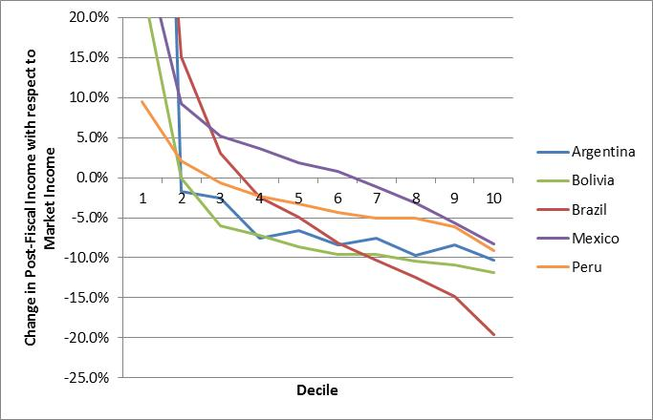
Impact of Indirect Taxes
Arg &Bol
Brazil

Slide 13
Methodological Issues
Under-reporting especially at the top
Households with zero incomes (follow SEDLAC)
Defining Income Concepts: What is Market Income?
Calculating taxes and transfers at the household level; deciles/ quintiles, ok to mix?
Ranking issues; if only net market income available, should HH always be ranked by it?
Scaling-up issues
Imputing in-kind public spending

Slide 14
Adding the top; Greater Bs. As., Argentina (Alvaredo and Piketty en López-Calva y Lustig, 2010)

Slide 15
Adding the top; Greater Bs. As., Argentina (Alvaredo and Piketty en López-Calva y Lustig, 2010)

Slide 16
Methodological Issues
Under-reporting especially at the top
Households with zero incomes (follow SEDLAC)
Defining Income Concepts: What is Market Income?
Calculating taxes and transfers at the household level; deciles/ quintiles, ok to mix?
Ranking issues; if only net market income available, should HH always be ranked by it?
Scaling-up issues
Imputing in-kind public spending

Slide 18
What is “market income”?
In addition to the uncontroversial wages and salaries, income from capital and private transfers (e.g., remittances), what about these:
  Incomes from sales of durables
  Auto-consumption
  Imputed rent for owner’s occupied housing
  Contributory pensions from individualized accounts
  Contributory pensions from social security

Slide 19
Commitment to Equity Project
  Incomes from sales of durables/NO
  Capital Gains/NO
  Auto-consumption/YES
  Imputed rent for owner’s occupied housing/YES
  Alimony, Inheritance and Gifts ???
  Contributory pensions from individualized accounts/YES
  Contributory pensions from social security:
    Benchmark: YES
    Sensitivity Analysis: NO

Slide 20
What is “Net Market Income”?
Market Income minus Direct Taxes and Contributions to Social Security (Payroll Taxes)
But, contributions to social security:
  Benchmark: contributions going to pension, are NOT subtracted; all the other contributions are
  Sensitivity Analysis: all contributions to social security are subtracted

Slide 21
Methodological Issues
Under-reporting especially at the top
Households with zero incomes (follow SEDLAC)
Defining Income Concepts: What is Market Income?
Construction of income concepts/Calculating taxes and transfers at the household level; deciles/ quintiles, ok to mix?
  Ranking issues; if only net market income available, should HH always be ranked by it?
  Scaling-up issues; totals from public accounts by tax category/program; only for inequality and incidence
  Imputing in-kind public spending: education, health; public goods (e.g., infrastructure)?

Slide 22
Construction of Income Concepts/Calculating Taxes & Transfers
Unfortunately, it is not possible to construct income concepts directly from household surveys
Household Surveys in LA are quite heterogeneous:
  Some report income and not consumption
  Some do not report autoconsumption
  Some do not report owner’s occupied housing rent; they do not have the information to run hedonic regressions

Slide 23
Construction of Income Concepts/Calculating Taxes & Transfers
Even more importantly:
  Not clear if reported income is before or after taxes. SEDLAC database assumes that employees’ income is net of taxes and contributions to social security and self-employment and capital incomes are before taxes and transfers
  Not always clear if people include government transfers in the income they report (which we usually take as “market” income)

Slide 24
Construction of Income Concepts/Calculating Taxes & Transfers
Data on direct taxes, contributions to social security, government transfers, consumption (for indirect taxes and subsidies), use of government health services may be imperfectly captured or not captured at all

Slide 25
Options to Construct Income Concepts
Direct Identification Method
Inference Method
Simulation Method
Imputation Method
Alternate Survey
Secondary Sources Method

Slide 29
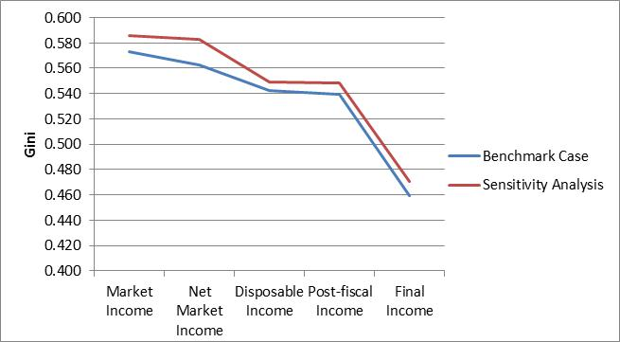
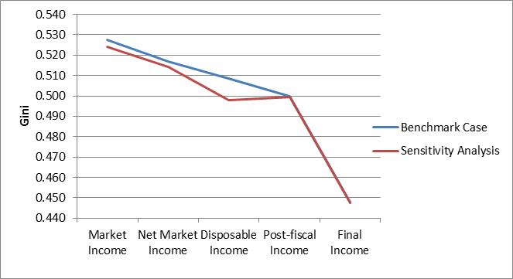
How sensitive are results to the placement of contributory pensions? Brazil vs. Mexico

Slide 30
How sensitive to placement of contributory pensions: Uruguay incidence

Slide 31
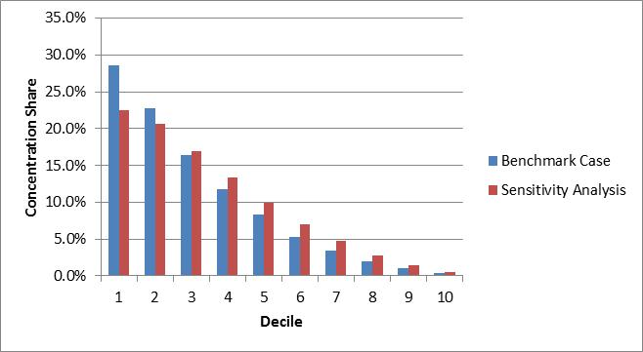
How sensitive to placement of contributory pensions: Uruguay concentration shares CCTs

Slide 32
Main Questions
Income vs. Consumption; “either or”, or “both”?
How to deal with under-reporting at the top? Use tax returns data (Alvaredo for Colombia)
What should be included under market income?
How should owner’s occupied imputed rent be estimated? (we used 10% of mket. Income)
Contributory pensions; “with” and “without”, other alternatives?

Slide 33
Main Questions
Mixing methods to estimate taxes and transfers; e.g., at household level with decile info; acceptable?
Ranking by which income concept? problem of heterogeneous surveys
Scaling-up: category by category? Full amounts in public accounts?
How to take into account tax evasion? direct taxes; indirect taxes

Slide 34
Main Questions
How should in-kind government transfers be calculated?
  Education
  Health
  Public goods: e.g., roads; sewage and sanitation; etc.

Slide 35
Main Questions
Absence of Conventions on Progressiveness/Regressiveness

Slide 36
Main Questions
Modeling:
Behavioral responses: consumption and labor supply
Inter-temporal effects
General Equilibrium Effects
Fiscal Sustainability

Slide 37
Main Questions
Costing “Opportunities for All”:
-Plain Vanilla case: CEQ calculates gaps straightforwardly (without scaling-up for income poverty measures)

