Slide 1
The Rise and Decline of Inequality in Mexico
By Raymundo Campos, Gerardo Esquivel and Nora Lustig
Presented by Nora Lustig
“The New Policy Model, Poverty and Inequality in Latin America”
WIDER, Buenos Aires, September 1-3, 2011

Slide 2
Outline
Evolution of (disposable household per capita) income inequality
Macroeconomic variables and inequality trends
Proximate causes of inequality trends: labor income, non-labor income and transfers
Proximate causes of labor income inequality trends: institutional factors, workers’ characteristics and returns to those characteristics
Summing up

Slide 3
Evolution of Inequality
The evolution of inequality in Mexico followed two distinct trends.
It rose during the 1980s and declined between 1996 and 2010.
The first period coincided with the debt crisis and structural adjustment initiatives: fiscal austerity, devaluation and financial and trade liberalization.
The second period coincided with the implementation of NAFTA in 1994 as well as with social policy reforms that emphasized access to basic education and introduced large-scale targeted anti-poverty programs.

Slide 4
Inequality (Gini) and Poverty (Headcount): 1984-1989

Slide 5
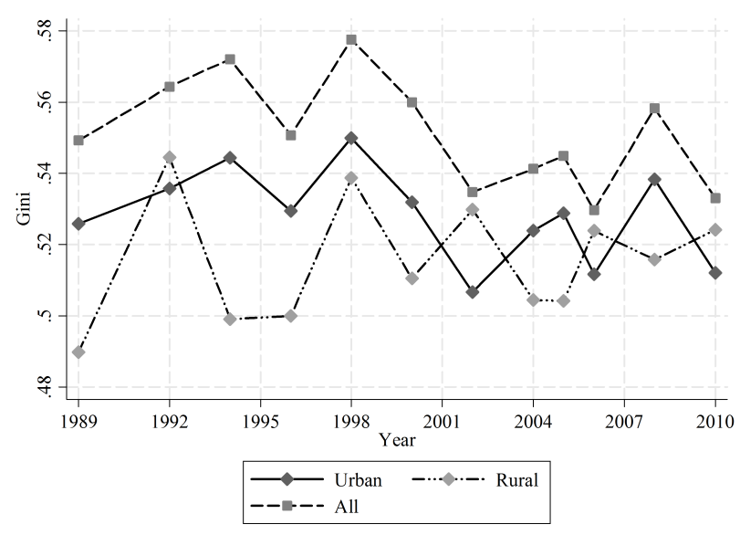
Gini Coefficient: 1989-2010
Structural
Reforms
Continue
1994: Implementation of NAFTA

Slide 6
Macroeconomic variables and inequality trends
A cursory examination of the evolution of inequality and macroeconomic variables does not seem to find an obvious correlation between the two.
Inequality increased and declined during periods of slow-growth, crises and recovery, depending on the period.

Slide 7
Macroeconomic variables and inequality trends
For example, inequality increased when average growth was negative in the 1980s, increased during the speedy recovery of 1995-2000 and declined during the period of anemic growth 2000-2006.
Likewise, inequality both increased and declined when the peso was appreciating or depreciating.
Hence, the explanation must be found elsewhere.

Slide 8
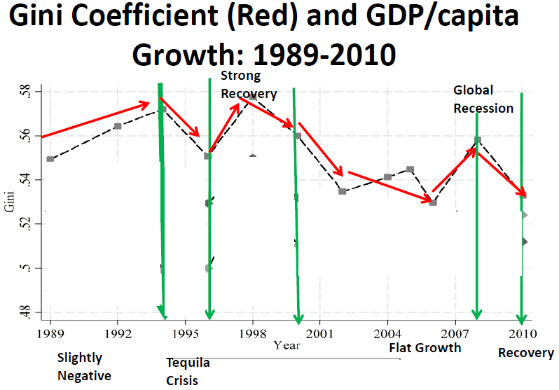

Slide 9
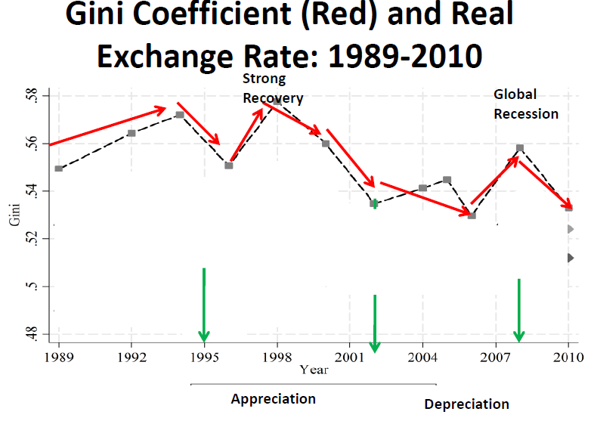

Slide 10
Causes of Rising Inequality: 1984-1994
Based on available evidence, the increase in inequality in the 1980s and early 1990s appears to be associated to the unequalizing effect of an increase in the premium to skills and falling minimum wages.
In turn, the increase in the premium to skills might have been a consequence of trade liberalization and other factors which shifted the relative labor demand towards workers with higher skills (especially, with tertiary education).

Slide 11
Causes of Declining Inequality: 1996-2010
Lerman and Yitzhaki (1985) static decomposition reveals that labor income, remittances and government transfers were equalizing after 1994 and until 2006.
In 2010, however, labor income became unequalizing while the other two continued to be equalizing.

Slide 12
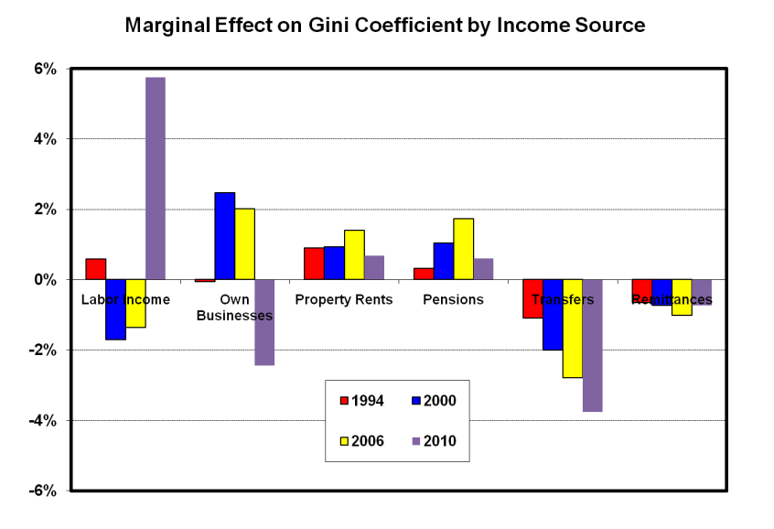

Slide 13
Inequality in labor earnings and hourly wages
Given the importance of labor market inequality dynamics in explaining the trend in overall inequality, this paper examined the role of:
institutional factors: minimum wages and unionization rate) and
market factors: relative demand and supply of labor by skill

Slide 14
Inequality in labor earnings and hourly wages
Labor income inequality increased for the period 1989-1994 and declined for the period 1996-2010—that is, the post-NAFTA period–
In turn, this decline had two distinct patterns:
The period 1996-2006 shows a marked decline in inequality in the distribution of hourly wages, and
the period 2006-2010 shows that inequality remained fairly constant.

Slide 16
Relative returns and relative supply of workers with high school education or more against workers with secondary or less
The increase in relative supply for the period 1989-1998 is approximately 30 percent while for the period 1998-2010 is approximately 50 percent.
Inequality measured as the relative returns of high-school educated workers, on the other hand, increases for the period 1989-1994 and declines for the period 1994-2010.

Slide 17
Relative
Supply
Increased
By 30%
Relative
Supply
Increased
By 50%

Slide 18
Supply, Demand or Institutional Factors? 1989-1994
Following Bound and Johnson (1992), if increases in supply are larger (smaller) than increases in demand then we expect a fall (rise) in the relative returns.
For the period 1989-1994 we observe both an increase in relative supply and relative returns for workers with tertiary education.
Hence, demand and institutional factors must be responsible for the increase in relative returns during this period.
SKBTC and declining minimum wages have been found to be determining factors.

Slide 20
Relative Dem
Outpaced Rel.
Supply:
SBTC and
Declining
Minimum
Wages

Slide 21
Supply, Demand or Institutional Factors? 1996-2010
For the period 1996-2010, institutional factors are relatively unimportant given that they remained practically constant throughout the period.
This suggests that only supply and demand factors are at play.
Given that relative supply increased and relative returns declined, it must be the case that growth in the relative supply outpaced growth in the relative demand.
Petering out of unequalizing effects of market-oriented reforms?

Slide 23
Relative Supply
Outpaced Rel.
Demand
Causes?

Slide 24
Characteristics Vs. Returns: Decomposition of Differences in the Distribution of Earnings: 1996 and 2010
Recentered Influence Function (RIF) procedures (Firpo, Fortin and Lemieux, 2009)
Extension of Oaxaca-Blinder parametric decomposition; advantage: non-path dependence

Slide 25
Characteristics Vs. Returns: 1996-2010:

Slide 26
Characteristics Vs. Returns: 1996-2010:
Changes in the distribution of characteristics (education and experience) were unequalizing
If only characteristics would have changed, earnings inequality would have been higher
Paradox of progress is still present because the characteristics became more equally distributed, especially education
Changes in the distribution of returns (to education and experience) were equalizing
If only returns would have changed, earnings inequality would have been yet lower

Slide 27
Have declining relative returns reached a turning point?
Returns of workers with at least high school relative to the rest of workers declined for the period 1996-2006, and for the period 2006-2010 returns are mostly constant.
Relative returns of workers with college education slightly increased for the period 2006-2010.
For the 2006-2010 period, it is possible that relative demand for high skilled workers started to rise again.

Slide 28
Summing-up
Decline in inequality in Mexico has occurred in spite of its lackluster growth.
Furthermore, the decline in inequality defies some of the worst omens voiced by NAFTA critiques more than a decade ago.
The fear that further market liberalization, especially in agriculture, would result in lower earnings for the low-skilled as large numbers of peasants and workers in relatively weak domestic industries would be displaced by imports from the US did not really materialize.

Slide 29
Summing-up
There are apparently two main factors that explain the inequality decline between 1996 and 2010.
First, the skill premium (relative returns to post-secondary education) has declined and,
Second, government transfers have become more generous and progressive (that is, targeted to the poorest). PENDING

Slide 30
Summing-up
For the period 2006-2010 it appears that relative demand for high skilled workers started to increase again (returns to schooling follow a convex function in 2010).
This may explain why labor earnings became unequalizing in 2010 for the first time since NAFTA had been implemented.
However, since this conclusion is based on one observation (2010), such a conclusion should be considered tentative. It may or may not signal a new unequalizing trend in labor market dynamics.

