Slide 1
Commitment to Equity (CEQ):
A Diagnostic Tool of Latin American Governments’ Fiscal Policy
Nora Lustig
Samuel Z. Stone Professor of Latin American Economics
Tulane University
LACEA-NIP
Medellin, November 10, 2010

Slide 2
Outline of Presentation
Motivation: Inequality, Poverty and Fiscal Policy in LA
Commitment to Equity (CEQ): Description
  Lustig (2010)“Commitment to Equity (CEQ): A Diagnostic and Ranking Tool of Latin American Governments’ Fiscal Policies,” CIPR & Econ Dept/Tulane and Inter-American Dialogue, mimeo.
CEQ: An Application to Peru
(Miguel Jaramillo, GRADE)

Slide 3
Background: Participating Institutions and Funding
Joint project between the Inter-American Dialogue, and Tulane’s Center for Inter-American Policy and Research (CIPR) and Department of Economics
CIDA (lead funder), Norwegian Government, UNDP and General Electric Foundation and, since past Summer, CIPR/Tulane

Slide 4
Background: Implementation of First Phase
Three Pilot Studies:
  Argentina (Carola Pessino, U. di Tella)
  Mexico (John Scott, CIDE)
  Peru (Miguel Jaramillo, GRADE)
Planned New Studies: Bolivia, Costa Rica and Uruguay

Slide 5
Inequality, Poverty and Fiscal Policy in LA
Latin America is very unequal and extreme poverty is too high for its level of per capita GDP
Thanks to the expansion of education, macro stability and monetary transfers, inequality and poverty have been falling since 2000
However,
  redistributive power of the state through fiscal policy is grossly underutilized
  Upper-middle income LA should not have extreme poverty at all, and inequality could be much lower if proper policies were in place
Memo: Extreme (Moderate) Poverty is defined as those individuals with an income/consumption below the international $2.50 ($4) PPP dollars a day

Slide 6
Gini Coefficient by Region (in %), 2004

Slide 8
Annual Change in Gini (2000-2006)
(striped rectang. not stat. significant)

Slide 9
Europe after taxes & transfers
Europe before taxes & transfers

Slide 10
Fiscal Policy: Limited Use of Redistributive Power
Gini before direct taxes and monetary transfers is 13 percent higher in LA than the European average while disposable income (after taxes & transfers) Gini is 60 percent higher in LA than Europe
Caveats:
  estimates assume away behavioral responses (in Europe, pensions are a large portion of transfers)
  Include only monetary transfers which are a relatively small share of transfers in LA
  However, adding in-kind transfers (spending on education and health), the redistributive impact for LA increases but still limited; incidence analysis finds a fairly flat distribution of social spending across income quintiles in Latin America

Slide 11
What is Commitment to Equity instrument (CEQ)?
CEQ is a diagnostic tool to quantify and evaluate how aligned fiscal policies are with two principal policy objectives:
  supporting a minimum living standard and
  reducing income inequality
In ways that are broadly consistent with macroeconomic and microeconomic efficiency
  Carr (2004)

Slide 12
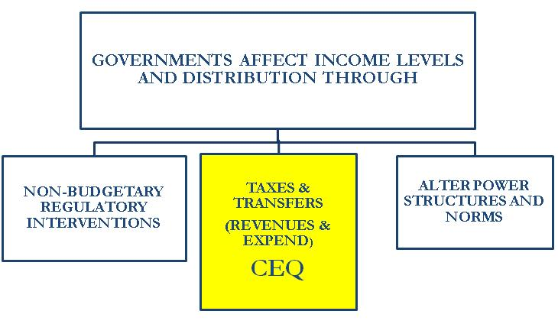
The Redistributive Power of the State: Three Main Mechanisms

Slide 13
CEQ’s Key questions
Do governments collect and allocate sufficient resources to substantially reduce poverty and human capital gaps and protect the poor from income fluctuations?
Do taxes and public spending patterns reduce inequality and by how much?
Are policies efficient and can spending be maintained?
Is information to monitor outcomes readily available and reliable, and are independent evaluations carried out?

Slide 14
Policy Instruments Covered
Monetary transfers
Subsidies to consumption goods and (some) inputs
In-kind transfers through the fully or partially subsidized provision of goods and services particularly in the area of education, health and basic infrastructure
Taxes on income, consumption and assets (including tax expenditures)
Co-payments and users’ fees
Note: in the cases of education and health, includes public investment but the rest of PI is not included in the analysis

Slide 15
Characteristics of CEQ
Focuses on government efforts rather than outcomes
  Different from/complement to HDI , MDG Monitoring Reports and Equality of Opportunity Index at WB, for example
Based on “hard” data and not perceptions
  Different from, for ex., Transparency’s Corruption Index
Relies significantly on primary sources of information and research
  Different from PREAL’s Education Report Card (uses mainly secondary sources)
CEQ more analytical than other exercises (e.g., Pew’s GPP). More similar to public expenditure reviews, incidence analysis, or Jeff Sach’s needs assessments

Slide 16
Limitations of CEQ
CEQ is not design to give rigorous answers to the following questions:
  Which allocation of public spending is optimal (spending on education vs pensions, health, monetary transfers, basic infrastructure, etc.)?
  Which allocation of public education within broad sectors is optimal (e.g., primary vs. secondary education)?
It uses ‘static’ incidence analysis; it does not include behavioral responses or general equilibrium or dynamic effects
CEQ’s purpose:
With a combination of quantitative and qualitative indicators, CEQ assesses the direct impact of government’s revenue and expenditure policies on poverty and inequality

Slide 17
CEQ: What form does it take?
CEQ consists of a series of indicators whose theoretical underpinning can be found in:
  economics of the welfare state
  criteria-based approach
Indicators derived from standard poverty and inequality analysis, fiscal incidence analysis and public finance
Experimenting with approaches to generate indicators in areas not well developed in the literature (e.g., estimate resources required due close poverty gaps caused by systemic or idiosyncratic shocks)

Slide 18
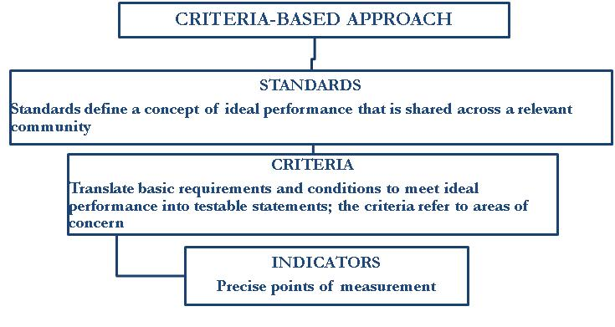

Slide 19
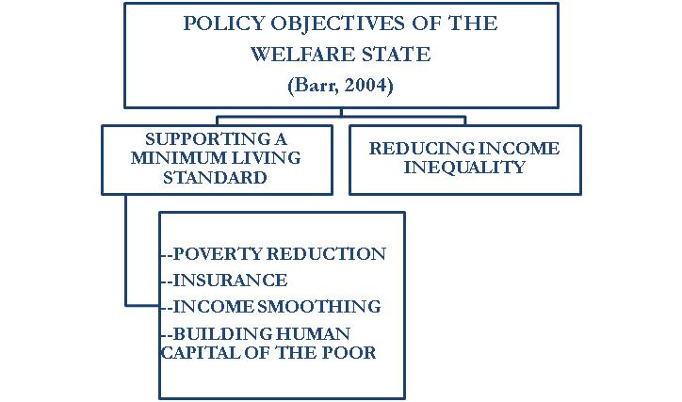
Standards in CEQ: Two Policy Objectives

Slide 20
Policy Objective 1: Supporting a minimum living standard has 4 elements
  poverty reduction: ensuring that everyone has a minimum level of consumption
  insurance: preventing individuals from falling (or falling further) below the minimum level of consumption due to adverse shocks, both idiosyncratic (unemployment, illness, bad harvests, etc.) and systemic (economic crises, natural disasters, spikes in food prices, etc.)
  income smoothing: ensuring that a minimum level of consumption is achieved throughout an individual’s life-cycle (maternity/paternity leave and retirement, in particular)
  building poor people’s human capital: ensuring that everyone has a minimum level of education and health.

Slide 21
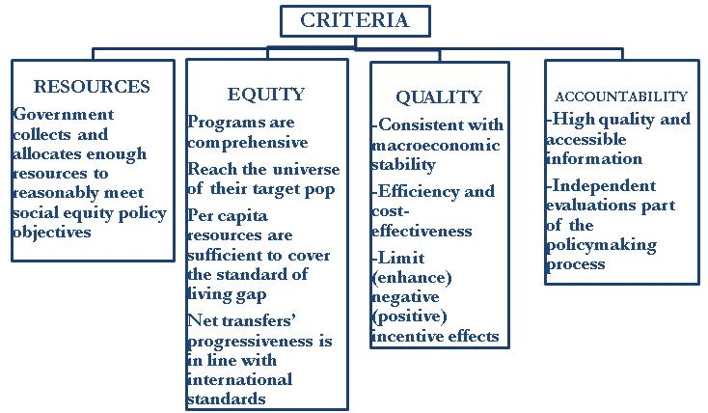
Criteria in CEQ are 4

Slide 22
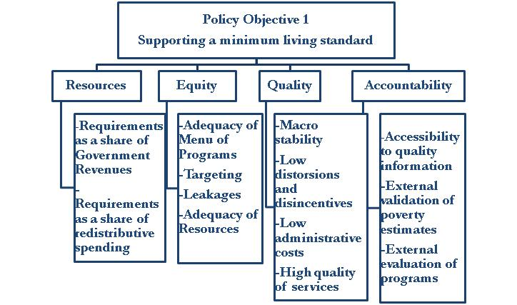
Indicators for PO 1: Synthesis

Slide 23
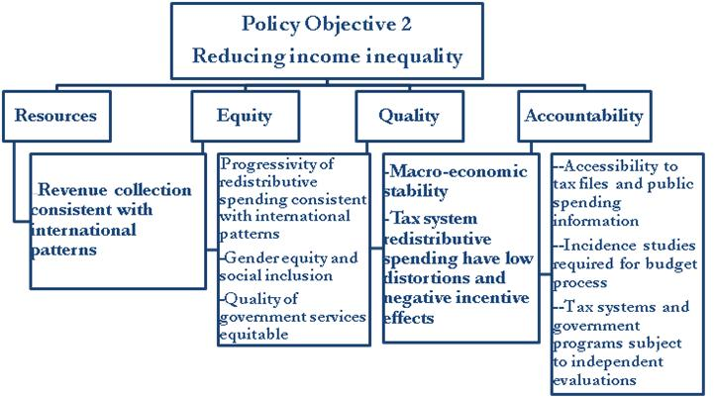
Indicators for PO 2: Synthesis

Slide 24
CEQ Diagnostic: Summing Up
CEQ has two standards or policy objectives
  1. Supporting a minimum standard of living
  2. Reducing inequality
First policy objective has four sub-standards: everyone has a minimum level of (1) consumption and (2) human capital (3) throughout the life-cycle and (4) in the face of adverse shocks
CEQ has four criteria: resources, equity, quality & accountability
CEQ has 71 indicators; 32 quantitative (Resources and Equity sections of questionnaire) and 39 “qualitative” (Quality and Accountability sections).
Thirty one indicators; require poverty, inequality and incidence analysis
Data requirements: household survey (preferably, an income-expenditure survey) and detailed public finance accounts

Slide 25
Methodology to assess whether Resources are sufficient to support a minimum living standard for all (PO 1)
Government makes substantial efforts to support a minimum standard of living and build the human capital of the poor through taxes and transfers
Criteria: resources, equity, quality and accountability

Slide 26
Indicators for PO 1: Synthesis (Fig 3)

Slide 27
PO 1 – Resources
Question 1: Requirement vs. Government Revenues

Slide 28
PO 1 – Resources
Question 2: Requirements vs. Redistributive Spending

Slide 29
STEPS
Calculate:
Market, disposable, post-fiscal and final income (described below)
  Imputation methods for in-kind income (health and education services provided by government free or quasi free)
  Estimation of impact of indirect taxes (including tax expenditures) and subsidies requires consumption data at the household level
Government Revenues and Redistributive Spending
Poverty and human capital gaps; or, more broadly, opportunity gaps (e.g., HK and basic infrastructure)

Slide 30
Definitions
Income: market, disposable, post-fiscal and final
Government revenues
Redistributive spending
Poverty and Human Capital Gaps

Slide 31
Definitions of Income: Market, Disposable, Post-Fiscal and Final Income (Lustig, 2010)

Slide 32
Definition of Government Revenue
Includes the total budgetary income of the federal government:
  tax and non-tax revenue
  plus income generated by direct budgetary controlled entities or public enterprises
In countries where revenue collected at the provincial or state level is “important,” the total will include the revenues obtained by governments at the subnational level

Slide 33
Definition: Redistributive Spending
Redistributive spending: all monetary transfers, direct and indirect subsidies, and in-kind transfers PLUS consumer subsidies, some producer subsidies and “social” tax expenditures MINUS non-subsidized portion of social security pensions
In countries where spending at the provincial or state (and municipal) level is important, includes redistributive spending by governments at the subnational level

Slide 34
Important: Redistributive and Social Spending are Different
Social spending as commonly defined in official budgetary classifications: spending on education, health, social security, and social assistance
Redistributive spending: all monetary transfers, direct and indirect subsidies, and in-kind transfers (mainly education, health, and some nutrition programs)
PLUS
  consumer subsidies (electricity and fuel) and some producer subsidies (agricultural support)
  “social” tax expenditures (e.g., exemptions on VAT for food)
MINUS
  non-subsidized portion of social security pensions (i.e., it subtracts contributions to social security pensions made by workers and employers from total spending on social security pensions; included on the tax side of the analysis)

Slide 35
Fig 5: Redistributive vs Social Spending

Slide 36
Indicators for Policy Objective 1: RESOURCES
  Remember that RESOURCES measures whether government revenues and redistributive spending are potentially consistent with what would be required for supporting a minimum standard of living for everybody.

Slide 37
Indicators for Policy Objective 1: RESOURCES :
Must determine whether resources collected and allocated to redistributive spending are sufficient to close all the pre-transfers gaps.
Steps:
  Calculate total government revenues
  Calculate redistributive spending
  Calculate total requirements: add up all the pre-transfers gaps (details next slides)
  Calculate ratio of total requirements to a. government revenues and b. government redistributive spending
    If ratios “substantially” lower than unity, means total fiscal and redistributive space is ample
    If ratios close or above unity, government efforts in collecting resources and/or allocating them for redistributive purposes are insufficient

Slide 38
Indicators for Policy Objective 1: RESOURCES : Pre-Transfers Gaps
TOTAL INCOME POVERTY GAPS (pre-Transfers)
Total Income Transfers Poverty Gap
Total Pensions Gap
Total Unemployment Compensation Gap
Total Systemic Shock Gap (economic crisis, rising food prices, natural disasters, epidemics)
TOTAL OPPORTUNITY GAPS (pre-Transfers)
TOTAL HUMAN CAPITAL GAPS (pre-Transfers)
Total Education Coverage Gap
Total Health Coverage Gap
TOTAL INFRASTRUCTURE GAPS (pre-Transfers)
Total Drinkable Water Gap
Total Electricity Gap
Total Sewerage Gap
Total Access to Markets Gap
Total Housing Gap

Slide 39
Estimating the Relevant Poverty Gaps: Definition of Variables

Slide 40
Total Requirements
Total (Pre-Transfers) Income Poverty Gaps

Slide 41
Total Requirements (cont)
Total (Pre-Transfers) Human Capital Gaps

Slide 42
Total (Pre-Transfers) Requirements (TR)
Total (Pre-Transfers) Gaps

Slide 43
Example: Mexico (Scott, 2010)
Must determine whether resources collected and allocated to redistributive spending are sufficient to close all the pre-transfers gaps.
Steps:
  Calculate total government revenues
  Calculate redistributive spending
  Calculate total requirements: add up all the pre-transfers gaps (details next slides)
  Calculate ratio of total requirements to a. government revenues and b. government redistributive spending
    If ratios “substantially” lower than unity, means total fiscal and redistributive space is ample
    If ratios close or above unity, government efforts in collecting resources and/or allocating them for redistributive purposes are insufficient

Slide 44
Example: Mexico (Scott, 2010)
Indicators for Policy Objective 1: RESOURCES : Pre-Transfers Gaps
TOTAL INCOME POVERTY GAPS (pre-Transfers)
Total Income Transfers Poverty Gap
Total Pensions Gap
Total Unemployment Compensation Gap
Total Systemic Shock Gap (economic crisis, rising food prices, natural disasters, epidemics)
TOTAL OPPORTUNITY GAPS (pre-Transfers)
TOTAL HUMAN CAPITAL GAPS (pre-Transfers)
Total Education Coverage Gap
Total Health Coverage Gap
TOTAL INFRASTRUCTURE GAPS (pre-Transfers)
Total Drinkable Water Gap
Total Electricity Gap
Total Sewerage Gap
Total Access to Markets Gap
Total Housing Gap

Slide 45
Example: Mexico (Scott, 2010)
(2009 Billion Mx$; z = US$4 a day)

Slide 46
Example: Mexico (Scott, 2010)
PO 1 - RESOURCES

Slide 47
Indicators for Policy Objective 1
EQUITY
Remember that EQUITY measures whether:
i. existing programs are adequate
ii. allocation of redistributive spending is consistent with supporting a minimum standard of living for everybody
iii. coverage among the poor
iv. leakages to non-poor

Slide 50
Indicators for Policy Objective 1
EQUITY
Remember that EQUITY measures whether:
i. existing programs are adequate
ii. allocation of redistributive spending is consistent with supporting a minimum standard of living for everybody
iii. coverage among the poor
iv. leakages to non-poor

Slide 51
Indicators for Policy Objective 1
EQUITY
Must determine whether resources allocated to the poor per relevant category are sufficient to close each and all the after-transfers gaps.
Steps:
  Calculate government spending per relevant category
  Calculate additional requirements per category (details next slides)
  Calculate difference in spending per relevant category minus additional requirements in relevant categories
    If positive, government is spending sufficient resources in the relevant category to potentially close the gap
    If negative (or zero), government efforts in terms of how much it is spending on the relevant gaps are insufficient

Slide 52
Indicators for Policy Objective 1: EQUITY
INCOME POVERTY GAPS
Income Transfers Poverty Gap
Pensions Gap
Unemployment Compensation Gap
Systemic Shock Gap (economic crisis, rising food prices, natural disasters, epidemics)
OPPORTUNITY GAPS:
HUMAN CAPITAL GAPS
Education Coverage Gap
Health Coverage Gap
INFRASTRUCTURE GAPS
Drinkable water
Electricity
Sewerage
Access to markets

Slide 53
Additional Requirements
After Transfers Income Poverty Gaps

Slide 54
Additional Requirements
After-Transfers Human Capital Gaps

Slide 55
Total Additional Requirements (AR)
Total (After-Transfers) Gaps

Slide 56
Example: Mexico (Scott, 2010)
(2009 Billion Mx$; z = US$2.5 & 4 a day)

Slide 57
Example: Mexico (Scott, 2010)
(2009 Billion Mx$; z = US$4 a day)

Slide 58
Calculating Systemic Shocks Poverty Gaps (econ crisis, nat disaster, policy reform, etc.
Three different methods:
  Arg (frequency of economic crisis, average impact on GDP; impact on poverty calculated using a poverty/growth elasticity)
  Mx (“arithmetic” calculation of additional income poverty due to 2008-2009 recession)
  Pe (probability of facing shock by the poor and estimated income loss for the poor due to a shock using regression analysis)

Slide 59
Methodology to answer questions under PO 2
Policy Objective 2: Government makes substantial efforts to reduce income inequality through taxes and transfers.
Criteria: resources, equity, quality and accountability

Slide 60
PO 2 – Resources

Slide 61
Method
OLS regressions with GDP per capita as independent variable; around 200 countries
Compare actual vs predicted value

Slide 62
PO 2 -- Equity

Slide 64
Indeces
Concentration Index
Kakwani Index
Reynolds-Smolensky

Slide 65
PO 2 – Equity (cont.)

Slide 66
References
Adcock, Robert and David Collier. 2001. “Measurement Validity: A Shared Standard for Qualitative and Quantitative Research.” The American Political Science Review 95(3): 529-546, September.
Barr, Nicholas. 2004. Economics of the Welfare State, 4th edition, Oxford University Press.
Chen, Shaohua and Martin Ravallion. 2008. “The developing world is poorer than we thought, but no less successful in the fight against poverty.” Policy Research Working Paper 4703. World Bank Development Research Group. Washington DC: World Bank. Danish Evaluation Institute. 2004. Criteria Based Evaluations: EVA’s Experience in Evaluations Based on Criteria. Published only on website. http://www.eva.dk/Publications.aspx?M=Shop&PID=1027&ProductID=220
Goñi, Edwin, J. Humberto López, and Luis Servén. 2008. “Fiscal Redistribution and Income Inequality in Latin America.” Policy Research Working Paper 4487. World Bank Development Research Group Macroeconomics and Growth Team. Washington DC: World Bank. López, Humberto J. and Guillermo Perry. 2008. “Inequality in Latin America: Determinants and Consequences.” Policy Research Working Paper 4504. World Bank Latin America and Caribbean Region Office of the Regional Chief Economist. Washington DC: World Bank.
Jaramillo, Miguel. 2010. “Compromiso con la equidad: Peru,” Document Prepared For The Project “Commitment To Equity,” CIPR/Tulane And Inter-American Dialogue, Mimeo.
Lopez-Calva, Luis F. and Nora Lustig. Eds. 2010. Declining Inequality in Latin America: A Decade of Progress? Washington DC: Brookings Institution Press.
  Lustig. 2010.“Commitment to Equity (CEQ): A Diagnostic and Ranking Tool of Latin American Governments’ Fiscal Policies,” CIPR & Econ Dept/Tulane and Inter-American Dialogue, mimeo.
Morra Imas, Linda G. and Ray C. Rist. 2009. The Road to Results: Designing and Conducting Effective Development Evaluations. Washington DC: World Bank.
Pessino, Carola. 2010. “Commitment to Equity: Argentina,” Document Prepared For The Project “Commitment To Equity,” CIPR/Tulane And Inter-American Dialogue, Mimeo.
Sadler, R. D. Apr 2005. “Interpretations of criteria-based assessment and grading in higher education.” Assessment & Evaluation in Higher Education 30(2):175-194. Available online http://www.his.se/upload/49726/sadler_criteriabased%20assessment.pdf
Scott, John. 2010. “Commitment to Equity: Mexico.” Document Prepared For The Project “Commitment To Equity,” CIPR/Tulane And Inter-American Dialogue, Mimeo.

