Slide 1
Markets, the State and Inclusive Growth in Latin America: Argentina, Brazil, Mexico, Peru and Uruguay
Nora Lustig
Professor, Tulane University
Asian Development Bank
“Social Inclusiveness in Asia’s Emerging Middle Income Countries”
13 September 2011, Jakarta, Indonesia

Slide 2
Sources:
Declining Inequality in Latin America: A Decade of Progress? Edited by Luis F. López-Calva and Nora Lustig, Brookings Institution and UNDP, 2010
“Declining Inequality in Latin America: Some Economics, Some Politics,” Birdsall, Lustig and McLeod in Handbook of Latin American Politics, forthcoming
“Declining Inequality in Latin America: How Much, Since When and Why?,” Lustig, Lopez-Calva and Ortiz, working paper, Tulane University, forthcoming
“Poverty and Inequality under Latin America’s New Left Regimes,” McLeod, Darryl and Nora Lustig (2010). Paper prepared for the 15th Annual LACEA Meeting, Medellin, Colombia: Universidad de Antioquia and Universidad Eafit. Under revision, 2011
“Cambios en la desigualdad del ingreso en América Latina. Contribución de sus principales determinantes: 1995 – 2006” (2009) Alejo et al., PNUD
“Commitment to Equity: Fiscal Policies in Latin America” coordinated by Nora Lustig: Argentina (Carola Pessino), Bolivia (George Gray Molina, Veronica Paz and Ernesto Yanez), Brazil (Claudiney Pereira and Sean Higgins), Mexico (John Scott) and Peru (Miguel Jaramillo and Barbara Sparrow)

Slide 3


Slide 4
Outline
Inequality in LA
  International comparison
Declining Inequality in LA:
  How Much?
  Since When?
Declining Inequality: Why?
  Falling skill premia
  More progressive government transfers
Caveat: Under-reporting of Top Incomes and Inequality Trends
The Future: Will (Measured) Inequality Continue to Decline?

Slide 5
  Inequality in LA: international comparison
  Gini Coefficient by Region (in %), 2004
I think the data for Asia are not correct. Please look at ADB Key Indicators 2007. This has data on rising ineqiuality in Asia. And you may wish to also show in arrow that Asia is increasing, while LA is falling

Slide 6
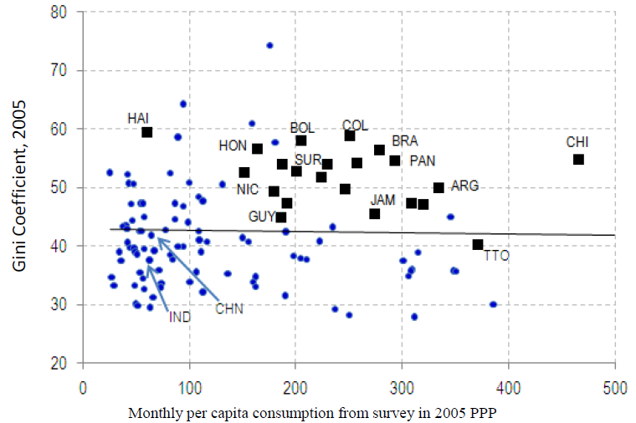
Excess Inequality (IDB, 2011)

Slide 7
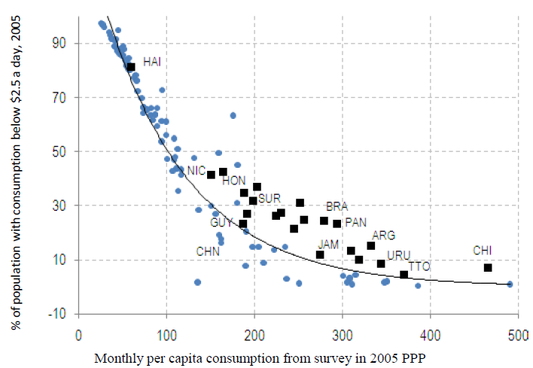
Excess Poverty (IDB, 2011)
You may wish to say that poverty in Asia (2.5 $) –m in comparison to LA - is much higher at around 40%, and MICs have higher poverty incidences in Asia than in LA

Slide 8
Trends in Inequality
Gini Coefficient Early 1990’s-Late 2000’s
Light Grey: Countries with Falling Ineq (Lustig et al., 2011)
I am not clear what the message in this figure is

Slide 9
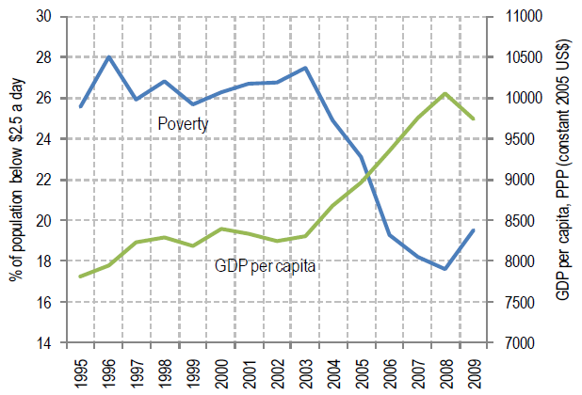
Trends in Poverty: 1995-2009 (IDB, 2011)
Interesting: While in LA GDP/capita goes up and 2.5$ poverty down in Asia, GDP per capita goes up but $2 poverty remains stable and high at 40%. What does this mean for the inclusiveness of growth in both regions?

Slide 10
Declining Inequality in LA: How Much?
Inequality in most Latin American countries (13 out of 17) has declined (roughly 1% a year) between (circa) 2000 and (circa) 2008
Decline is statistically significant
Decline continued through the global financial crisis in 2009
ADB’s research on inequality shows that this is different in Asia, where inequalities are rising during the last 15 years of economic growth

Slide 11
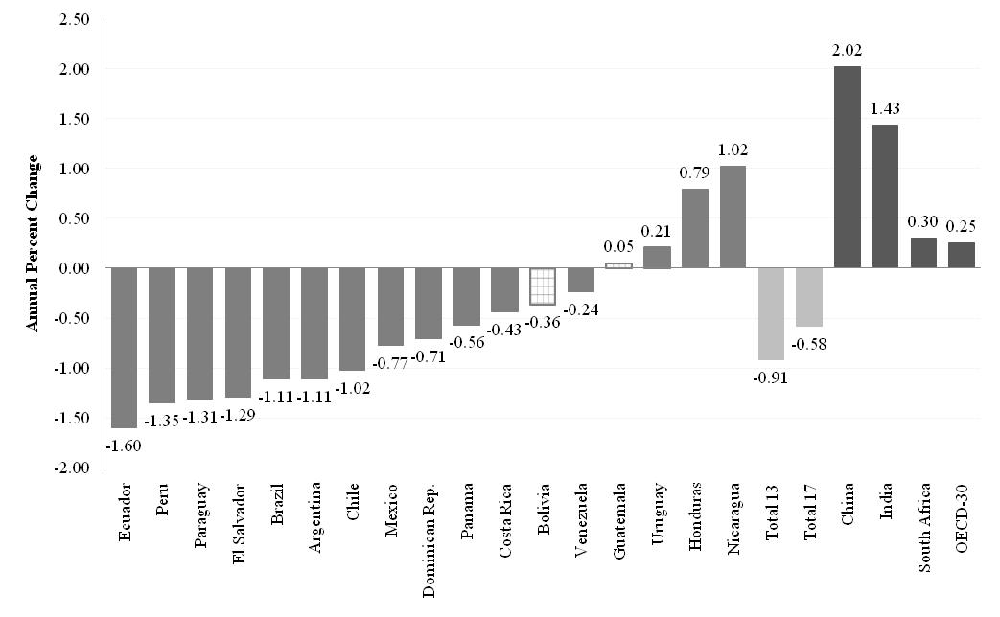
Change in Gini Coefficient by Country: circa 2000-2008 (yearly change in percent)

Slide 12
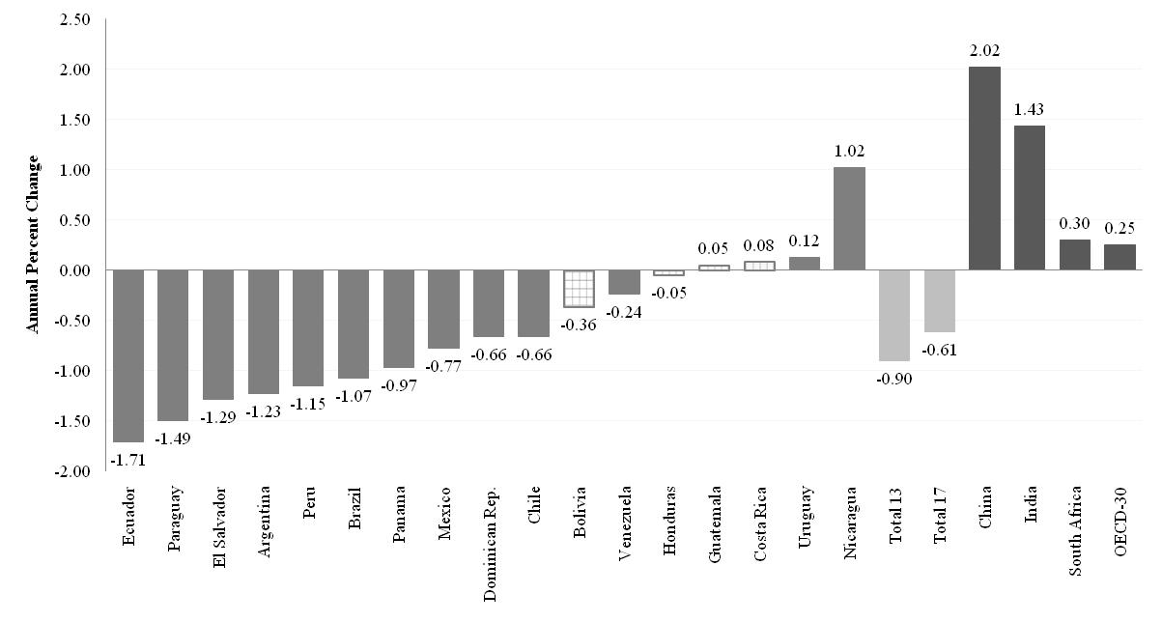
Change in Gini Coefficient by Country: circa 2000-2009 (yearly change in percent)
You can delete this slight as it is a duplication

Slide 13
Comparing the Increase in the 1990’s with Decline in the 2000’s (Lustig et al., 2011)
Why this different? I think your message is: Public policies and not markets, I think make the difference

Slide 14
Decline is robust
Decline in inequality is statistically significant and significant in terms of order of magnitude
There is Lorenz dominance (unambiguous decline independently of choice of inequality measure)
Robust to income concept (e.g., monetary vs. total)

Slide 15
Declining Inequality in LA: Since When?
In three countries, during second half of 1990s: Mexico, Brazil and Chile
In six, started in 2002-2003: Argentina, Bolivia, El Salvador, Paraguay, Panama and Peru
In others, although there are fluctuations, inequality between 2000 and 2009 increased: Costa Rica, Honduras and Uruguay (only statistically significant of three)
  While growth rates were similar in all countries, thre countries that reduced inequalities are the countries with majpor poverty reudctionanfd socialprotetcion programs

Slide 16
First Year in Which Inequality Started to Decline (Lustig et al, 2011)

Slide 17
The decline in inequality has been widespread
The decline took place in:
Persistently high inequality countries (Brazil) and normally low inequality countries (Argentina)
Fast growing countries (Chile and Peru), slow growing countries (Brazil and Mexico) and countries recovering from crisis (Argentina and Venezuela)
Countries with left “populist” governments (Argentina), left social-democratic governments (e.g., Brazil, Chile) and center/center-right governments (e.g., Mexico and Peru)

Slide 18
Yearly Change in Gini: Left and Non-left Regimes (circa 2000-2009)

Slide 20
Why has inequality declined in Latin America? Are there factors in common?
In-depth analysis in four countries:
  Argentina (Gasparini and Cruces) (urban; 2/3 of pop)
  Brazil (Barros, Carvalho, Mendoca & Franco)
  Mexico (Esquivel, Lustig and Scott)
  Peru (Jaramillo & Saavedra)
  Source: Lopez-Calva and Lustig (2010)

Slide 21
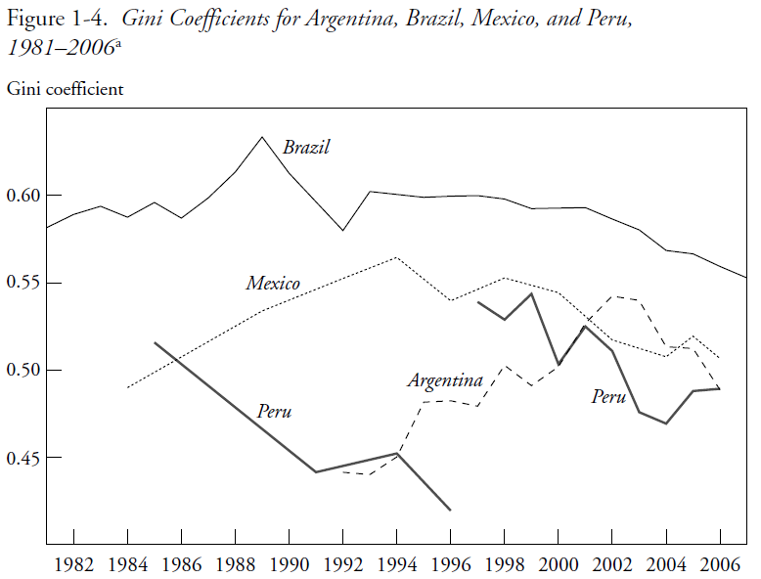

Slide 22
Four countries are a ...
Representative sample of Latin American diversity:
  high/medium/low ineq
  high/low growth
  Populist/social democratic/center-center-right governments

Slide 23
Sample Representative of High and Low Inequality Countries
(Latin America: Gini Coefficient by Country; circa 2007; in percent)

Slide 24
Sample Representative of High and Low Growth Countries
Argentina and Peru were growing at around 6 percent a year since 2003
Brazil and Mexico were growing at less than 3 percent a year (Brazil’s growth rate picked up only from 2008 onwards)

Slide 25
Income of the Brazilian poor has been growing as fast as per capita GDP in China while income of the richest ten percent has been growing like Germany’s per capita GDP
This is a very interesting graph
Notes:
25

Slide 26
Mexico: Growth Incidence Curve 2000-2008

Slide 27
Proximate and fundamental determinants of changes in inequality
There are many different factors that affect the distribution of income over time: “… the evolution of the distribution of income is the result of many different effects—some of them quite large—which may offset one another in whole or in part.” (Bourguignon et al., 2005)
Useful framework: to consider the ‘proximate’ factors that affect the distribution of income at the individual and household level:
  Distribution of assets and personal characteristics
  Return to assets and characteristics
  Utilization of assets and characteristics
  Transfers (private and public)
  Socio-demographic factors

Slide 28
Four countries share two relevant socio-demographic changes
Proportion of working adults as a share of the total number of adults (and total household members) rose; partly linked to the sharp increase in female labor force participation:1990-2006 by 18.1 p.pts in Mexico, 14.2 in Argentina, 12.0 in Brazil and 5.8 in Peru.
  Dependency ratios improved proportionately more for low incomes.
  Working adults (except for Peru) became more equally distributed (female adults participated proportionately more for low incomes)
Average years of schooling rose faster for the bottom quintile than for the top quintile.
  => Distribution of education (human capital) became more equal in all four countries

Slide 30
Household per capita income and its determinants
DEMOGRAPHIC
Per capita household income
Proportion of adults in the household
FERTILITY
Household income per adult
DEMOGRAPHIC
MARKET
POLITICS/INST./SOC. NORMS
STATE
(EDUCATION)
MARKET
POLITICS/
INST.
STATE
Household non-labor income per adult
RENTS & PROFITS
REMITTANCES
GOV. TRANSFFERS
Household labor income per adult
Proportion of working adults
PARTICIPATION IN LABOR FORCE
EMPLOYMENT OPPORT
Labor income per working adult in the household
WAGES BY SKILL/OTHER
HOURS WORKED
DEMOGRAPHIC
MARKET

Slide 31
Decomposing changes into proximate determinants (Barros et al. 2006, 2007)
Per capita household income can be written as:
    y = a ( u w + o)
This identity relates changes in per capita household income, y, to its four proximate determinants:
  changes in the proportion of adults in the household, a;
  changes in the proportion of working adults, u;
  (iii) changes in labor income per working adult in the household, w; and
  (iv) changes in household non-labor income per adult, o.

Slide 32
Decomposition results (Alejo et al., 2009):
Demographics: Changes in the ratio of adults per household were equalizing, albeit the orders of magnitude were generally smaller except for Peru.
Labor force participation: With the exception of Peru, changes in labor force participation (the proportion of working adults) were equalizing. This effect was stronger in Argentina.

Slide 33
Decomposition results (Alejo et al., 2009):
Labor income (Earnings): In Argentina, Brazil, and Mexico between 44% and 65% of the decline in overall inequality is due to a reduction in earnings per working adult inequality. In Peru, however, changes in earnings inequality were unequalizing at the household level but not so at the individual workers’ level.
Non-labor income: Changes in the distribution of non-labor income were equalizing; the contribution of this factor was quite high in Brazil and Peru (45% and 90%, respectively).

Slide 34
Decomposition results (Alejo et al., 2009):
Main finding:
=> Decline in labor inc0me (except for Peru at the household level) and non-labor income inequality important determinants of the decline in overall income inequality (in per capita household income)

Slide 35
Argentina: 2004-06
(Gasparini & Cruces)
Decline in labor income inequality:
employment generated by recovery: open unemployment fell from 14.8% in 2000 to 9.6% in 2006
shift in favor of more low-skilled, labor-intensive sectors as a result of the devaluation
rise in the influence of labor unions which compresses wages
fading of the one-time effect of skill-biased technical change that occurred in the 1990s
Decline in non-labor income inequality:
more progressive government transfers: Jefes y Jefas de Hogar program launched in 2002

Slide 36
This is important: it shows the need to invest in higher education. In Asia too many governments still focus on basic education and leave higher education to market/families’ income

Slide 37
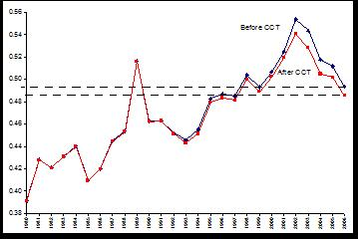
Argentina: Distributional impact of Conditional cash transfers
Why did GINI go down in 1990 so rapidly? Was there a similar anti-poverty program that time ?

Slide 38
Brazil: 2001-2007
(Barros et al.)
Decline in labor income inequality:
  About 50% accounted for by decline in attainment inequality (quantity effect) and less steep returns --wage gap by skill narrows—(price effect). Latter dominant. (See Gini for years of schooling and returns by skill in next two slides)
  About 25% accounted for by decline in spatial segmentation; especially, reduction in wage differentials between metropolitan areas and medium/small municipalities. Also, decline in sectoral segmentation.

Slide 40
Brazil: Decline in non-labor income inequality
Contribution of changes in the distribution of income from assets (rents, interest and dividends) and private transfers was unequalizing but limited.
Most of the impact of non-labor income on the reduction of overall income inequality was due to changes in the distribution of public transfers: changes in size, coverage and distribution of public transfers. Bolsa Familia accounts for close to 10 percent of the decline in household per capita income inequality.

Slide 41
Mexico: 2000-2006
(Esquivel, Lustig & Scott, 2009)
Decline in labor income inequality:
  Educational attainment became more equal and returns less steep.
  The latter seems to be associated with the decline in relative supply of workers with low educational levels. Between 1989 and 2006, the share of workers with less than lower-secondary education fell from 55% to around 33%.
  It coincides with the period in which government gave a big push to basic education.
    Between 1992 and 2002 spending per student in tertiary education expanded in real terms by 7.5 percent while it rose by 63 percent for primary education.
    The relative ratio of spending per student in tertiary vs. primary education thus declined from a historical maximum of 12 in 1983-1988, to less than 6 in 1994-2000 (by comparison, the average ratio for high-income OECD countries is close to 2).
  Next two slides show: Gini for yrs. of schooling and returns to schooling

Slide 42
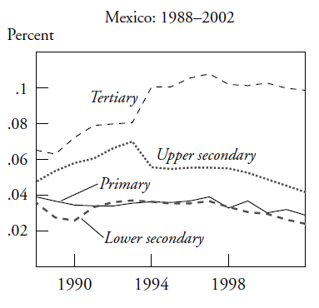

Slide 43
Mexico: Decline in non-labor income inequality
The equalizing contribution of government transfers increased over time (both at the national level as well as for urban and, especially, rural households). By 2006 transfers became the income source with the largest equalizing effect of all the income sources considered.
Remittances became more equalizing too but with a smaller effect than government transfers.
Both more than offset the increasingly unequalizing impact of pensions.
The discussion of remittances is important for Asia too. Many gvts here trust in remittances a lot (e.g. PHI). But you say that in LA remittances have little redistributive effect. I think the same is here in Asia, as remittances are often only used for consumption (and a bit for education)

Slide 44
Mexico: Decline in non-labor income inequality
The sharp rise in the role and equalizing impact of public transfers was a consequence of a significant policy shift in 1997, when the government launched the conditional cash transfer program Progresa/Oportunidades.
During 1996-2006 the size of public transfers increased; they became more equally distributed among recipients, and the recipients of transfers increasingly belonged to relatively poorer segments of the population.

Slide 45
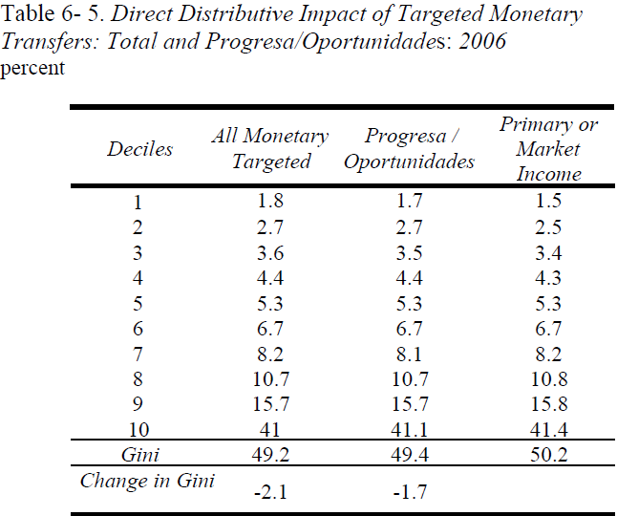

Slide 46
Peru: 1997-2006
(Jaramillo & Saavedra, 2009)
Labor income inequality:
  Changes in educational structure were equalizing at the household and individual workers levels.
  Changes in returns to education, however, were equalizing at the individual workers level but not at the household level. Changes in assortative matching might have been a factor.
  Earnings gap by skill narrowed at the individual workers level as in the other countries. Fading out of skill-biased technical change and a more equal distribution of education/educational upgrading.
  Next two slides show the Gini for years of schooling and the returns to schooling.

Slide 47
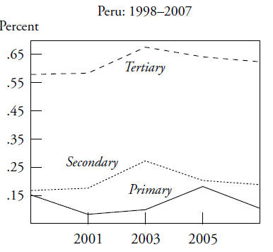

Slide 48
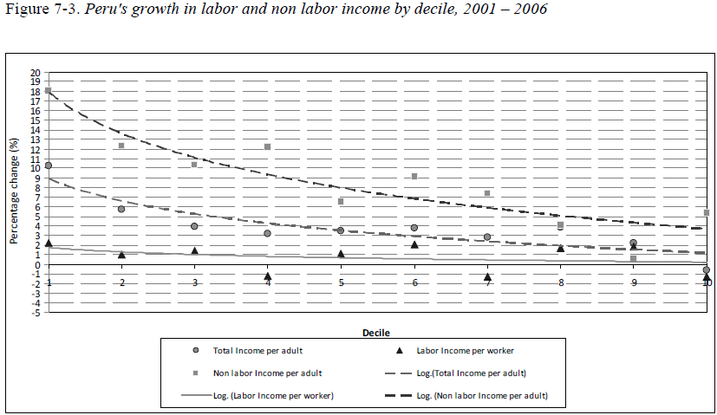
Peru: Decline in non-labor income inequality: progressivity rose in non-monetary transfers

Slide 49
Why has inequality declined? Main findings
Educational upgrading and a more equal distribution of educational attainment have been equalizing (quantity effect). No “paradox of progress” this time.
Changes in the steepness of the returns to education curve have been equalizing at the individual workers level (price effect). Except for Peru, they have been equalizing at the household level too.
Changes in government transfers were equalizing: more progressive government transfers (monetary—e.g., CCT--and in-kind transfers); expansion of coverage, increase in the amount of transfers per capita, better targeting.

Slide 50
Why has the skill premium declined? Main findings
Increase in relative demand for skilled labor petered out: Fading of the unequalizing effect of skill-biased technical change in the 1990s: Argentina, Mexico & Peru.
Decline in relative supply of low-skilled workers: Expansion of basic education since the 1990s: Brazil, Mexico and Peru .

Slide 52
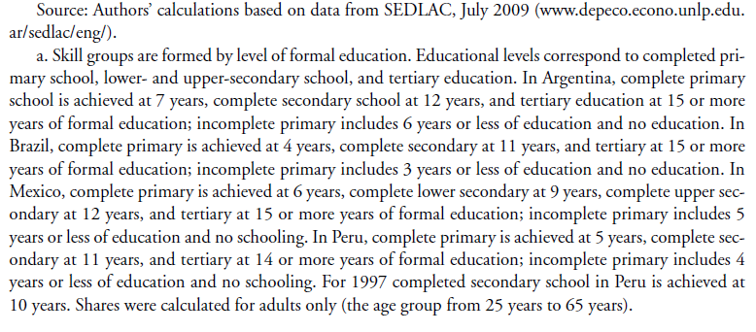

Slide 53
Why has earnings inequality declined? Main findings
Other effects:
Decline in spatial labor market segmentation in Brazil.
In the case of Argentina, the decline also driven by a pro-union government stance and by the impetus to low-skill intensive sectors from devaluation. In Brazil, increase in minimum wages.

Slide 54
Why has inequality in non-labor incomes declined? Main findings
In the four countries government transfers to the poor rose and public spending became more progressive
    In Argentina, the safety net program Jefes y Jefas de Hogar.
    In Brazil and Mexico, large-scale conditional cash transfers => can account for between 10 and 20 percent of reduction in overall inequality. An effective redistributive machine because they cost around .5% of GDP.
    In Peru, in-kind transfers for food programs and health. Also access to basic infrastructure for the poor rose.

Slide 55
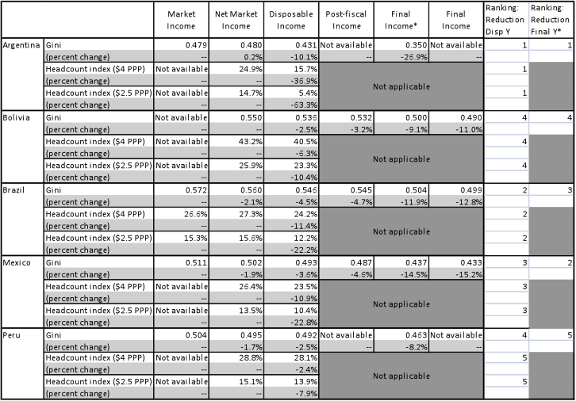
Fiscal Policy and Redistribution (Lustig, coord., 2011)

Slide 56
Conclusions
In the “race” between skill-biased technological change and educational upgrading, thanks for the expansion in investments in education, in the last ten years the latter has taken the lead (Tinbergen’s hypothesis)
Perhaps as a consequence of democratization and political competition, government (cash and in-kind) transfers have become more generous and targeted to the poor

Slide 57
Is Inequality Likely to Continue to Fall?
Despite the observed progress, inequality continues to be very high (the highest in the world) and the bulk of government spending is not sufficiently progressive.
The decline in inequality resulting from the educational upgrading of the population will eventually hit the ‘access to tertiary education barrier’ which is much more difficult to overcome: inequality in quality and ‘opportunity cost’ are high and costly to address.
  => United States experience should serve as warning (Goldin and Katz, 2008)

Slide 58
THANK YOU

