Slide 1

Fiscal Policy, Poverty and Redistribution in Latin America
Nora Lustig
Tulane University
Nonresident Fellow CGD and IAD
Inter-American Development Bank/OVE
Washington, DC, July 31, 2013

Slide 2
Suppose you want to know…
Assessment of current fiscal system or parts of it:
What is the impact of taxes and government transfers on inequality and poverty?
Who are the net tax payers to the “fisc” (with and without imputing benefits from in-kind transfers)?
How equitable is access to government education and/or health services? By income, gender, ethnic origin, for example.
How progressive is taxation and spending (as a whole and by categories)?

Slide 3
Suppose you want to know…
Impact of hypothetical or actual reforms:
How do inequality and poverty change when you eliminate VAT exemptions?
Who benefits from the elimination of user fees in primary education or the expansion of noncontributory pensions?
Who loses from the elimination of energy subsidies?

Slide 4
Types of Incidence Analysis
Standard vs. Behavioral, CGEs, Intertemporal
Partial vs. Comprehensive
Average vs. Marginal

Slide 5
Welfare Indicator
Income vs. Consumption
Current vs. Lifetime
Per capita vs. equivalized

Slide 6
Basic elements of “applied” standard incidence
Start with:
Pre-tax/pre-transfer income/consumption of unit h, or I_{h}
Taxes/transfers programs T_{i}
“Allocators” of program i to unit h, or S_{ih} (or the share of program i borne by unit h)
Then, post-tax/post-transfer income of unit h (Y_{h}) is:
Y_{h} = I_{h} - ∑_{i} T_{i}S_{ih}

Slide 7
Allocation Methods
Direct Identification in microdata
If not in microdata, then:
  (micro) Simulation: statutory vs. tax shifting or take-up assumptions
  Imputation
  Inference
  Alternate Survey
  Secondary Sources

Slide 8
Allocation Methods
Tax shifting assumptions
Tax evasion assumptions
Take-up of cash transfers programs
Monetizing in-kind transfers

Slide 9
Commitment to Equity Assessments (CEQ) for Latin America
Comprehensive standard fiscal incidence analysis of current systems
No behavior and no general equilibrium effects
Harmonizes definitions and methodological approaches to facilitate cross-country comparisons
Uses income per capita as the welfare indicator
Allocators vary => full transparency in the method used for each category, tax shifting assumptions, etc.
Mainly average incidence; a few cases with marginal incidence

Slide 10
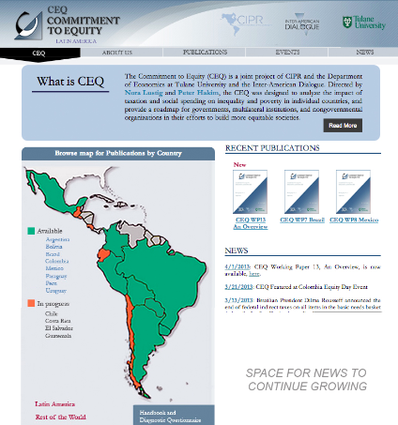
www.commitmentoequity.org

Slide 11
Special issue: Lustig, Pessino and Scott. Editors. “Fiscal Policy, Poverty and Redistribution in Latin America,”Public Finance Review (forthcoming)
  Argentina (2009): Nora Lustig and Carola Pessino
  Bolivia (2009): George Gray Molina, Wilson Jimenez, Veronica Paz and Ernesto Yañez
  Brazil (2009): Sean Higgins and Claudiney Pereira
  Mexico (2008): John Scott
  Peru (2009): Miguel Jaramillo
  Uruguay (2009): Marisa Bucheli, Nora Lustig, Maximo Rossi and Florencia Amabile

Slide 13
Contributory Pensions
Government transfer or market income?
  No agreement in literature for pay as you go systems
CEQ Benchmark
  Contributory pensions are part of market income
  Contributions to pensions are not subtracted
CEQ Sensitivity Analysis
  Contributory pensions are a government transfer
  Contributions to pensions are subtracted like tax

Slide 14
Market Income
In addition to the uncontroversial wages and salaries, income from capital and private transfers (e.g., remittances), it includes:
  Auto-consumption (with some exceptions)
  Imputed rent for owner’s occupied housing
  Contributory pensions from individualized accounts
  Benchmark: Contributory pensions from social security

Slide 15
Net Market Income
Start with market income
Subtract direct taxes
  individual income taxes
  corporate taxes (when possible); NOT IN CURRENT VERSIONS
  property and other direct taxes (when possible)
Subtract contributions to social security
  Benchmark: contributions going to pensions are NOT subtracted; all the other contributions are
  Sensitivity Analysis: all contributions to social security are subtracted
If survey reports after tax and cash transfers income, go backwards to construct net market and market income

Slide 16
Disposable, Post-fiscal, Final Income
Disposable income
  Add direct transfers
  Includes cash transfers and food transfers
  Sensitivity analysis: pensions are a direct transfer
Post-fiscal income
  Add indirect subsidies
  Subtract indirect taxes
Final income
  Add in-kind transfers from free or subsidized public services in education, health, housing
  Currently, government cost method is used to value these services

Slide 17
Scaling Up
Household surveys understate “true” income
  Underreporting
  Lack of adequate questions
  Society’s richest not captured by survey
HOWEVER, No scaling up for poverty measures (no corrections for under-reporting)
Scaling up for inequality and distributional measures to avoid overstating impact of in-kind transfers

Slide 18
Tax Shifting and Tax Evasion Assumptions
Burden of direct personal income taxes is borne by the recipient of income
Burden of payroll and social security taxes falls entirely on workers
Consumption taxes are assumed to be shifted forward to consumers
Individuals who do not participate in the contributory social security system assumed not to pay income or payroll taxes
Depending on the country, purchases in informal sector establishments or in rural areas assumed not to pay consumption taxes

Slide 19
Valuation of Public Services: Education and Health
Valuation of public spending on education and health followed is the so-called ‘government cost’ approach.
Uses per beneficiary input costs obtained from administrative data as the measure of marginal benefits.
This approach—also known as ‘classic’ or ‘nonbehavioral approach’—amounts to asking the following question: how much would the income of a household have to be increased if it had to pay for the free or subsidized public service at full cost?

Slide 20
Results
Wide variation among countries in terms of:
  Policy choices (or outcomes of political processes?)
  Impact of those choices on:
    Income redistribution and poverty reduction
    Progressivity of taxes and spending
    Winners and losers; who bears the burden/benefits of taxes/transfers
    Inequality of opportunity

Slide 21
Budget Size and Composition
Primary and Social Spending as % of GDP
Notes:
Size of government varies greatly: Primary Government spending is around 40 percent of GDP in Argentina and Brazil—similar to that of some European nations with larger welfare states while it is only around 20 percent in Mexico and Peru

Slide 22
Gini Before and After Taxes, Transfers, Subsidies and Free Government Services
Notes:
Redistributive Impact HeterogeneousTaxes and transfers reduce inequality by nontrivial amounts in Argentina, Brazil, and Uruguay, less so in Mexico, and relatively little in Bolivia and Peru
Bolivia and Uruguay start from similar Market Income Gini’s but end in different places with Final Income
Brazil has the highest Market Income Gini by several orders of magnitude but ends up with a lower Final Income Gini than Bolivia and Peru

Slide 23
Gini Before and After Direct Taxes
Notes:
Direct Taxes Progressive but Underutilized Personal income tax varies from around five percent of GDP in Uruguay to nearly zero in Bolivia
In all countries in which they exist, direct taxes are progressive, but because direct taxes are a small percentage of GDP almost everywhere, their redistributive impact is small

Slide 24
Direct and Indirect Taxes as % of GDP

Slide 25
Headcount: Before and After Cash Transfers (pov. Line US$2.5/day ppp)
Notes:
Cash transfers reduce extreme poverty by more than 60 percent in Uruguay and Argentina but only by 7 percent in Peru, which spends too little on cash transfers
Bolivia spends five times more in cash transfers than Peru (as a share of GDP) but because funds are not targeted to the poor, the amount of redistribution and poverty reduction has been limited: it is only slightly higher than in Peru

Slide 26
Coverage of Direct Cash Transfers
Notes:
Peru’s Juntos, although quite effective because of its fine targeting, achieves very limited poverty and inequality reduction because the scale of the program is small:
coverage of extreme poor is below 60 percent and per capita transfer is low (compared to poverty gap)

Slide 27
Distribution of Direct Cash Transfers
(Percent going to poor and nonpoor)

Slide 28
Headcount Ratio Before and After Indirect Taxes
Notes:
In Brazil and Bolivia, indirect taxes wipe out most of the effect of direct transfers, and poverty is almost the same after as before taxes and cash transfers.
In contrast, in Mexico, indirect taxes and subsidies reduce poverty further, because exemptions and informality allow the poor to pay little in the form of indirect taxe

Slide 29
Gini Before and After Government Services Valued at Cost

Slide 30
REDISTRIBUTION
Tracking the Gini coefficient from Market to Final Income

Slide 31
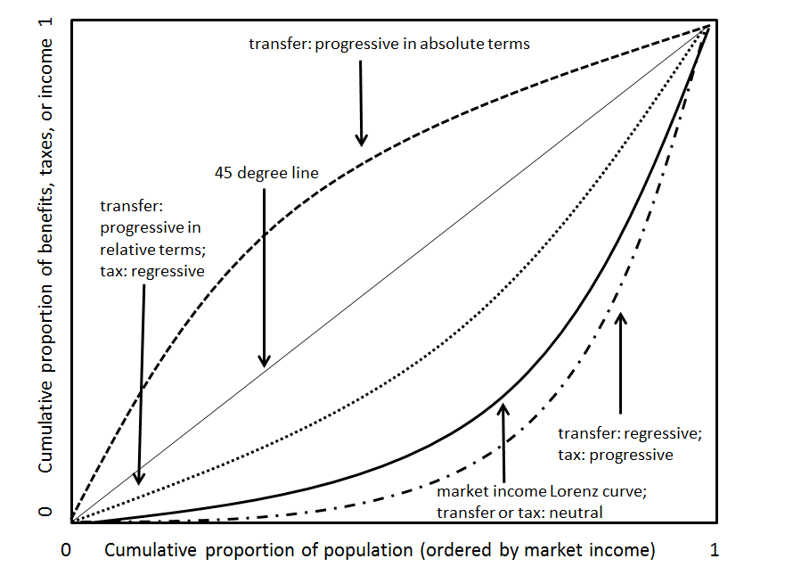
Defining Progressive/Regressive
Taxes and Transfers

Slide 32
Progressivity
Kakwani Index for Taxes: Red= regressive

Slide 33
Progressivity
Concentration Coefficients for Transfers
Green= progressive in abs terms

Slide 34
Fiscal Incidence Indicators: Winners and Losers
Who bears the burden of taxes and receives the benefits from cash transfers?
Fiscal incidence by decile and socio-economic groups
Fiscal Mobility and Degree of Impoverishment

Slide 35
Incidence of Taxes and Cash Transfers
Net Change in Income after Direct and Indirect Taxes and Transfers by Decile

Slide 37
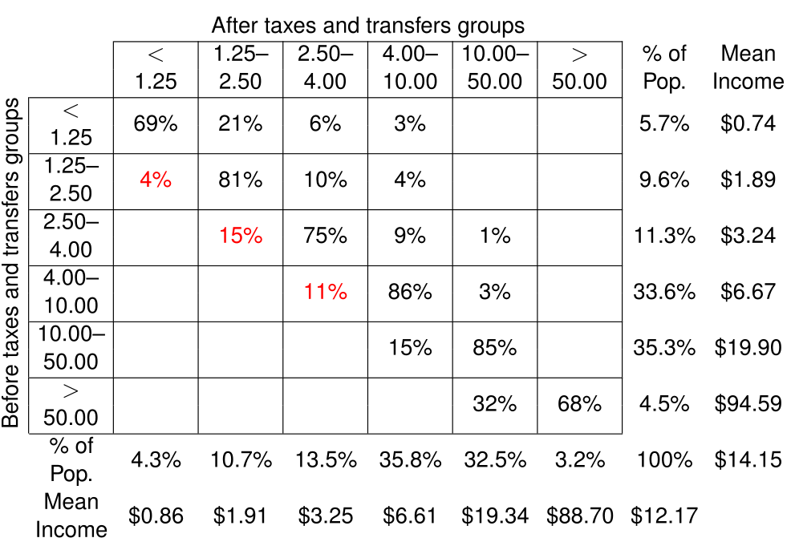
Impoverishment
Fiscal Mobility Matrix for Brazil

Slide 39
THANK YOU

