Slide 1
Comparing Taxation, Transfers, and Redistribution in Brazil and the United States
Sean Higgins
Nora Lustig
Whitney Ruble
Tulane University
Timothy Smeeding
University of Wisconsin at Madison
IARIW-IBGE Conference on Income, Wealth and Well-being in Latin America
Rio de Janeiro, Brazil, September 11-14, 2013

Slide 2
Motivation
Two largest economies and most populous countries in Western Hemisphere
Large racial/ethnic minorities
High income inequality and inequality of opportunity
Low intergenerational mobility
Both countries have persistently been relatively unequal given their level of development
In 1989, Brazil was the second most unequal country in the world behind only Sierra Leone (Ferreira, Leite, and Litchfield, 2008)
In 1985, the United States was the second most unequal OECD country behind only Turkey (OECD, 2011)
US had similar level of inequality to Brazil today when it had similar level of development: Gini of 0.55 in 1940 (Plotnick et al., 1998)

Slide 3
Motivation
(continued)
High inequality of opportunity
Brazil among highest of a large sample of countries and US high among developed countries (Brunori, Ferriera, and Peragine 2013)
Low intergenerational mobility (Corak, 2011)
Possibly “converging” levels of inequality and mobility
Inequality is higher in Brazil than the US
But falling in Brazil (Barros et al., 2010)
and rising in the US (Kenworthy and Smeeding, 2013)
Reasons to believe trends could continue
Intergenerational mobility is lower in Brazil than the US
But rising in Brazil (Ferreira et al. 2013)
and falling in the US (Aaronson and Mazumder, 2008)

Slide 4
Our Analysis
Comprehensive fiscal incidence analysis for the US and Brazil
Direct taxes (individual income tax, payroll taxes, corporate income tax, property taxes)
Direct transfers (cash transfers for poor and elderly, unemployment benefits, food transfers, refundable tax credits)
Indirect taxes (sales and excise taxes)
Indirect subsidies (household energy subsidies)
In-kind transfers (government-provided health, education, and housing)
Multiple data sources
Current Population Survey 2011
American Community Survey 2011
National Household Education Survey 2007
Pesquisa de Orçamentos Familiares 2008-2009
Pesquisa Nacional por Amostra de Domicílios 2008

Slide 5
Preview of Results: Inequality Reduction
Brazil
U.S.

Slide 6
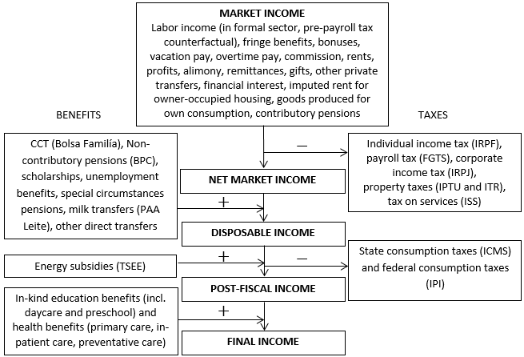
Construction of Income Concepts: Brazil

Slide 7
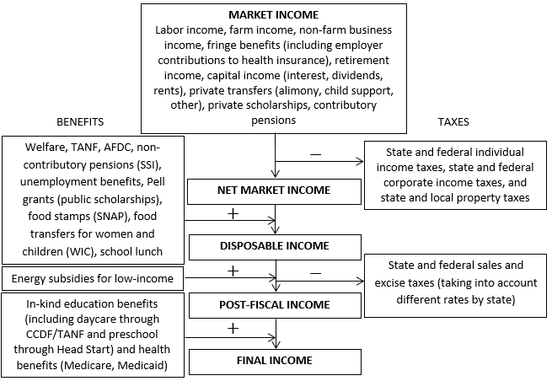
Construction of Income Concepts: United States

Slide 8
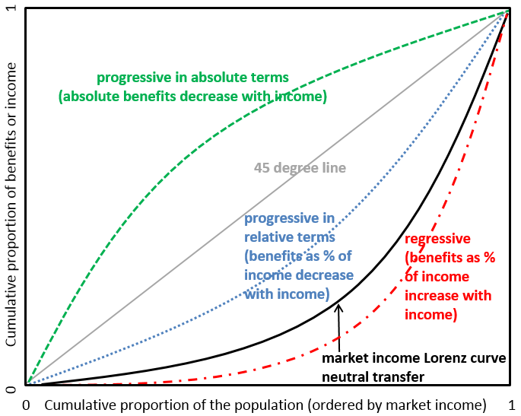
Definitions of Progressivity for Transfers
Source: adapted from Lustig and Higgins (2013)

Slide 9
Direct Taxes and Transfers
Direct taxes and transfers reduce inequality by
7.0 percentage points in US
3.9 percentage points in Brazil
Source: authors’ calculations for Brazil and US;
Immervoll et al. (2009) for Europe

Slide 10
Direct Taxes and Transfers
Underutilized individual income tax in Brazil
2.1% of GDP, compared to 8.2% in US
Less progressive direct taxes in Brazil (regardless of size)
Kakwani of 0.194 in the US compared to 0.122 in Brazil
Brazil’s well-targeted programs are small:
Bolsa Família (conditional cash transfers)
Beneficio de Prestação Continuada (non-contributory pensions)
Programa de Aquisição de Alimentos – Leite (milk transfers)
…make up less than 1% of GDP combined!
Food stamps in US increase incomes of bottom decile (in %) more than any transfer program in Brazil

Slide 11
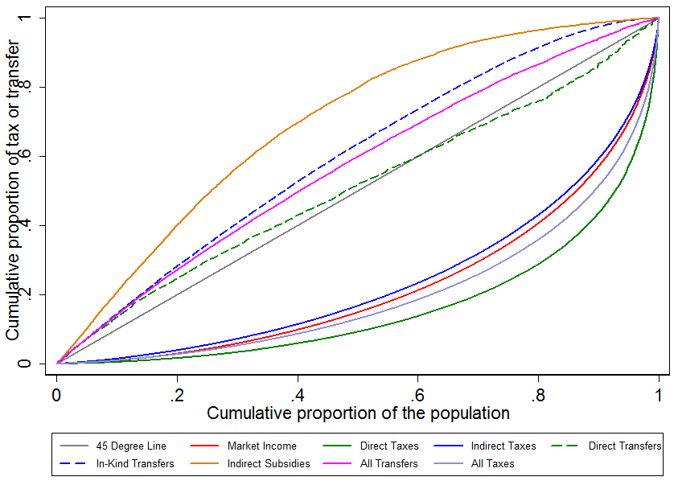
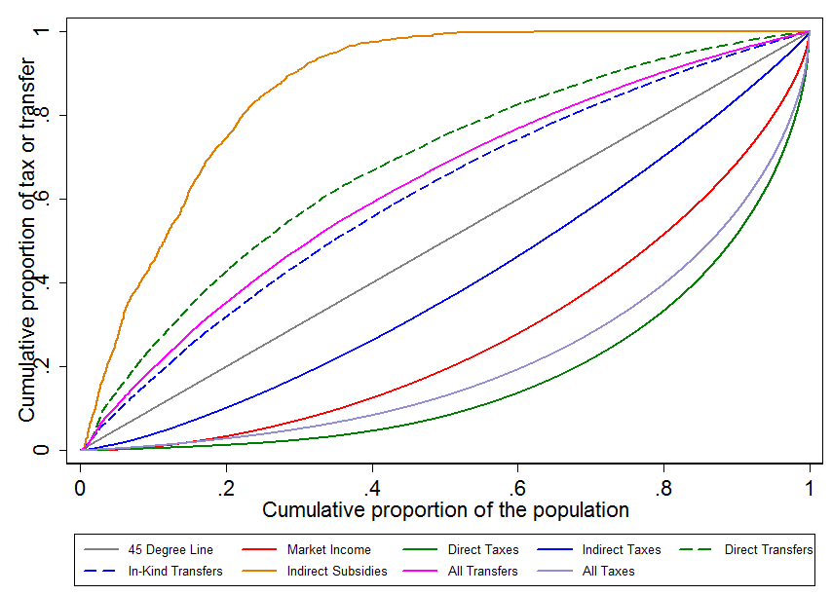
Indirect Taxes
Large but only slightly regressive in Brazil
Smaller but much more regressive in US
Brazil
US

Slide 12
Household Energy Subsidies
Targeted to low-income families
Progressive in absolute terms in both countries
Concentration coefficient of -0.73 in US, -0.33 in Brazil
But very small programs
Increase incomes of poorest decile by only around 1% in both countries

Slide 13
In-kind Transfers
An important part of redistribution in both countries
US: Gini reduced from 0.45 (market income) to 0.33 (final income)
5.2 percentage points due to spending on non-tertiary education, health, and housing
Health: Medicaid is highly progressive in absolute terms (CC = -0.51)
Brazil: Gini reduced from 0.55 (market income) to 0.43 (final income)
7.7 percentage points due to spending on non-tertiary education and health
All three types of public health spending analyzed
Preventative care
Basic care
Inpatient care
…are progressive in absolute terms

Slide 14
Education
Spending on public preschool is particularly progressive
Head Start has a concentration coefficient of -0.68 in US
Public preschool has concentration coefficient of -0.30 in Brazil
Tertiary education
Not possible to determine beneficiaries in US, so excluded for both countries
When included for Brazil, tertiary education spending almost neutral; overall education spending still progressive in absolute terms
Sources:
Argentina: Lustig and Pessino (2013)
Bolivia: Paz Arauco et al. (2013)
Brazil: Higgins and Pereira (2013)
Mexico: Scott (2013)
Peru: Jaramillo (2013)
Uruguay: Bucheli et al. (2013)

