Slide 1
Inequality, Poverty and Leftist Governments in LA
Nora Lustig
Social Policy in LA since the Left Turn
Tulane University
April 1, 2014

Slide 2
Inequality in Last Decade 2000-2011 (Yearly changes in Gini; SEDLAC, Feb 2014 for LA)

Slide 3
LA Poverty Changes: Redistribution vs Growth (Lustig et al, 2014)

Slide 4
Determinants of Change in Inequality
Wage Gap (red); Transfers (Green); Demographic (Blue) (Azevedo et al. 2012)

Slide 5
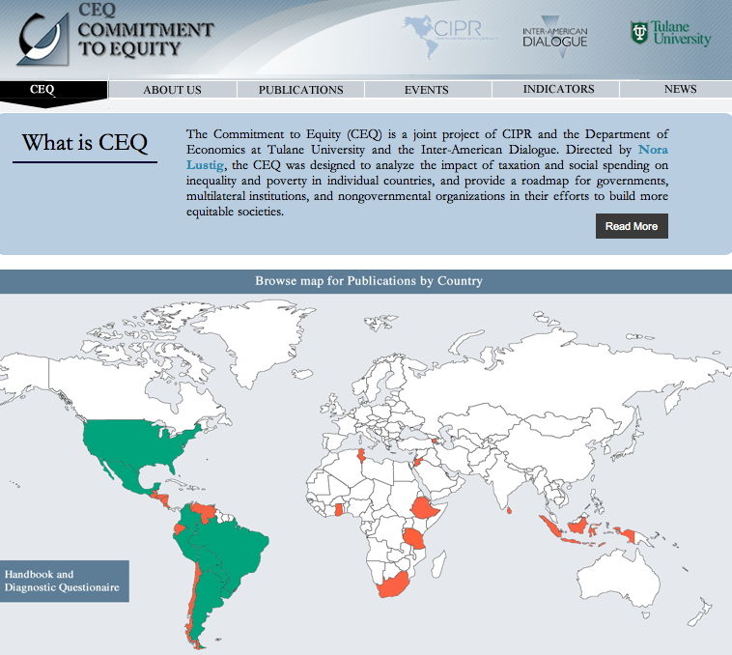
www.commitmentoequity.org

Slide 6
Fiscal Policy and Political Regime
Gini: Left (Green) Nonleft (Black) –CEQ Project

Slide 7
Headcount: Before and After Cash Transfers

Slide 8
However, net Payers to the Fisc: Left Not More Pro-poor

Slide 9
And, consumption taxes offset the poverty-reducing effect of cash transfers in Brazil (and Bolivia)

Slide 10
And, Poor Pardos in Brazil Receive Less in Cash Transfers than Equally Poor Whites
Incidence of Cash Tranfers by Race

Slide 11
Budget Size and Composition
Primary and Social Spending as % of GDP
(Lustig, Pessino and Scott, 2014)
Notes:
Size matters but is not destiny. Uruguay showed was number 2 in terms of redistribution and number 1 in terms of poverty reduction but its budget size is close to Mexico´s.
In Peru, fiscal space, however, may be a restriction.

Slide 14
Argentina: Evolution of Pensions
(Lustig and Pessino, 2014; this and next two slides)

