Slide 1


Taxation, Transfers, and Redistribution
Brazil and the United States
Nora Lustig
Tulane University
Nonresident Fellow CGD and IAD
Presented at “Sustainable Growth in the XXIst Century,”
Institute for New Economic Thinking, New School, NY, April 24-25, 2014

Slide 2
Comparing Taxation, Transfers, and Redistribution in Brazil and the United States
CEQ Working Paper 16 www.commitmentoequity.org
Sean Higgins
Nora Lustig
Whitney Ruble
Tulane University
Timothy Smeeding
University of Wisconsin at Madison

Slide 3
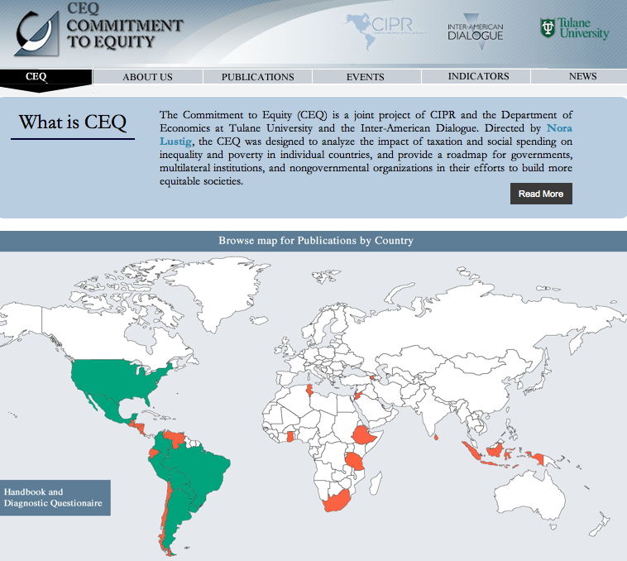

Slide 4
Motivation
Two largest economies and most populous countries in Western Hemisphere
  Large racial/ethnic minorities
  High income inequality and inequality of opportunity
  Low intergenerational mobility
Both countries have persistently been relatively unequal given their level of development
  In 1989, Brazil was the second most unequal country in the world behind only Sierra Leone (Ferreira, Leite, and Litchfield, 2008)
  In 1985, the United States was the second most unequal OECD country behind only Turkey (OECD, 2011)
  US had similar level of inequality to Brazil today when it had similar level of development: Gini of 0.55 in 1940 (Plotnick et al., 1998)

Slide 5
Motivation
(continued)
High inequality of opportunity
  Brazil among highest of a large sample of countries and US high among developed countries (Brunori, Ferreira, and Peragine 2013)
Low intergenerational mobility (Corak, 2011)
Possibly “converging” levels of inequality and mobility
  Inequality is higher in Brazil than the US
    But falling in Brazil (Barros et al., 2010)
    and rising in the US (Kenworthy and Smeeding, 2013)
    Reasons to believe trends could continue
  Intergenerational mobility is lower in Brazil than the US
    But rising in Brazil (Ferreira et al. 2013)
    and falling in the US (Aaronson and Mazumder, 2008)

Slide 6
Inequality in the US and Brazil,1990-2011

Slide 7
Government Size
In both countries, consolidated government is fairly large
Primary spending (total government spending at the federal, state, and local levels minus interest payments)
  Brazil: 41.4 % of GDP in 2009
  US: 38.6 % of GDP in 2011

Slide 8
Our Analysis
Comprehensive fiscal incidence analysis for the US and Brazil
  Direct taxes (individual income tax, payroll taxes, corporate income tax, property taxes)
  Direct transfers (cash transfers for poor and elderly, unemployment benefits, food transfers, refundable tax credits)
  Indirect taxes (sales and excise taxes)
  Indirect subsidies (household energy subsidies)
  In-kind transfers (government-provided health, education, and housing)
Multiple data sources
Current Population Survey 2011
American Community Survey 2011
National Household Education Survey 2007
Pesquisa de Orçamentos Familiares 2008-2009
Pesquisa Nacional por Amostra de Domicílios 2008

Slide 9
Composition of Revenues
The composition of tax revenues differs substantially in the two countries, with the US relying heavily on direct taxes and Brazil relying heavily on consumption taxes.
  US: direct taxes included in our analysis (individual income, corporate income, and property taxes) account for 11.7 % of GDP and the indirect taxes included (sales and excise taxes on consumption) represent 3.6 % of GDP.
  Brazil: direct taxes 8.2 % of GDP and consumption taxes 12.9 % of GDP

Slide 10
Composition of Spending
Brazil spends more as a % of GDP on direct transfers: 4.2 % compared to 3.3 % in the US when pensions are not considered a transfer
  Difference is even larger if pensions are considered a transfer: 13.2 % of GDP in Brazil and 8.1 % in the US
Similar spending on non-tertiary education: 4.1 % of GDP in Brazil vs. 4.2 % in the US
Despite Brazil providing free universal healthcare and the US merely subsidizing healthcare for the poor and elderly, the Brazilian government spends 5.2 % of GDP vs. 6.3 % in the US

Slide 14
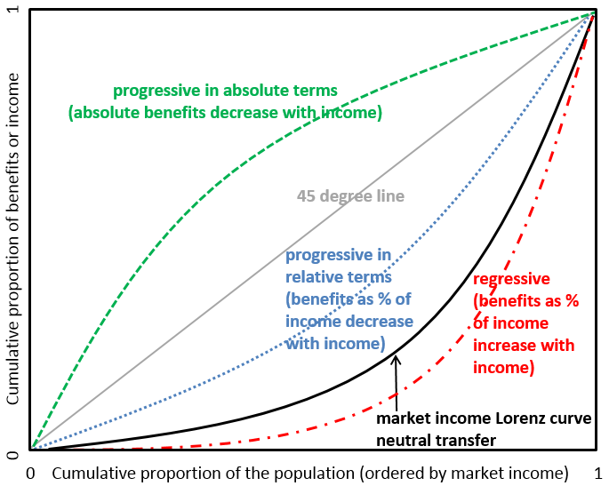
Definitions of Progressivity for Transfers
Source: adapted from Lustig and Higgins (2013)

Slide 15
Direct Taxes and Transfers
Direct taxes and transfers reduce inequality by
  7.2 percentage points in US (11.2 with contributory pensions as transfers)
  3.8 percentage points in Brazil (5.8 with contributory pensions as transfers)
Source: authors’ calculations for Brazil and US;
Immervoll et al. (2009) for Europe

Slide 16
Direct Taxes and Transfers
Underutilized individual income tax in Brazil
  2.1% of GDP, compared to 8.2% in US
Less progressive direct taxes in Brazil (regardless of size)
  Kakwani of 0.194 in the US compared to 0.122 in Brazil
Brazil’s well-targeted programs are small:
  Bolsa Família (conditional cash transfers)
  Beneficio de Prestação Continuada (non-contributory pensions)
  Programa de Aquisição de Alimentos – Leite (milk transfers)
  …make up less than 1% of GDP combined!
Food stamps in US increase incomes of bottom decile (in %) more than any transfer program in Brazil

Slide 17
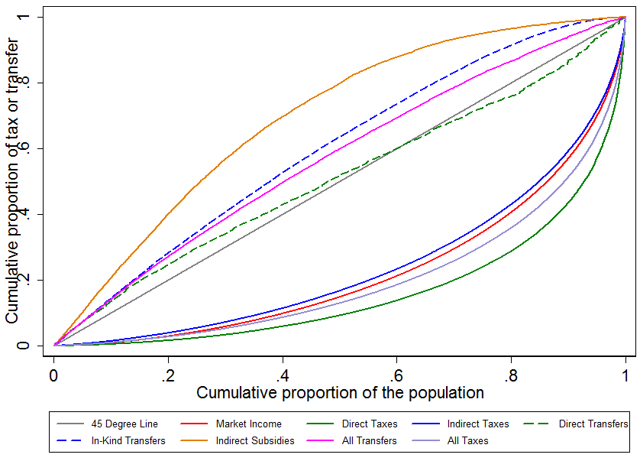
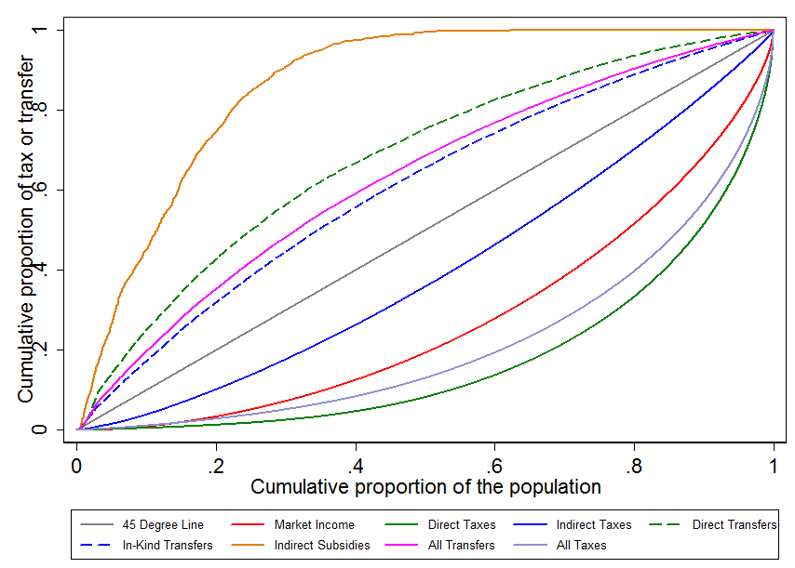
Indirect Taxes
Large but only slightly regressive in Brazil
Smaller but much more regressive in US
Brazil
US

Slide 18
Household Energy Subsidies
Targeted to low-income families
Progressive in absolute terms in both countries
  Concentration coefficient of -0.73 in US, -0.33 in Brazil
But very small programs
  Increase incomes of poorest decile by only around 1% in both countries

Slide 19
In-kind Transfers
An important part of redistribution in both countries
US: Gini reduced from 0.45 (market income) to 0.33 (final income)
  5.2 percentage points due to spending on non-tertiary education, health, and housing
  Health: Medicaid is highly progressive in absolute terms (CC = -0.51)
Brazil: Gini reduced from 0.55 (market income) to 0.43 (final income)
  7.7 percentage points due to spending on non-tertiary education and health
  All three types of public health spending analyzed
    Preventative care
    Basic care
    Inpatient care
  …are progressive in absolute terms

Slide 20
Education
Spending on public preschool is particularly progressive
  Head Start has a concentration coefficient of -0.68 in US
  Public preschool has concentration coefficient of -0.30 in Brazil
Tertiary education
  Not possible to determine beneficiaries in US, so excluded for both countries
  When included for Brazil, tertiary education spending almost neutral; overall education spending still progressive in absolute terms
Sources:
Argentina: Lustig and Pessino (2013)
Bolivia: Paz Arauco et al. (2013)
Brazil: Higgins and Pereira (2013)
Mexico: Scott (2013)
Peru: Jaramillo (2013)
Uruguay: Bucheli et al. (2013)

