Slide 1


Inequality and Fiscal Redistribution in MIDDLE INCOME COUNTRIES
Brazil, Chile, Colombia, Indonesia, Mexico, Peru and South Africa
Nora Lustig
Desafios do Desenvolvimento Brasileiro
Seminário em homenagem a Albert Fishlow
IEPE/CdG
Rio de Janeiro, Brasil
3 de julho de 2015

Slide 2

What is CEQ: Description of Project
The CEQ project is an initiative of:
  The Center for Inter-American Policy and Research (CIPR) and the Department of Economics, Tulane University, the Inter-American Dialogue and the Center for Global Development
CEQ’s goals are to:
  Foster evidence-based policy discussion
  Assist governments, multilateral institutions, and nongovernmental organizations in their efforts to build more equitable societies

Slide 3
What is CEQ: the CEQ Assessment
The CEQ project developed the CEQ Assessment, a diagnostic instrument
Comprehensive framework to analyze the effect of taxation and public spending on inequality and poverty
Method: Fiscal Incidence analysis and qualitative diagnostic approach
Application of a common methodology across countries makes cross-country comparisons more accurate
Methodology is designed to be as comprehensive as possible without sacrificing detail in any particular component of the analysis

Slide 4
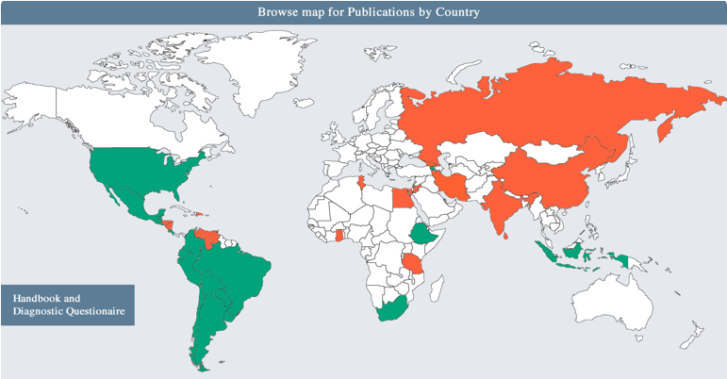
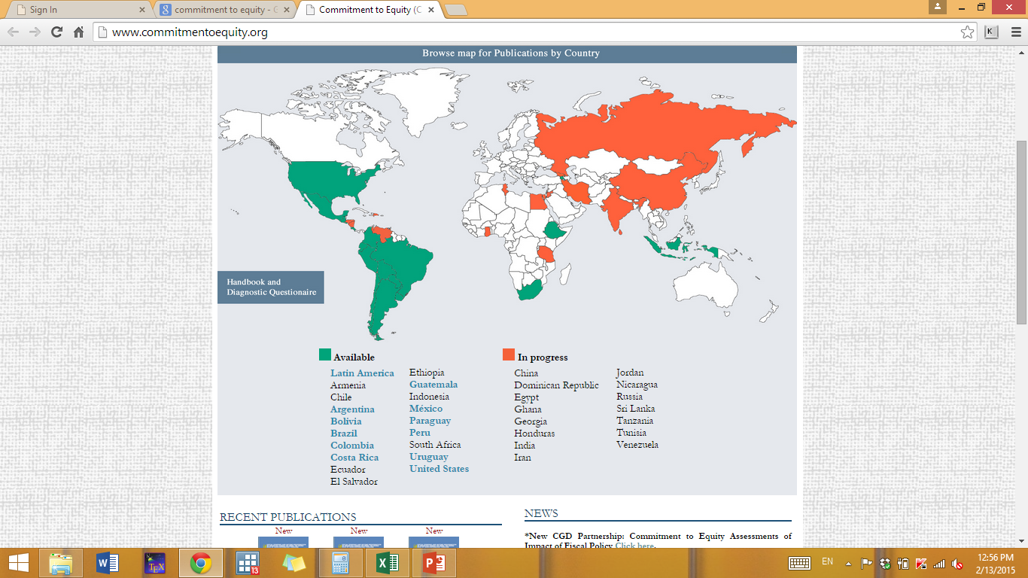
www.commitmentoequity.org

Slide 5
Paper based on following CEQ studies:
Brazil: Higgins, Sean and Claudiney Pereira. 2014. “The Effects of Brazil’s Taxation and Social Spending on the Distribution of Household Income.” In Lustig, Nora, Carola Pessino and John Scott. 2014. Editors. The Redistributive Impact of Taxes and Social Spending in Latin America. Special Issue. Public Finance Review, May, Volume 42, Issue 3 and CEQ Master Workbook: Brazil, November 4.
Chile: Ruiz-Tagle, Jaime and Dante Contreras. 2014. CEQ Master Workbook: Chile, August.
Colombia: Melendez, Marcela. 2014. CEQ Master Workbook: Colombia, November 21, Tulane University.
Indonesia:Afkar, R., J. Jellema, and M. Wai-Poi, "Fiscal Policy, Redistribution, and Inequality in Indonesia," in G. Inchauste and N. Lustig (eds), The Distributional Impact of Fiscal Policy: Experience from Developing Countries, forthcoming.
Mexico: Scott, John. 2014. “Redistributive Impact and Efficiency of Mexico’s Fiscal System.” In Lustig, Nora, Carola Pessino and John Scott. 2014. Editors. The Redistributive Impact of Taxes and Social Spending in Latin America. Special Issue. Public Finance Review, May, Volume 42, Issue 3.
Peru: Jaramillo, Miguel. 2014. “The Incidence of Social Spending and Taxes in Peru.” In Lustig, Nora, Carola Pessino and John Scott. 2014. Editors. The Redistributive Impact of Taxes and Social Spending in Latin America. Special Issue. Public Finance Review, May, Volume 42, Issue 3 and CEQ Master Workbook: Peru, June 21, 2013.
South Africa: Inchauste, Gabriela, Nora Lustig, Mashekwa Maboshe, Catriona Purfield and Ingrid Wollard. 2015. The Distributional Impact of Fiscal Policy in South Africa. Policy Research Working Paper 7194, The World Bank, February.

Slide 21
Obrigada

